Slide 1
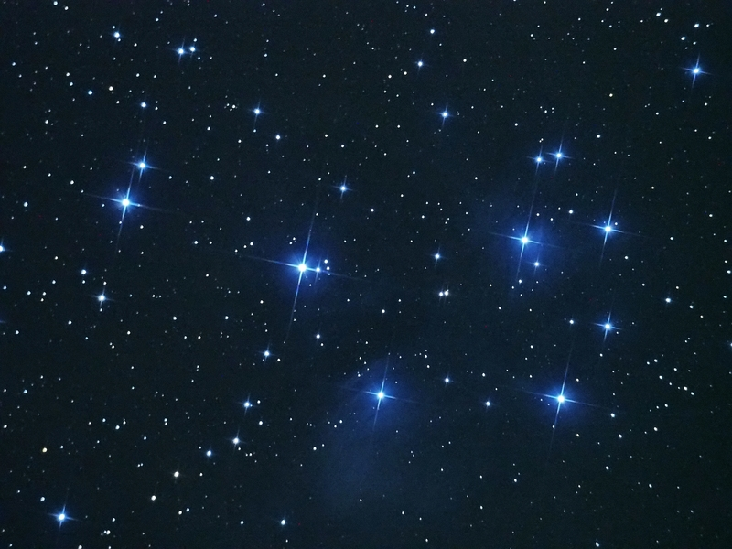
This is the Matariki cluster of stars.
Why is this cluster significant to people of Aotearoa at this time of the year?.

Slide 2
You are the tohunga of your class so you need to recognise these seven stars in the sky. Notice how the cluster is facing a different direction from the last picture. How will you recognise the Matariki cluster when you see it?

Slide 3
Is this Matariki?

Slide 4
Is this Matariki?

Slide 5
Is this Matariki?

Slide 6
Is this Matariki?

Slide 7
Her is one way that a tohunga might organise Matariki.
What ways did you use?

Slide 8
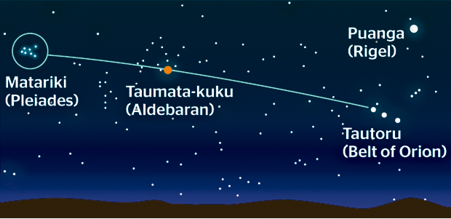
North-East
East
Matariki rises just before dawn . You can find the star cluster in this way.
Look for Puanga (Rigel) or Tautora (Orion’s belt) in the Eastern sky. Look to the left (heading North-East) to find a bright orange star called Taumata-kuku (Aldebaran) and continue left to find Matariki. In the first half of June you might see Mercury looking like a star in this area of the sky as well.

Slide 9
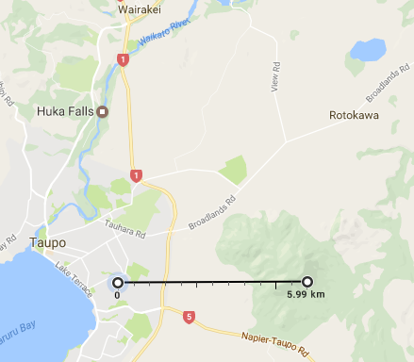
North
East
An example of finding East and North from your home using Google Maps

