Slide 1
A koru (fern frond) forms the basic shape in most kōwhaiwhai designs. Use the Fibonacci spiral to draw you own koru.

Slide 2
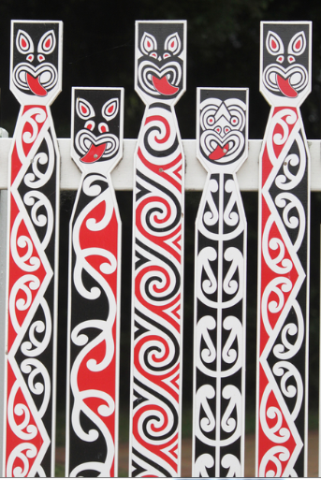
Kōwhaiwhai patterns have spiritual significance for tangata whenua.
Kōwhaiwhai patterns as well as being decorative are also used to communicate cultural ideas and stories. Nature is often the inspiration for the various designs, and are most commonly seen on the heke (rafters) and the tāhū (ridge beam) in wharenui (meeting houses).
Traditionally the colours were often restricted to white, red and black.

Slide 3
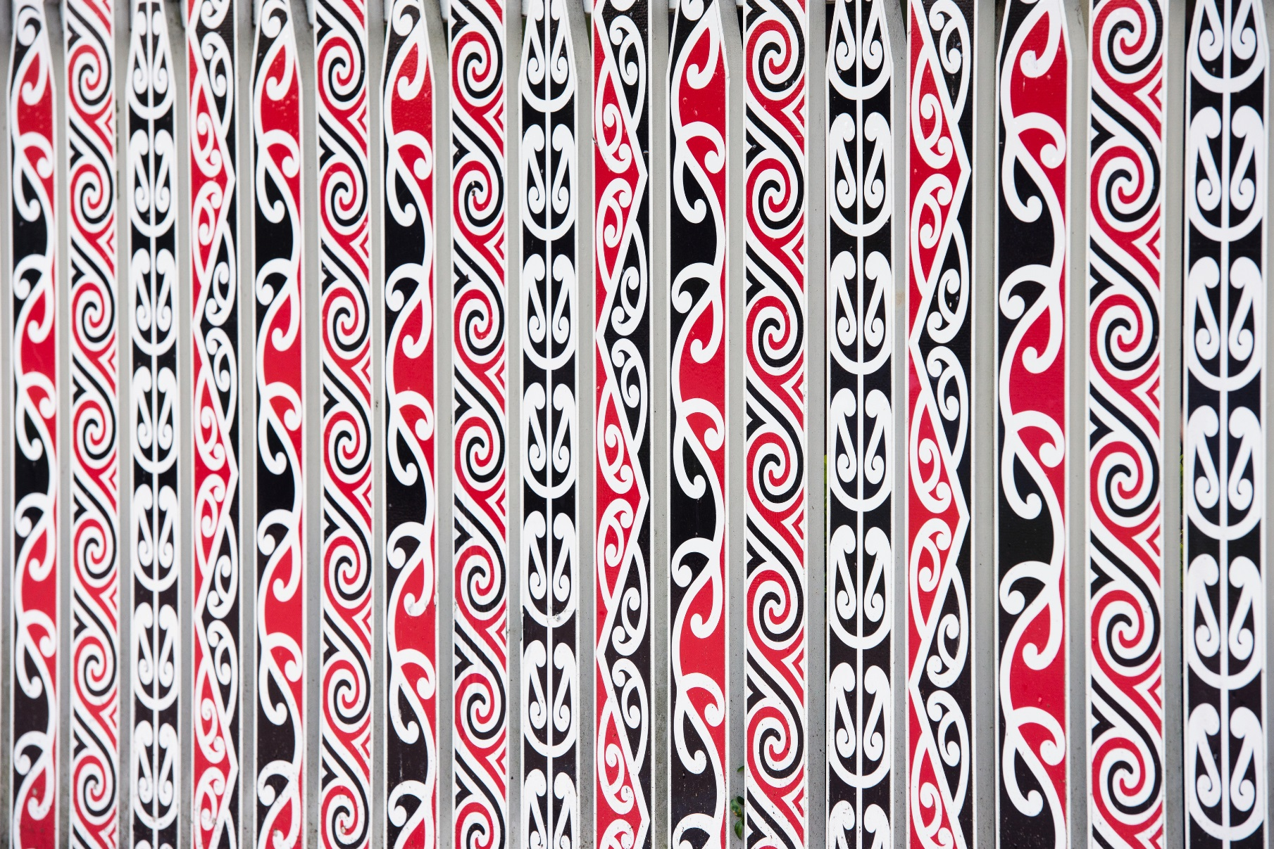
Look at these examples of kōwhaiwhai patterns.
What types of transformation can you see used?

