Slide 1
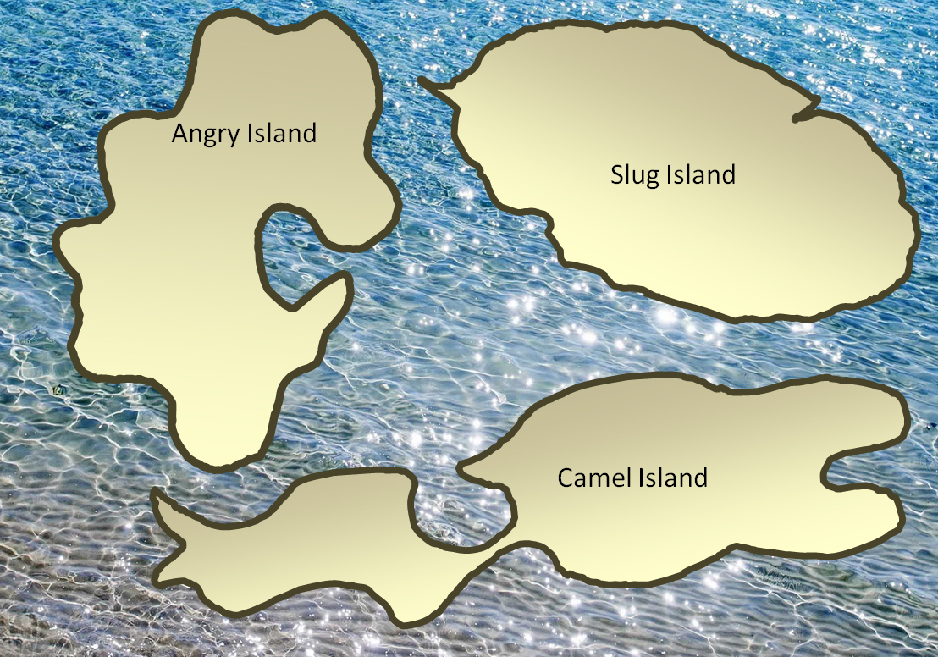
Which island is largest? Use the units you have available to help you.

