Slide 1
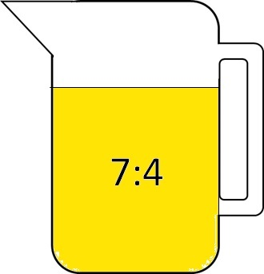
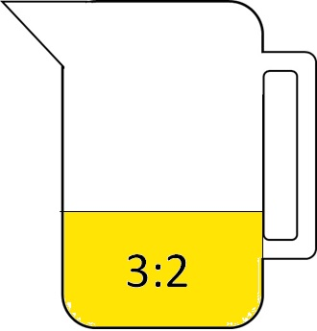
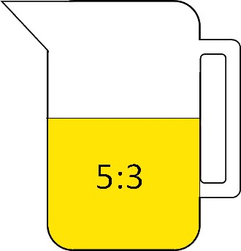
Which ratio of concentrate to water gives the strongest taste?

Slide 2






$$\frac{4}{11}$$
$$\frac{3}{8}$$
$$\frac{2}{5}$$
$$\frac{7}{11}$$
$$\frac{5}{8}$$
$$\frac{3}{5}$$
3:2
7:4
5:3

Slide 3
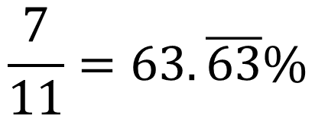
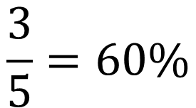
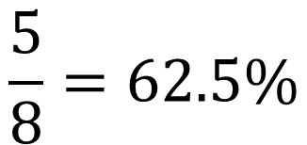
3:2
7:4
5:3
$$\frac{3}{5}=60\%$$
$$\frac{7}{11}=63.\overline{63}\%$$
$$\frac{5}{8}=62.5\%$$

Slide 4
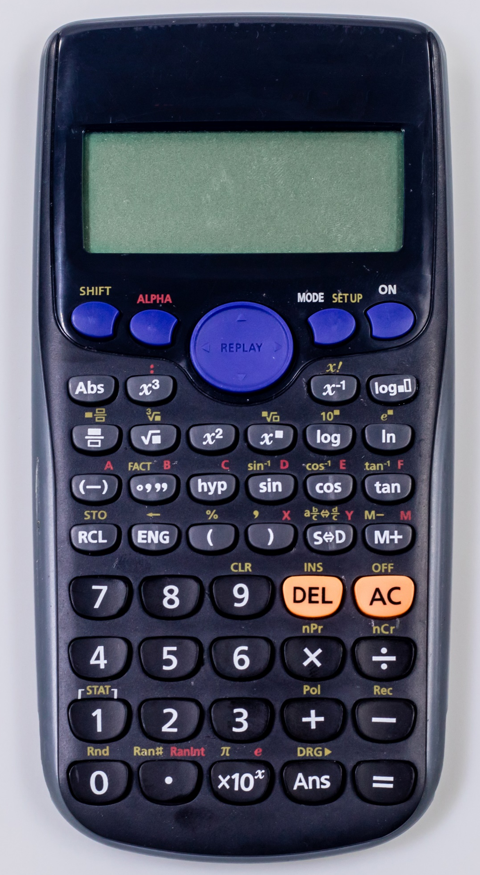
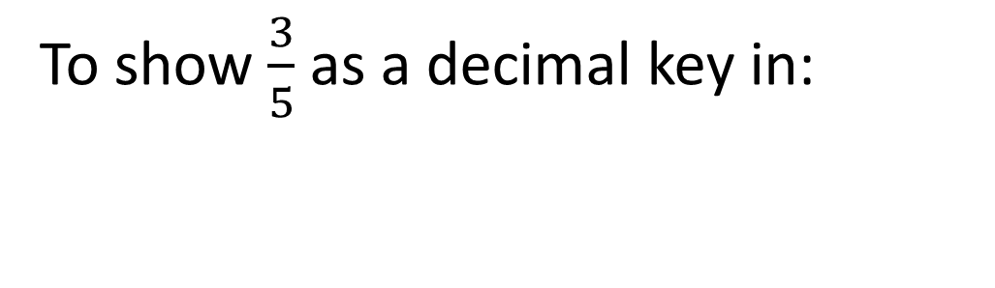
To show $\frac{3}{5}$ as a decimal key in:
3
Shift
5
=
S D

Slide 5
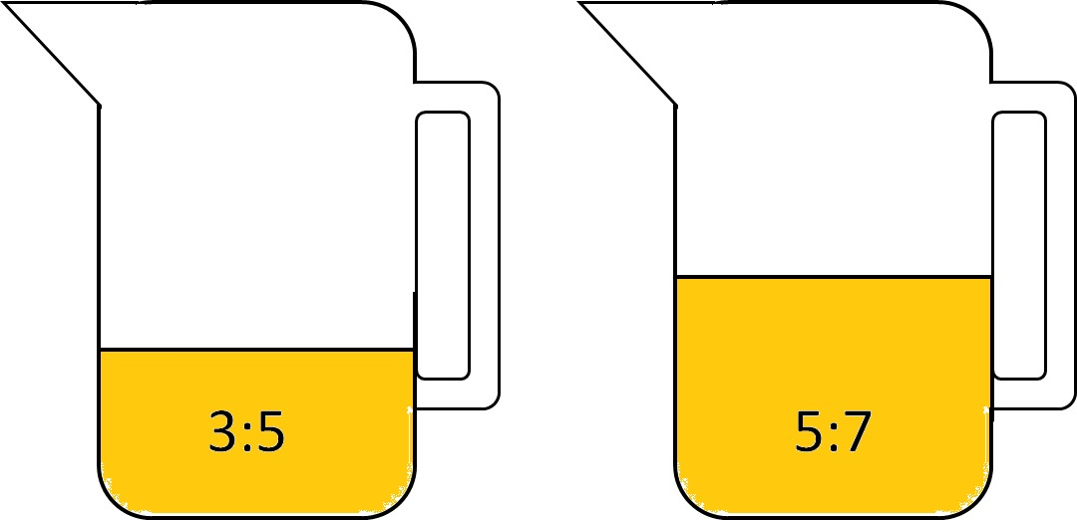
These two jugs of juice are combined.
What will the ratio be of the combined juice?
What percentage of the mix will be concentrate?

