Slide 1
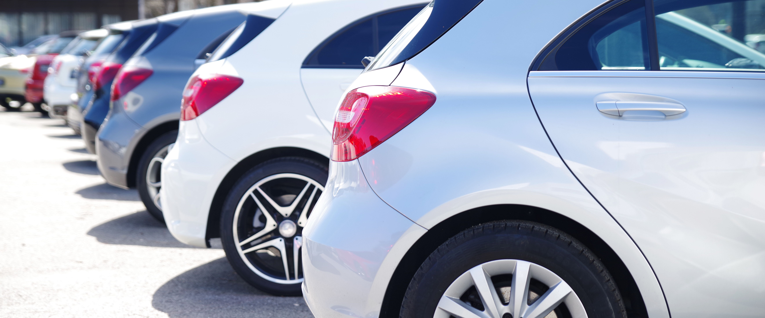
A car manufacturer makes the same model in various engine sizes, i.e., the body of the car is the same, but the engines sizes are different. The graph below shows the average fuel consumption in litres per 100 kilometres for the cars with different engine sizes (measured in cubic centimetres or litres). What conclusions can you draw about the relationship between engine size and fuel efficiency?

Slide 2
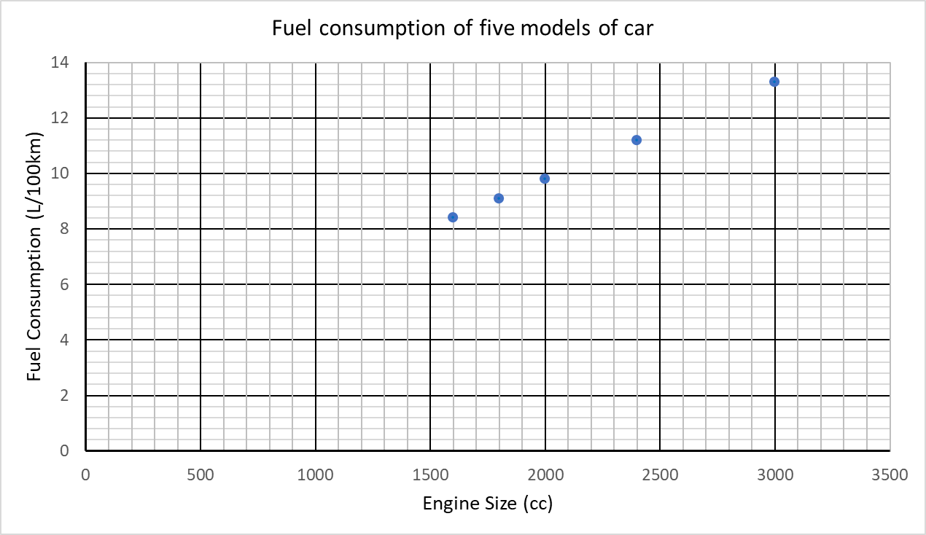
E
D
C
B
A

Slide 3
Engine size (cc) | Fuel consumption (L/100km)
1600 | 8.4
1800 | 9.1
2000 | 9.8
2400 | 11.2
3000 | 13.3
What distance would each model be expected to travel on 10 litres of fuel?

Slide 4
Step 1: Create a ratio table to represent the important information in the problem.
Number of Litres
Number of Kilometres
From the graph data.
8.4
100
From the problem
Goal.
10
?

Slide 5
Step 2: Maybe find the unit rate, how far the car travels on 1 litre of petrol.
Number of Litres
Number of Kilometres
8.4
100
What operation?
÷ 8.4
÷ 8.4
1
?
11.905
10
?

Slide 6
Step 3: Multiply the unit rates to get the correct distance.
Number of Litres
Number of Kilometres
8.4
100
1
11.905
What operation?
x 10
x 10
10
119.05
?

Slide 7
Step 1: Create a ratio table to represent the important information in the problem. Then find a relationship between the measures.
Number of Litres
Number of Kilometres
Find the multiplier.
How?
8.4
100
x 11.905
Use the multiplier.
10
119.05
?
x 11.905

Slide 8
