Slide 1
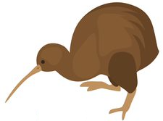
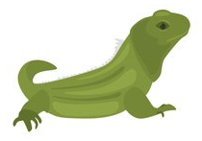
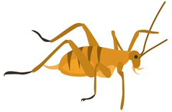
1 | 2 | 3 | 4 | 5 | 6 | 7

Slide 2
What animal is in place 8? How do you know?
1 | 2 | 3 | 4 | 5 | 6 | 7

Slide 3
6 | 7 | 8 | 9 | 10 | 11 | 12

Slide 4
What animal is in place 19? How do you know?
6 | 7 | 8 | 9 | 10 | 11 | 12

Slide 5
16 | 17 | 18 | 19 | 20 | 21 | 22

Slide 6
What animal is in place 28? How do you know?
16 | 17 | 18 | 19 | 20 | 21 | 22

Slide 7
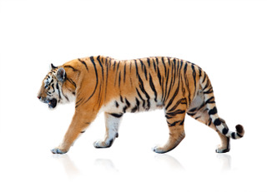
26 | 27 | 28 | 29 | 30 | 31 | 32

