Slide 1
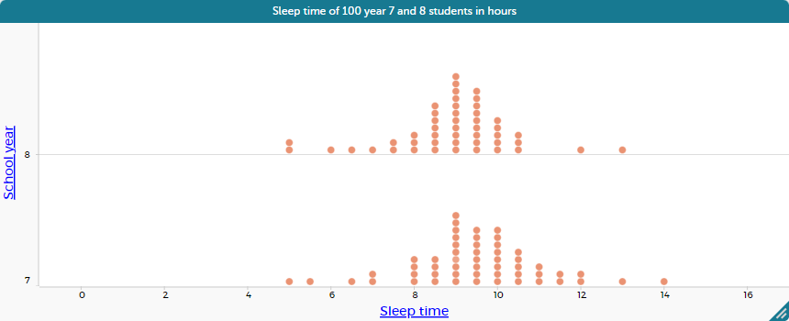

Slide 2
Medians

Slide 3
Means

Slide 4
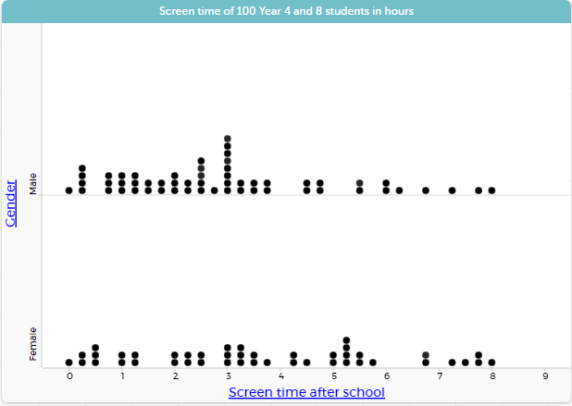

Slide 5
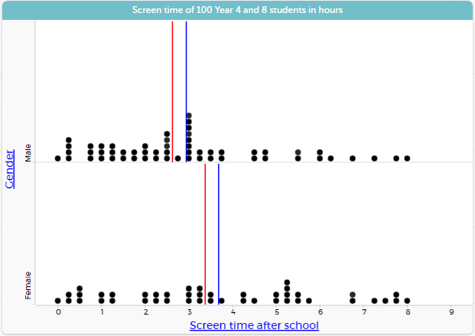
Median
Mean

Slide 6
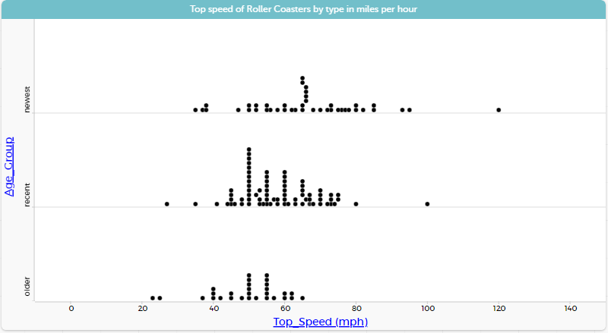
Source: https://codap.concord.org/app/static/dg/en/cert/index.html#file=examples:Roller%20Coasters

Slide 7
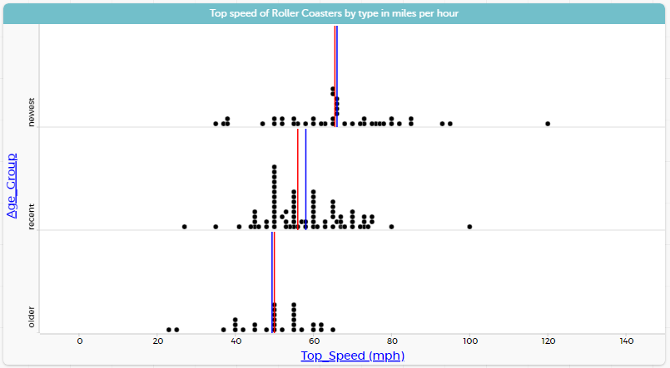
Median
Mean

