Slide 1
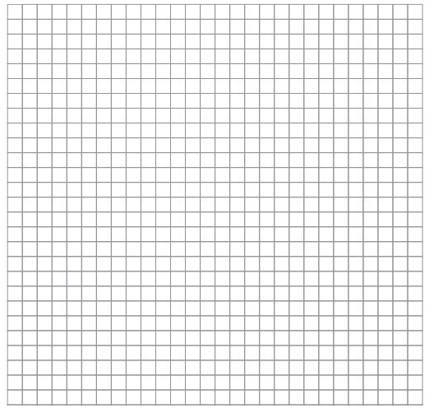

Slide 2
10
(⁻4, 8)
5
(9, 3)
⁻10
⁻5
5
10
⁻5
(4, ⁻8)
⁻10

Slide 4
10
(⁻1, 7)
5
(⁻6, 2)
(5, 0)
⁻10
⁻5
5
10
⁻5
(2, ⁻7)
⁻10

