Slide 1
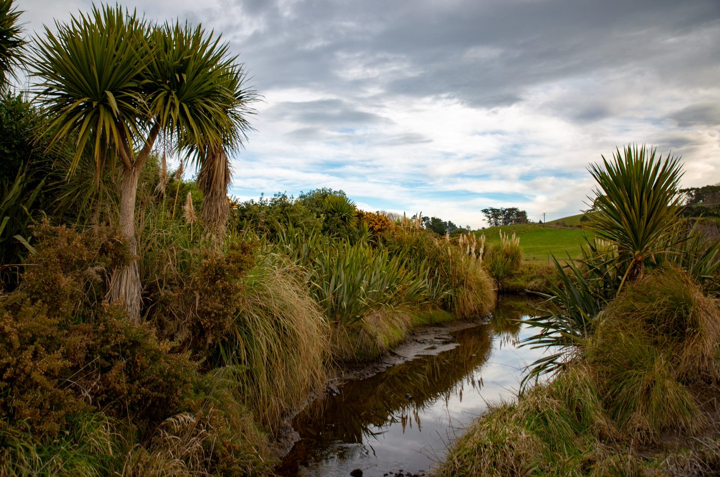
John farms kōura in forestry ponds.
He hopes to grow kōura for export and, at the same time, save the species from extinction.
To start a farm John ‘seeds’ the pond with kōura .
What do you think ‘seeds’ means?

Slide 2
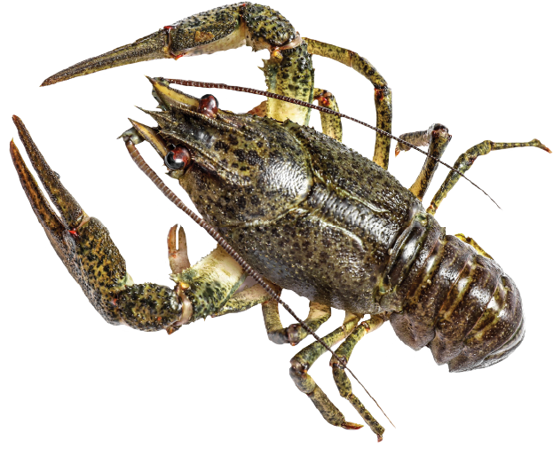
John has twenty young kōura to seed some ponds.
He wants to put five kōura in each pond.
How many new ponds will he need to use?

Slide 3
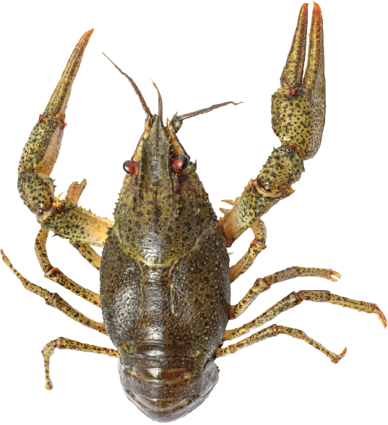
Let’s check your prediction.
John can use multiplication to work out “How many fives are made from 20?”
How?

Slide 4
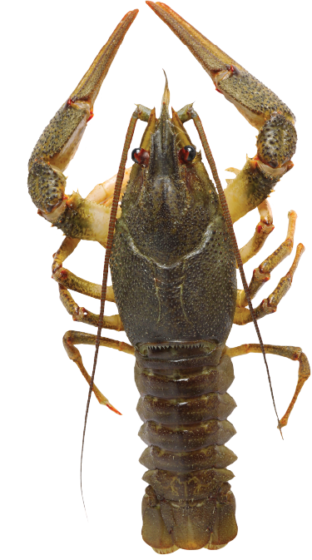
The next ponds are bigger so John can put ten young kōura in each.
John has 70 young kōura to seed these ponds.
How many bigger ponds will he need to use?

Slide 5
Let’s check your prediction.
John can use multiplication to work out “How many tens are made from 70?”
How?

Slide 6
The next ponds are small so John can put two young kōura in each.
John has 18 young kōura to seed these ponds.
How many smaller ponds will he need to use?

Slide 7
Let’s check your prediction.
John can use multiplication to work out “How many twos are made from 18?”
How?

