Slide 1
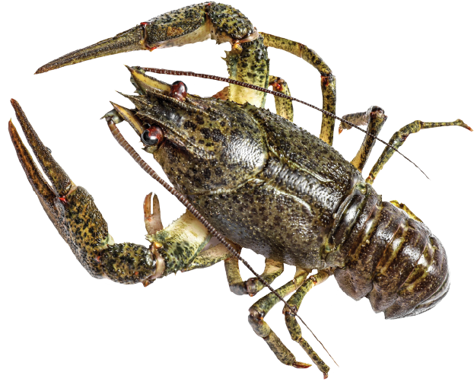

Slide 2
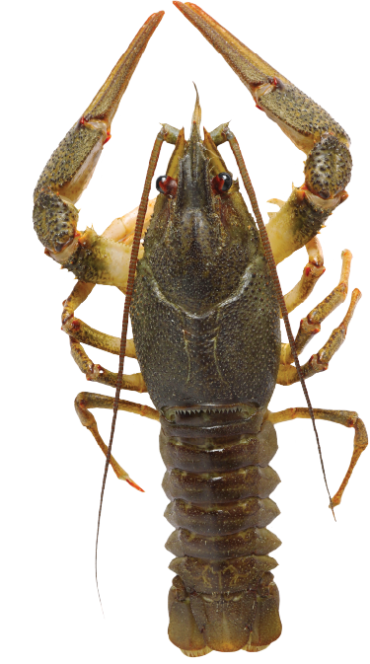

Slide 3
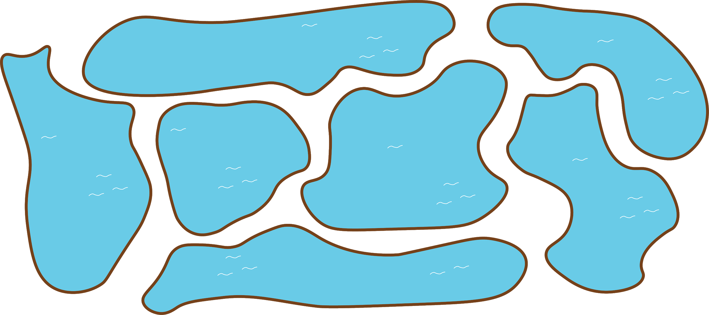
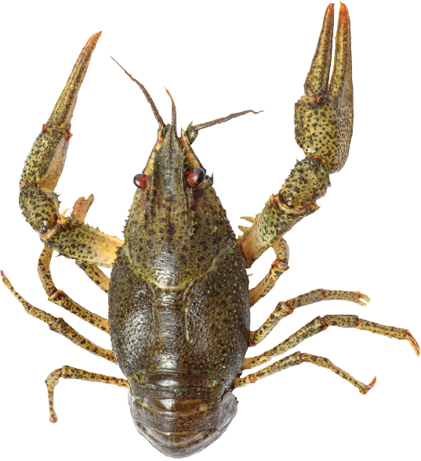
It’s night and the kōura are out again.
There are seven ponds. Each pond has three kōura.
How many kōura are there?

Slide 6
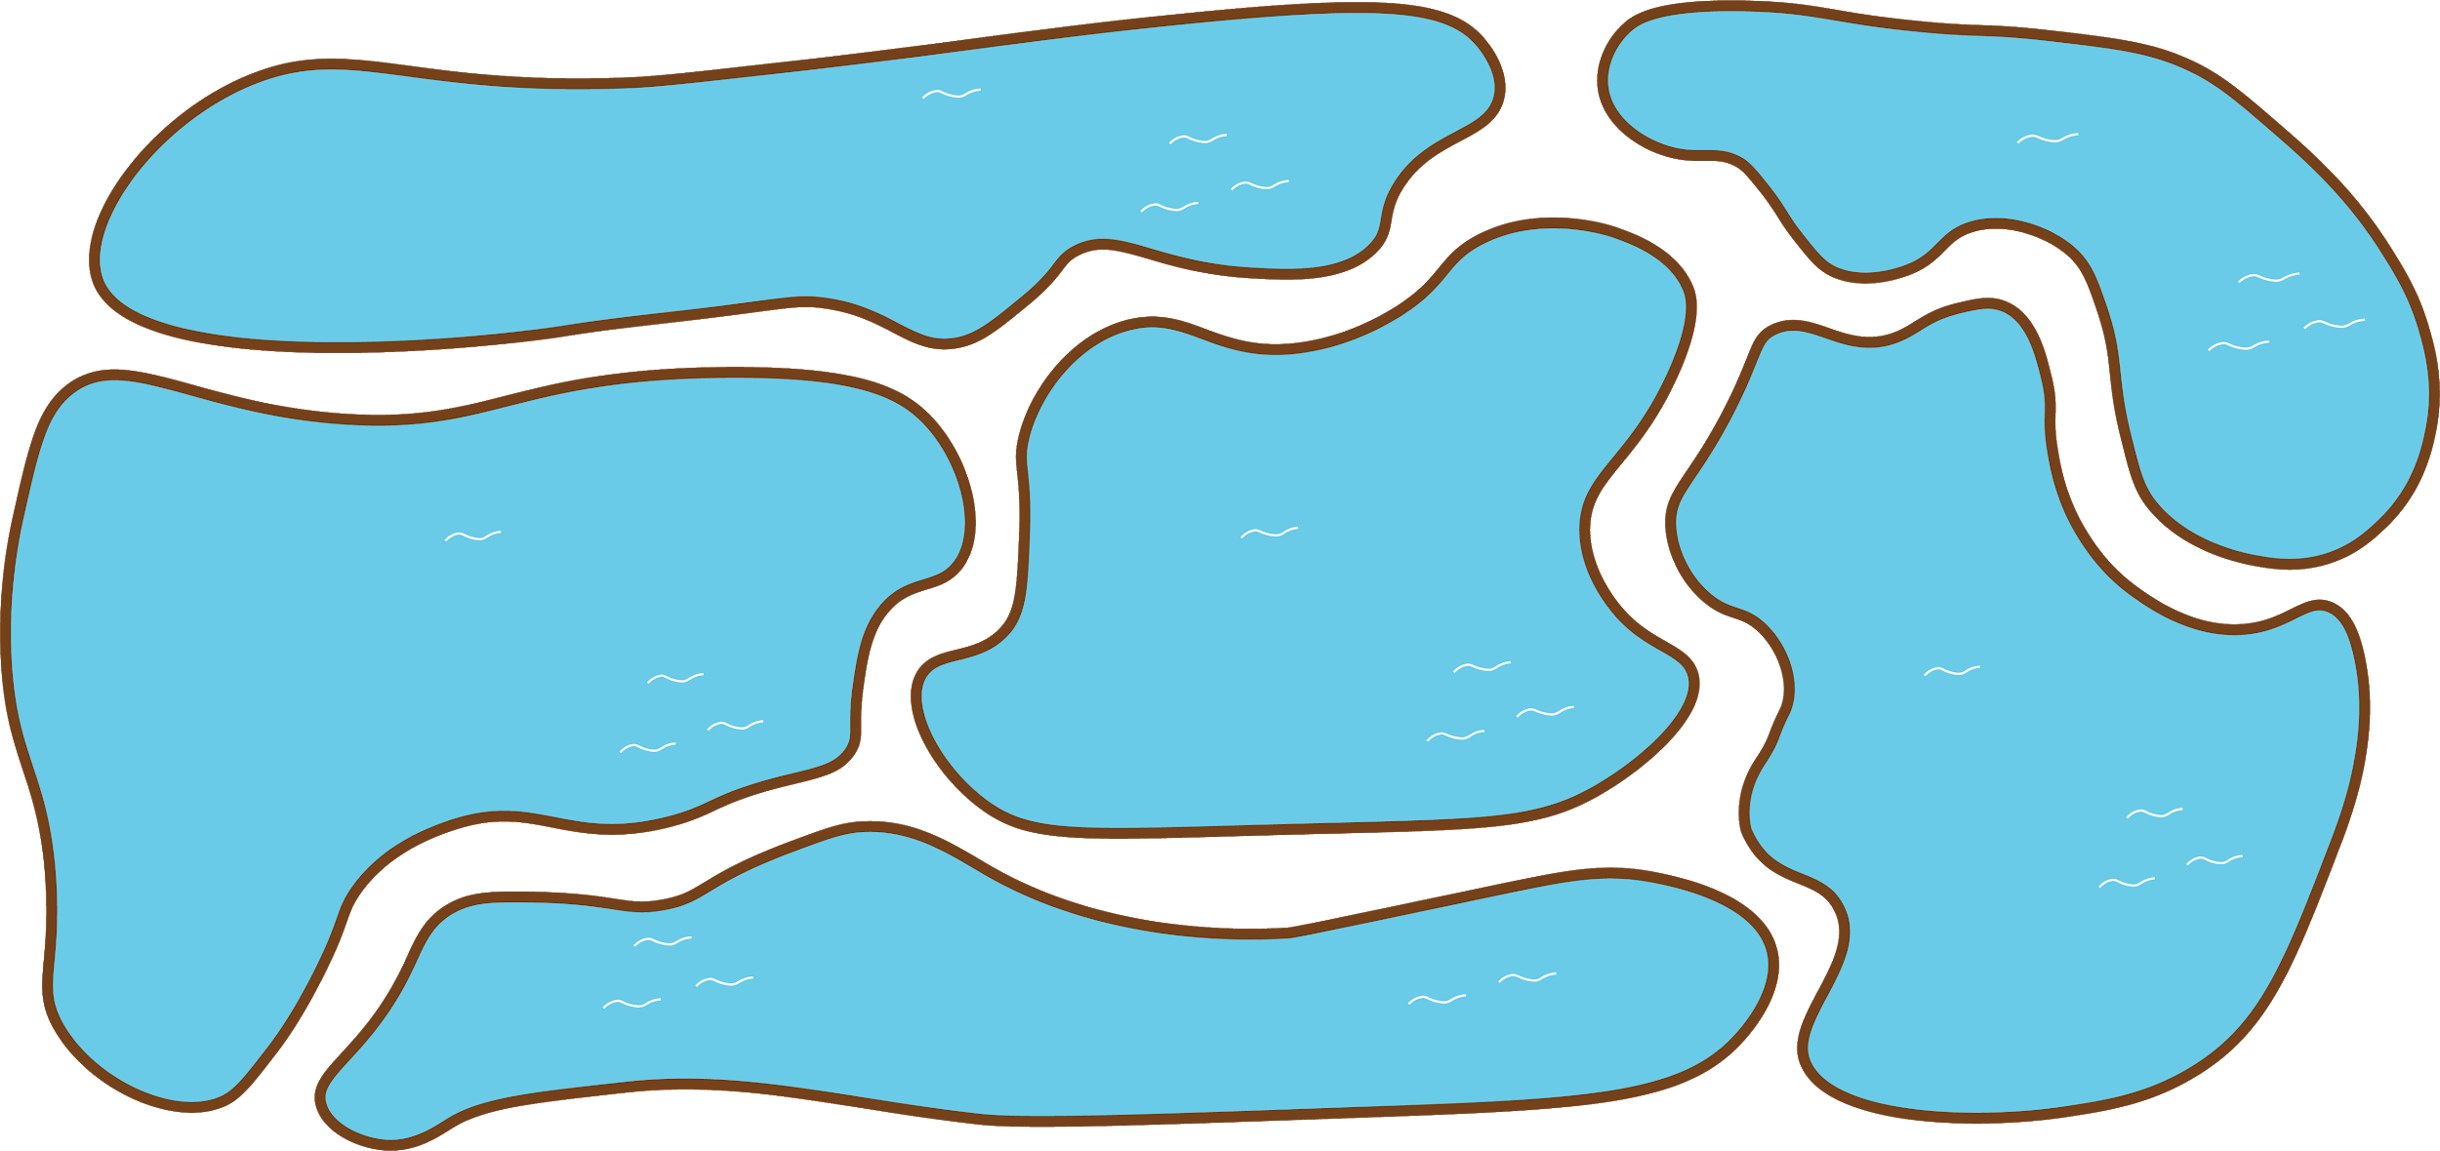
It’s night and the kōura are out again.
There are six ponds. Each pond has six kōura.
How many kōura are there?

