Slide 1
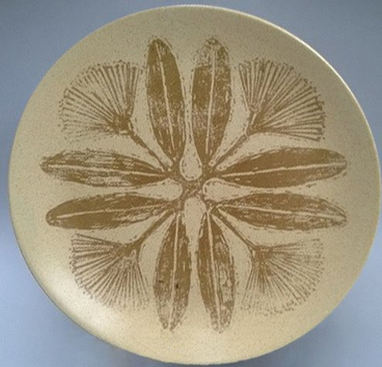
Crown Lynn Ceramics
“Nirvana” Design

Slide 2
m

Slide 3
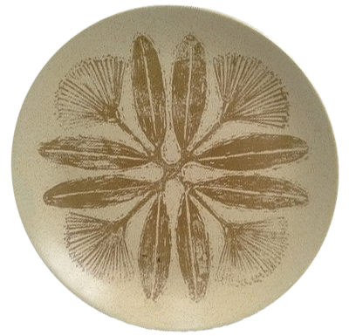
m

Slide 4
m

Slide 5
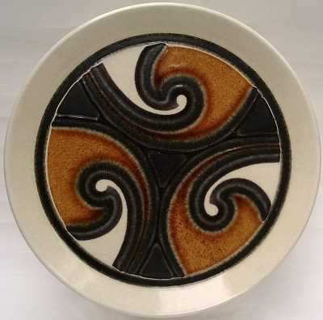
Crown Lynn Ceramics
Polynesian Design

Slide 6
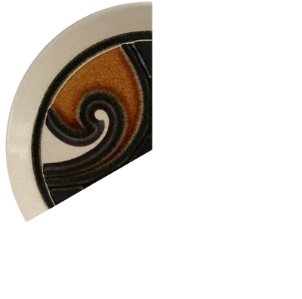

Slide 7
What is the angle of rotation?

Slide 8
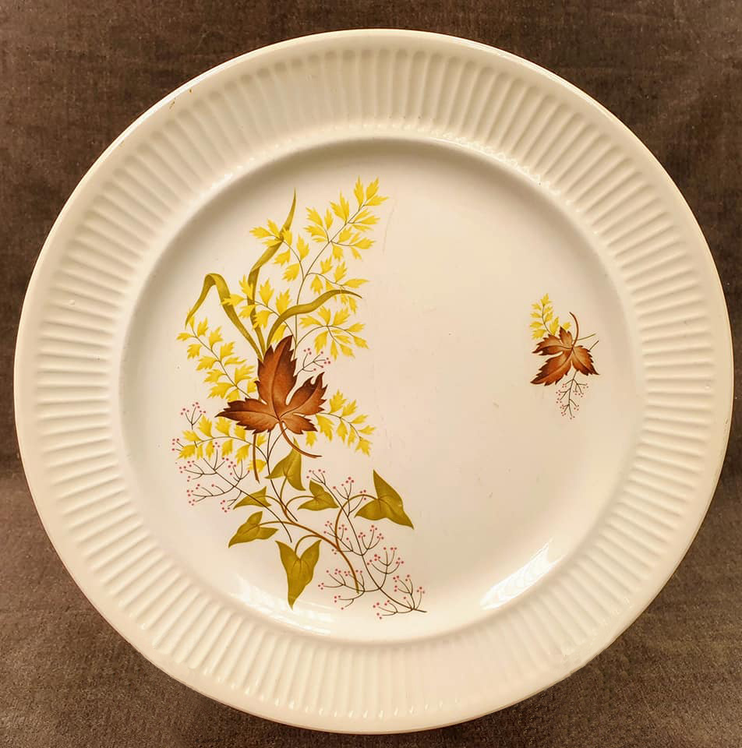
Crown Lynn Ceramics
“Red Roses” Design

