Slide 1
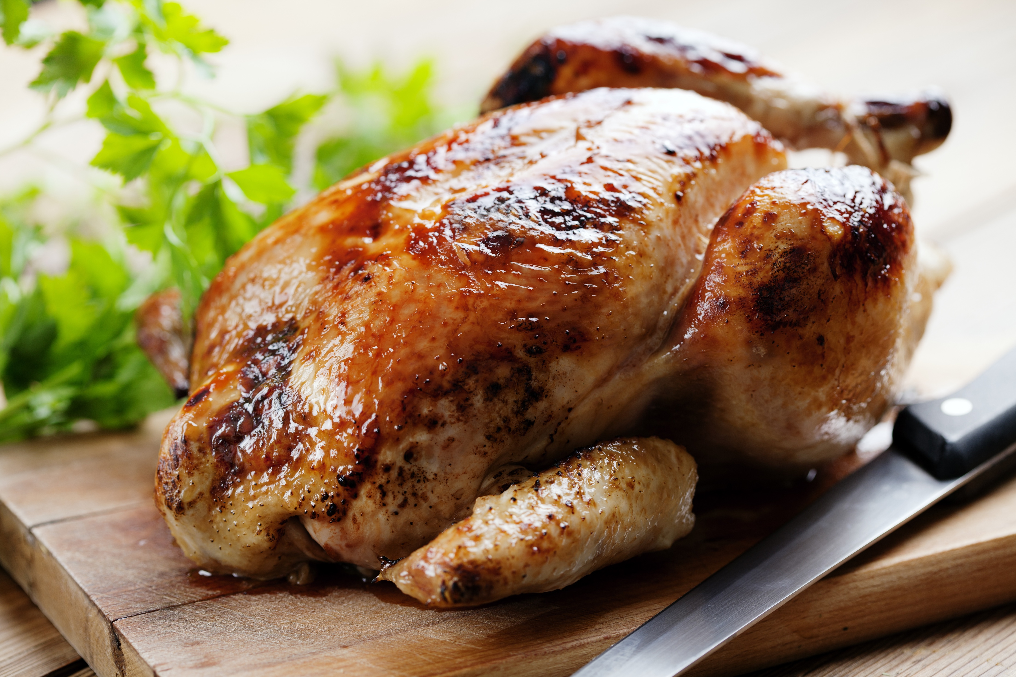
Did you know?
New Zealanders eat about 43 kilograms of chicken per capita.

Slide 2
A size 12 chicken has a weight of about 1.2 kilograms.
A size 14 chicken has a weight of about 1.4 kilograms.

Slide 3
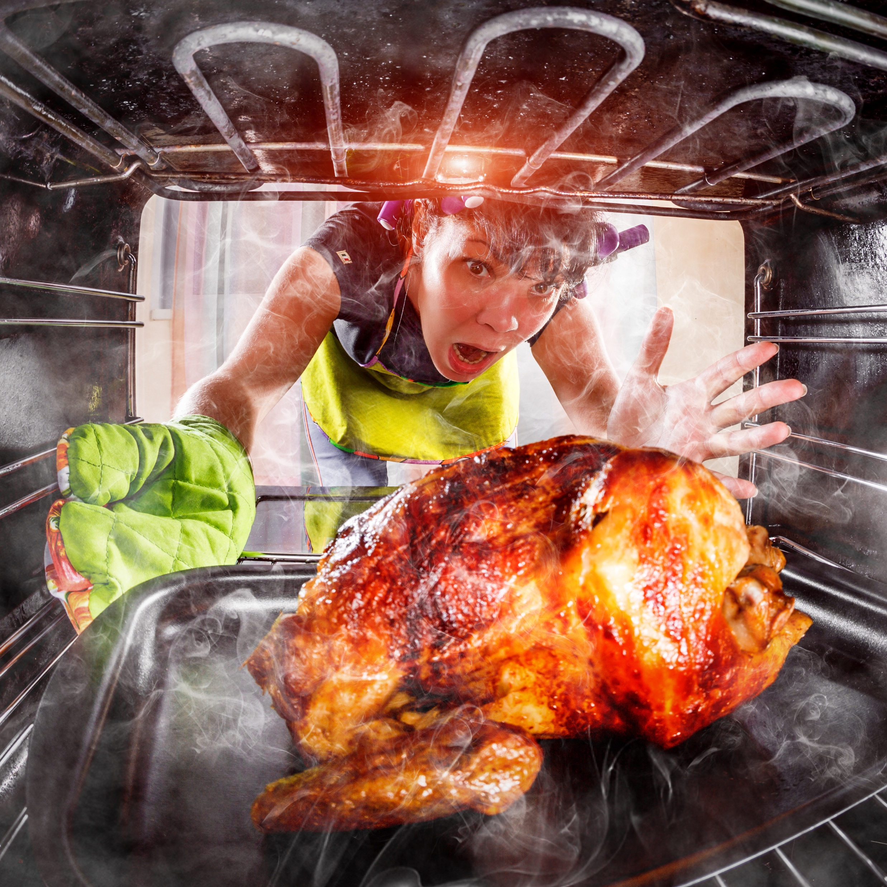
Get the timing right! Preheat the oven to 180⁰C.
Cook the chicken for 55 minutes per kilogram, plus another 20 minutes.

Slide 4
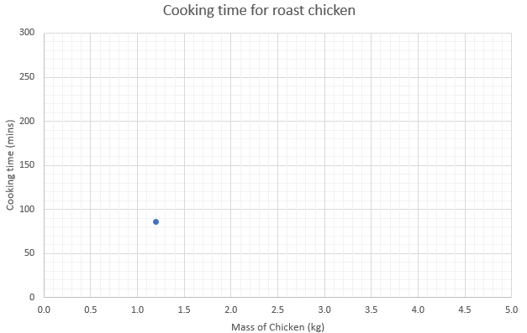
(1.2,86)

Slide 5
How long should you roast a size 18 chicken for?
If a chicken should be roasted for 97 minutes, what mass is the chicken?
If a chicken should be roasted for 75 minutes, what mass is the chicken?

Slide 6
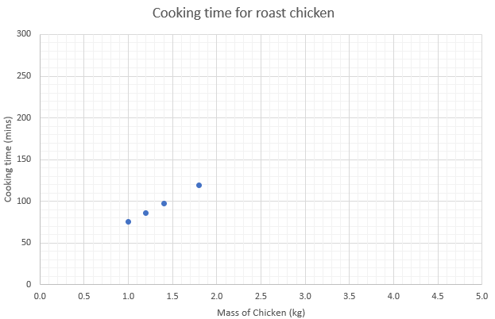

Slide 7
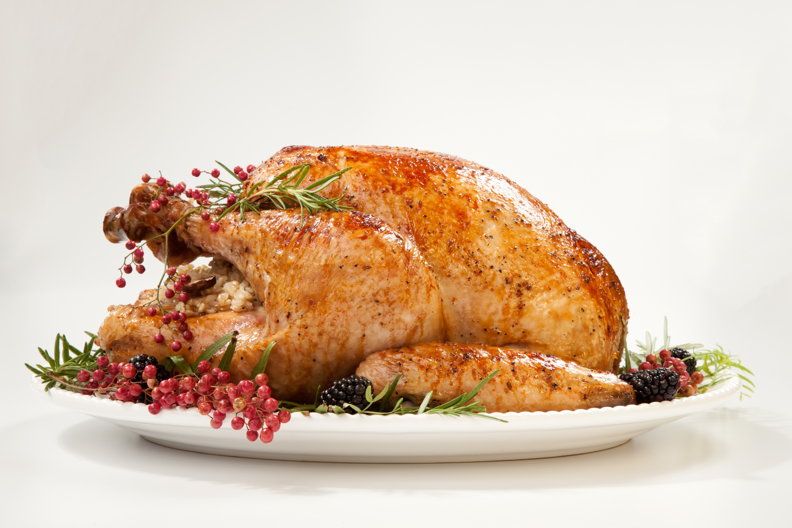
In the United States of America, it is traditional to cook a turkey to celebrate Thanksgiving.
Commercial turkeys are much larger than chickens and have a mass of between 3.6 and 10.8 kilograms.

Slide 8
Mass (kg) | Cooking time (mins)
4.5 | 180
8 | 210
10 | 240
13 | 300
Here are some recommended times for stuffed turkey, roasted at 180⁰C.
Is the graph of mass and cooking time linear?
Find a rule to work out the roasting time for any mass of turkey?
Use your rule to calculate the roasting time for a 7 kilogram turkey.
Do turkeys take less time, per kilogram, to roast than chickens?
Why might that be?

Slide 9
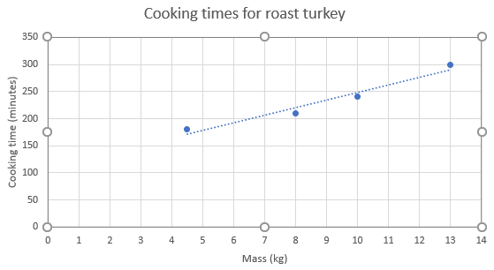

Slide 10
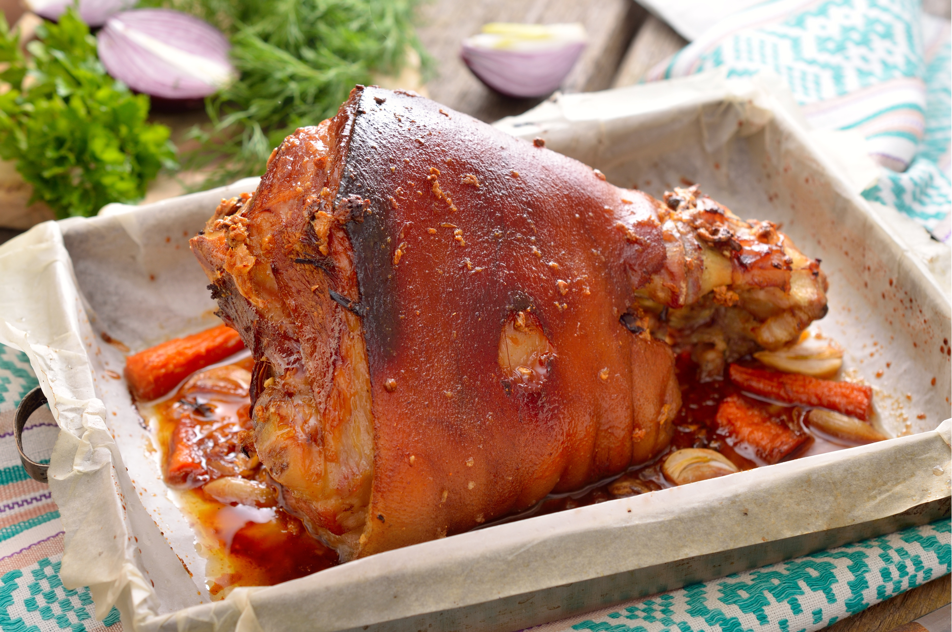
Kiwis eat about 24 kilograms of pork, per capita, each year.
Here are the recommended roasting time details for a shoulder roast.
Put in the oven for 30 minutes at a temperature of 220⁰C.
Turn the oven down to 180 ⁰C.
Cook the roast for 20 minutes per 500 grams.
Create a graph to help people work out the roasting time for pork.

Slide 11
