Slide 1
How does the tensile strength of spaghetti change as you add more strands?

Slide 2
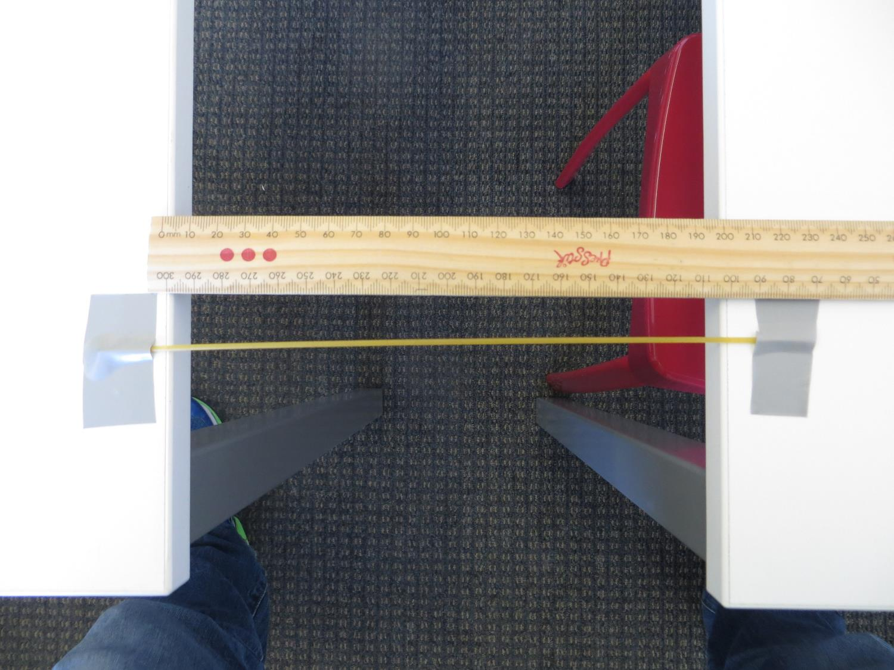
Set up two desks that are the same height. The edges should be 20cm apart.
Use duct tape to anchor the ends of the spaghetti.

Slide 3
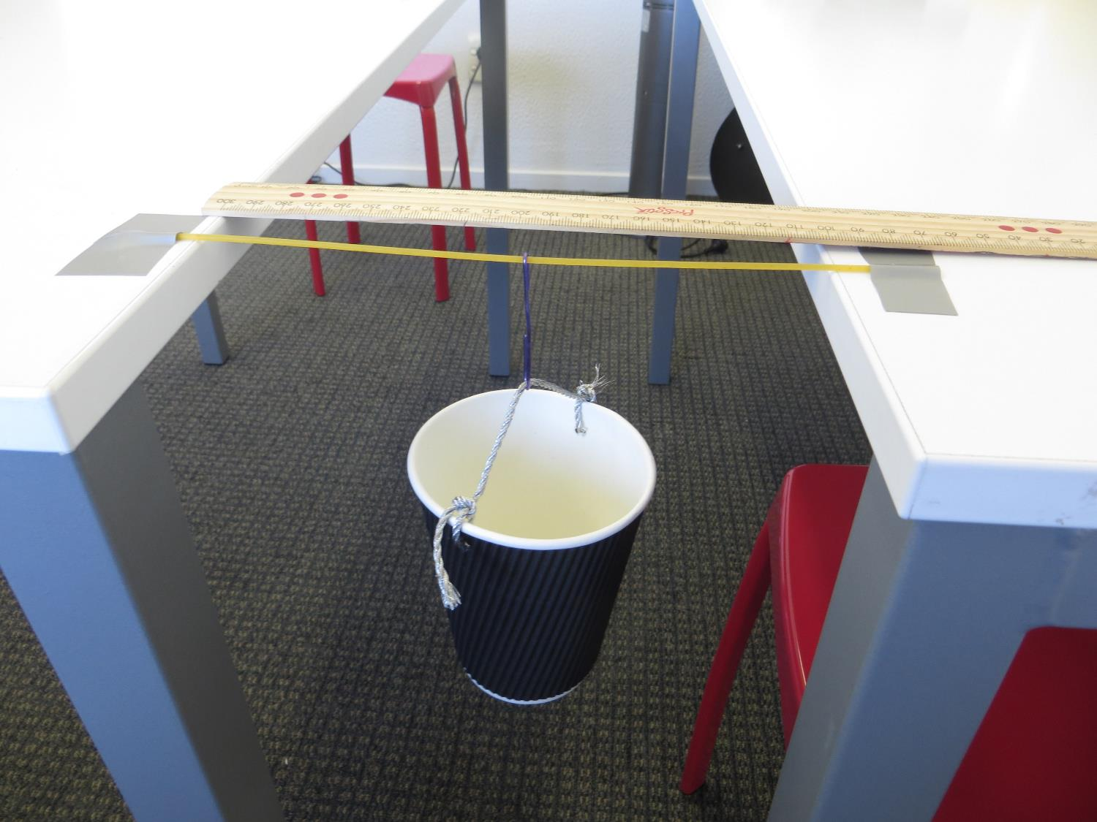
Make a hook from a paper clip. Turn a paper cup into a small bucket. Use string for the handle.

Slide 4
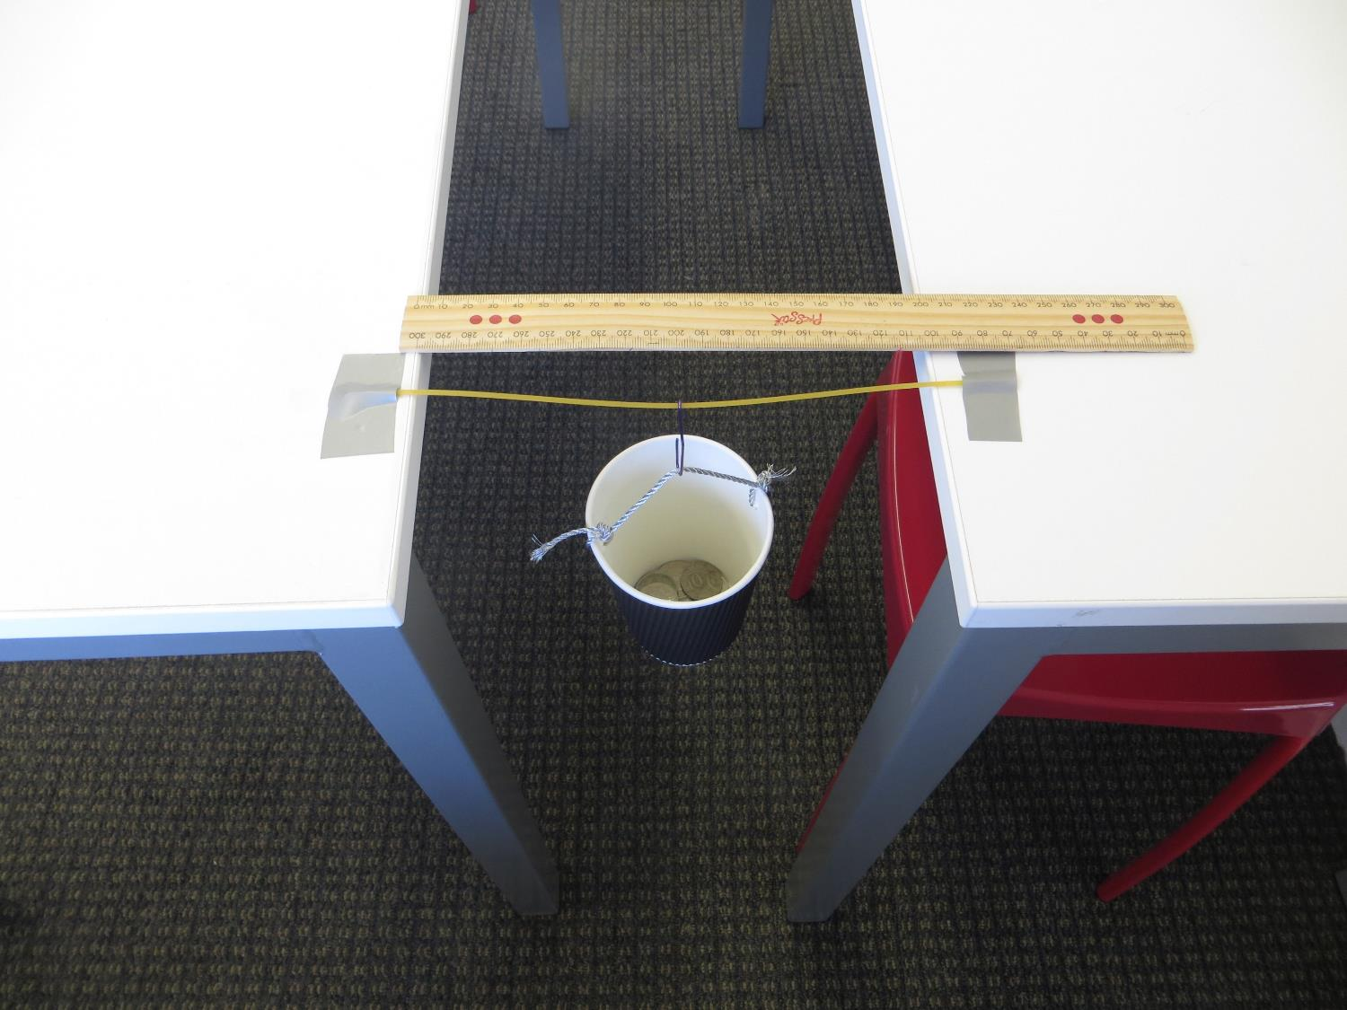
You might wrap tape around the hook so it does not cut like a knife.

Slide 5
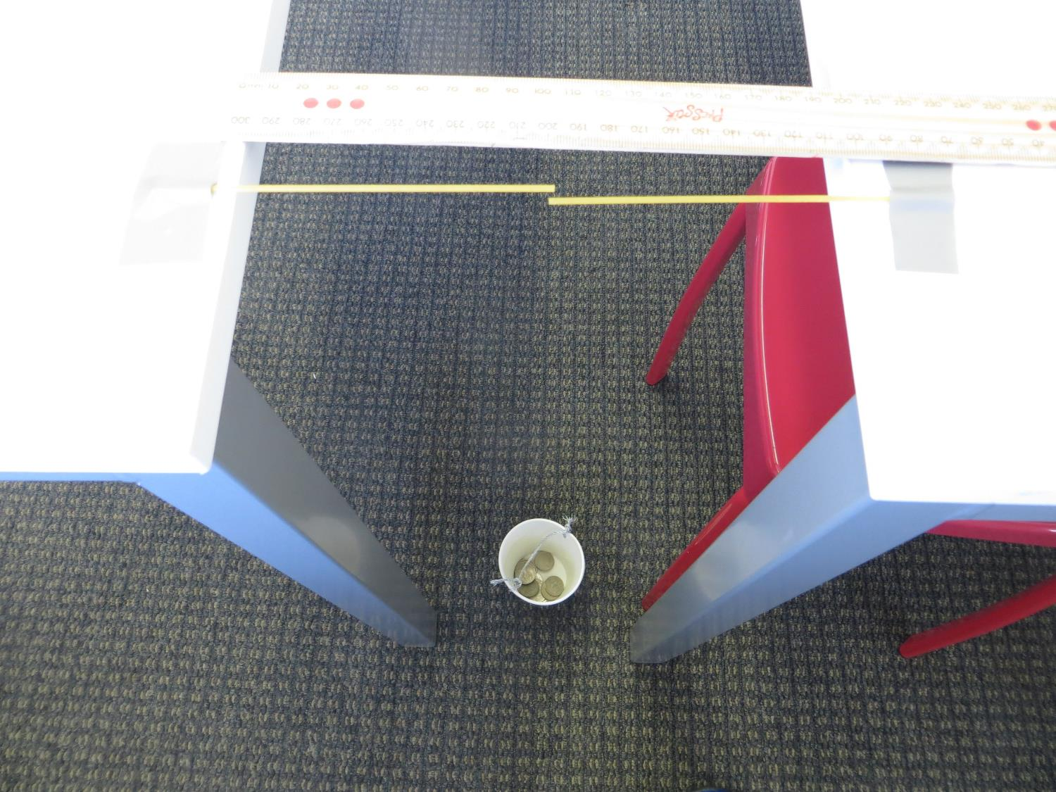
Add weights such as coins into the cup gently until the spaghetti snaps.
Do not drop the coins into the cup? Why?

Slide 6
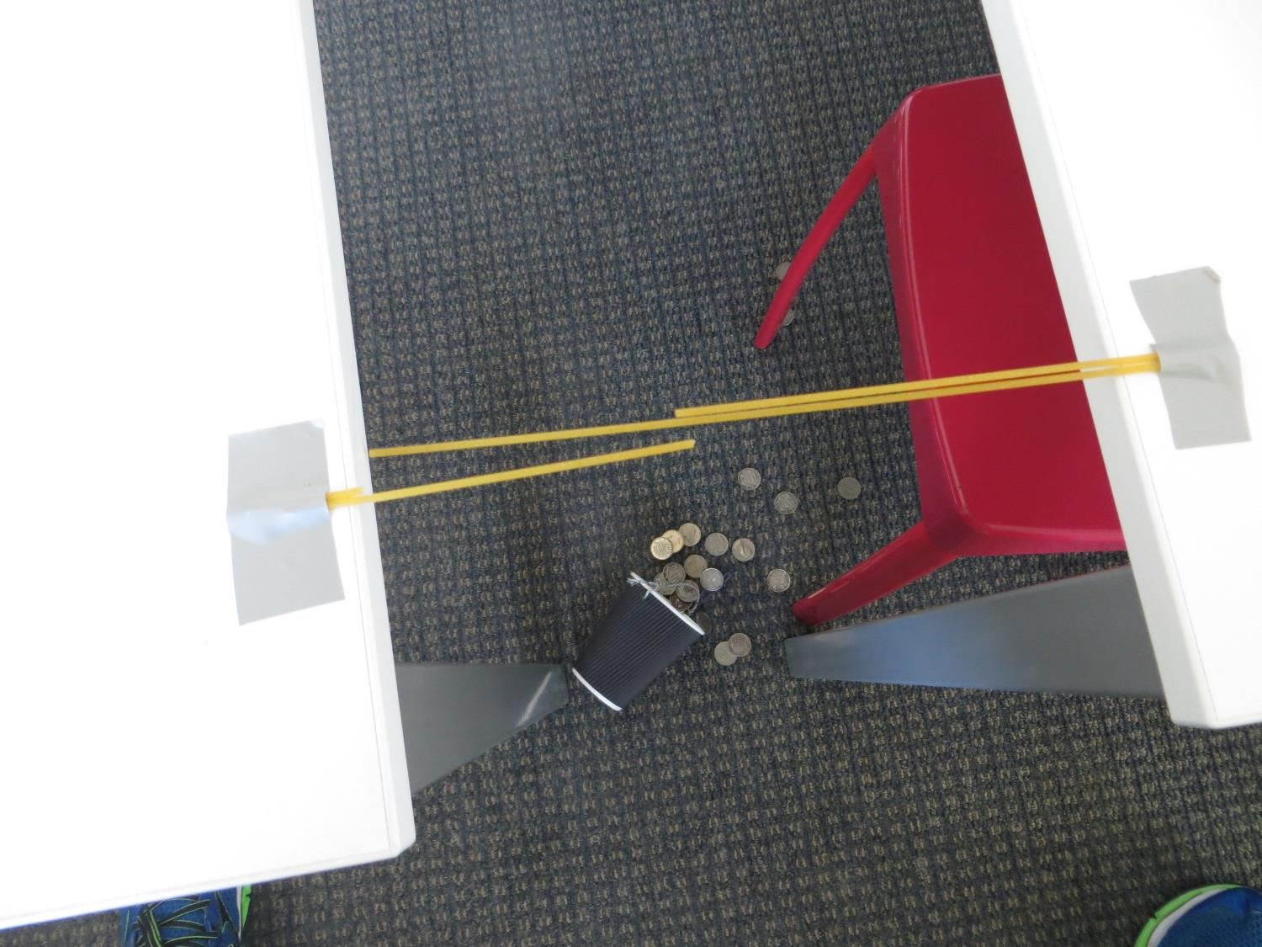
Test the tensile strength of different numbers of strands.
Do you expect the spaghetti to have same or different tensile strength?

Slide 7
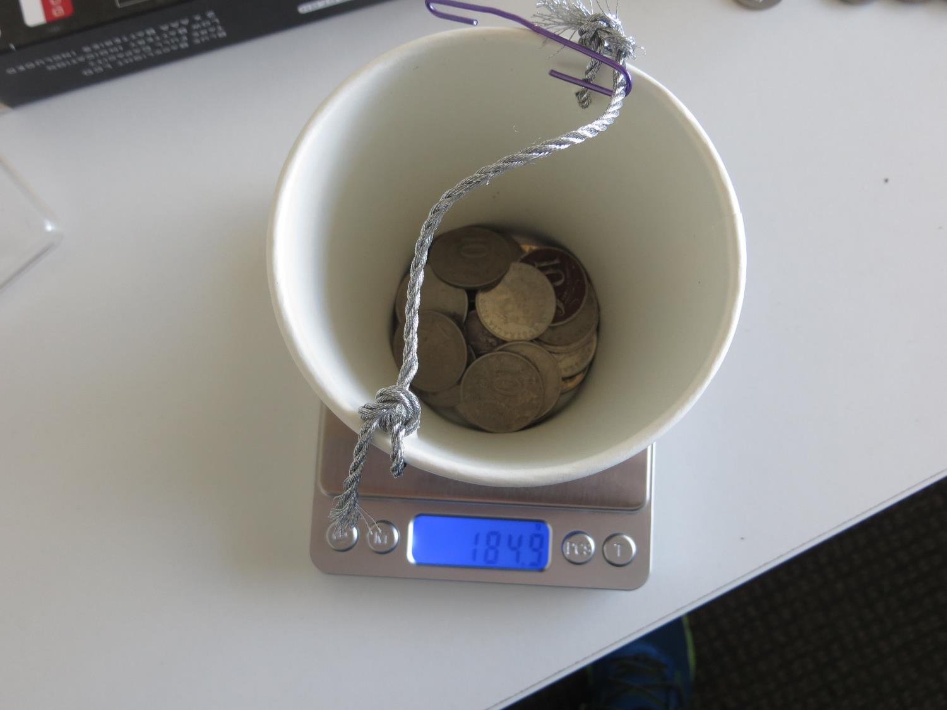
Each time you test the spaghetti find the mass of the cup and coins.
Record the measures.

Slide 8
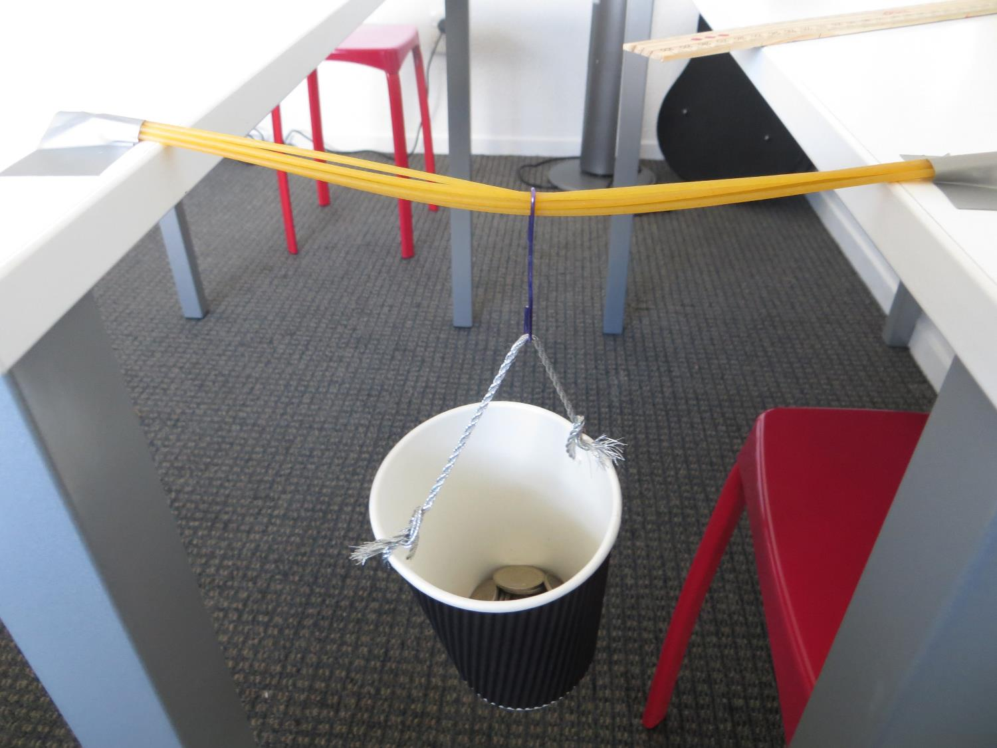
Can you predict the mass a collection of strands will hold before snapping?

Slide 9
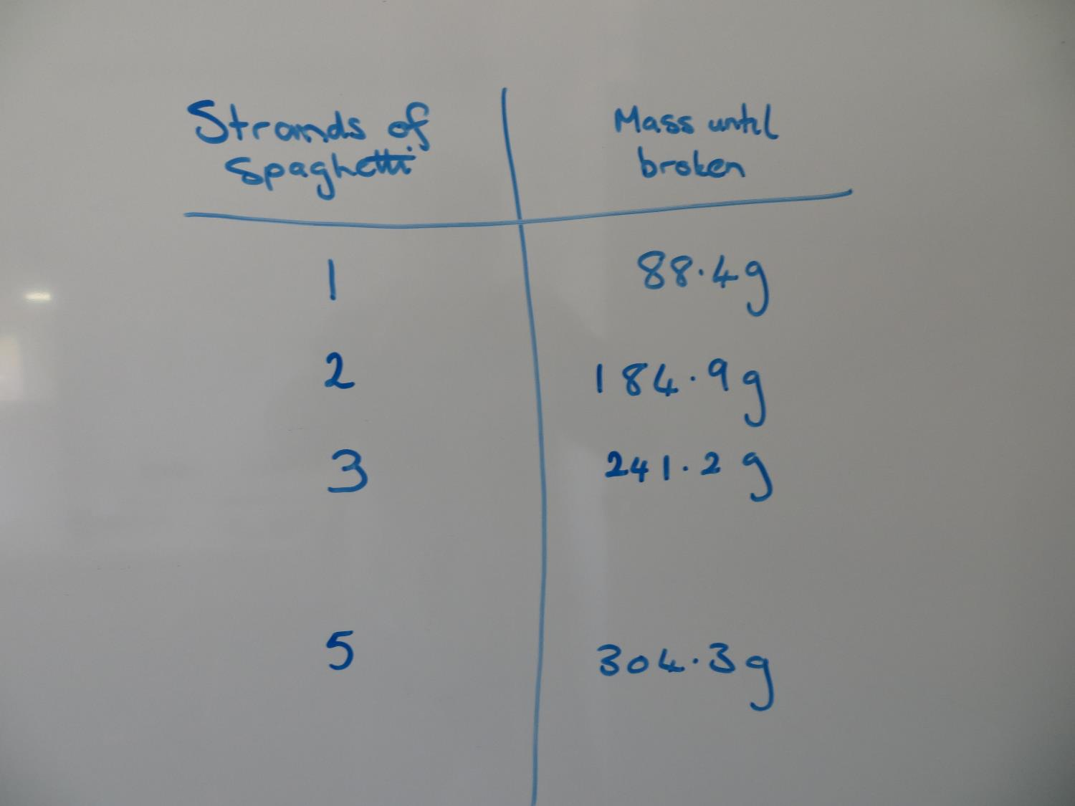
Organise your data in a table to look for patterns.
Is one test of each number of strands enough? Why?

Slide 10
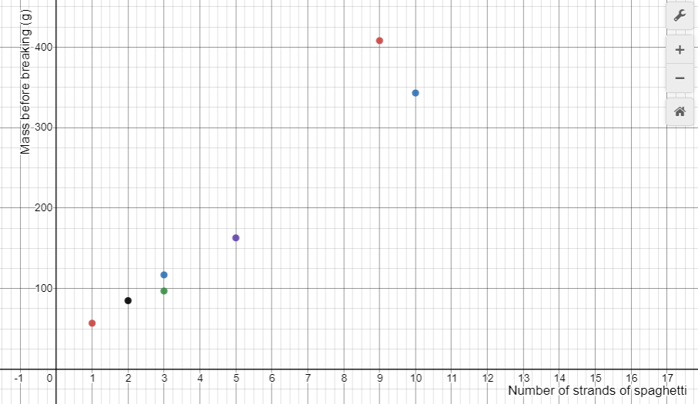

Slide 11
