Slide 1
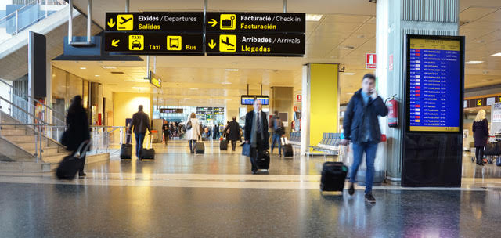
The departure lounges in International terminals are busy places.
Auckland Airport hosts about 10 million passengers per year.
That is twice the whole population of New Zealand.

Slide 2
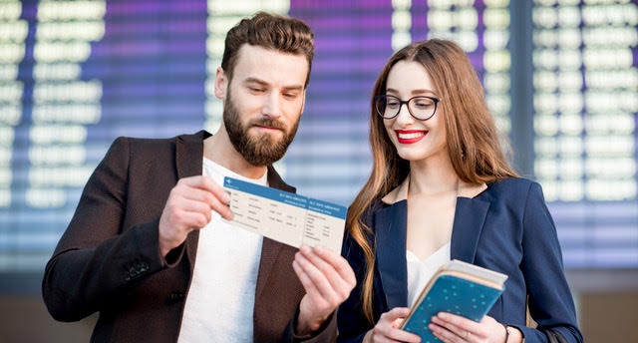
When you check in you receive a boarding pass with details of boarding time and departure gate.
Try not to miss your flight!

Slide 3
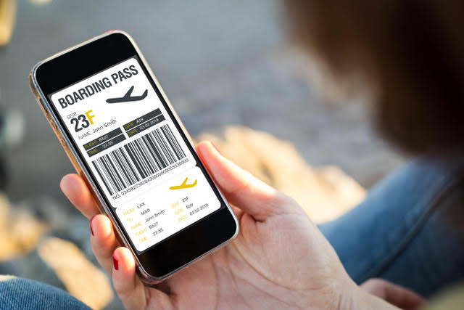
You can also get the boarding pass on your mobile phone.

Slide 4
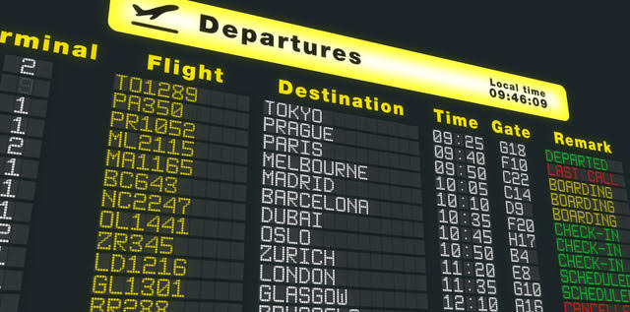
Information boards give the arrival and departure times of flights.
It is important to check the boards for changes of time and gate.

Slide 5
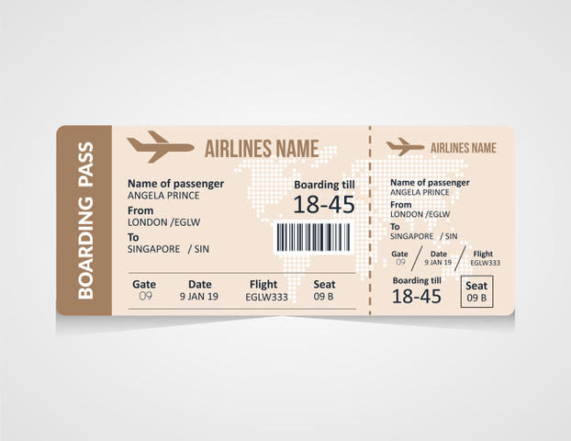
What details can you find about Angela’s flight from her boarding pass?

Slide 6
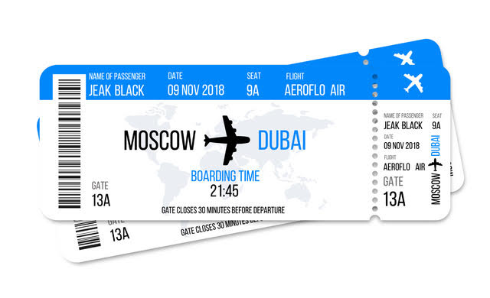

Slide 7
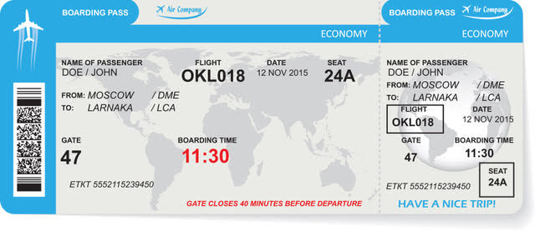

Slide 8
