Slide 1
Problem One
This pattern is known as Sierpinski’s triangle.
It is a kind of fractal because each iteration of the pattern looks like the previous one.

Slide 2
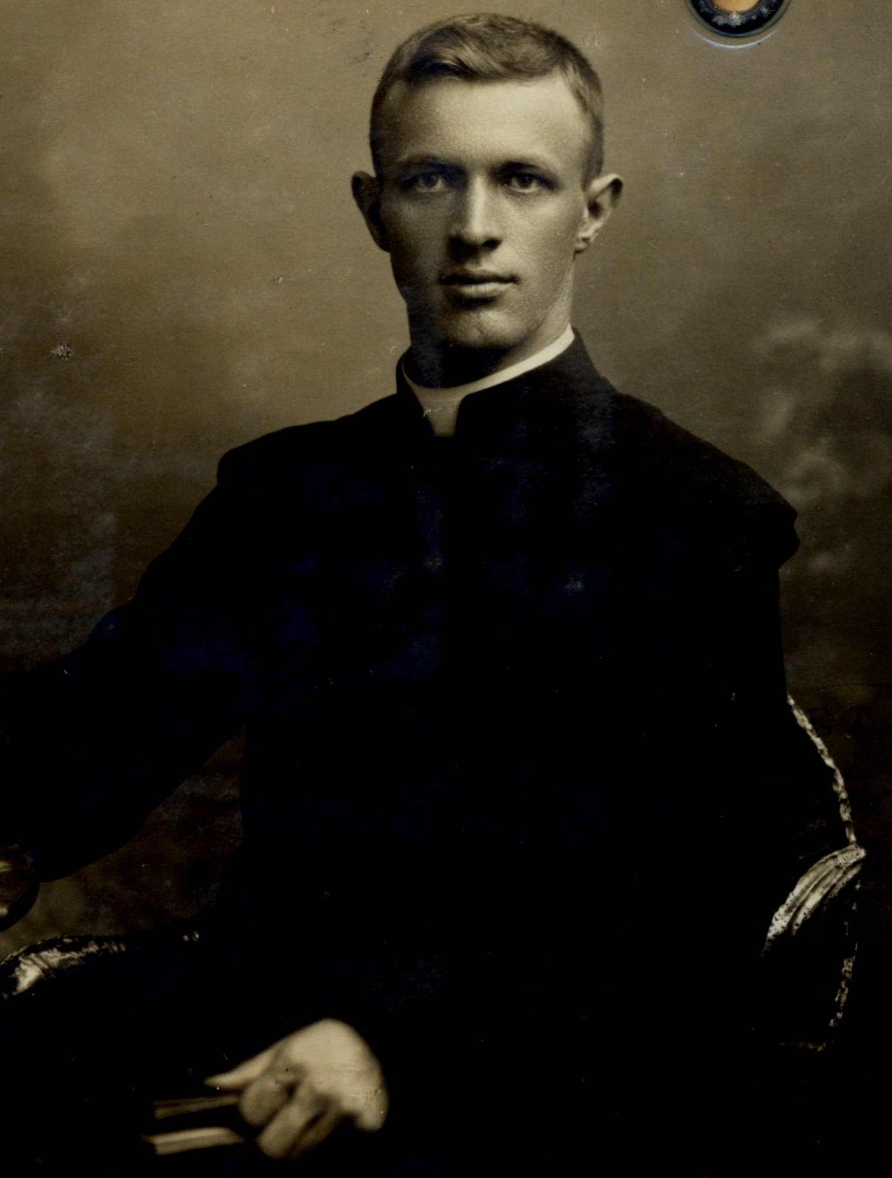
Draw the triangle to six generations, by hand or with digital technology.
How many black triangles are in the figure?
Write an equation that relates generation number to the number of black triangles.
Waclaw Sierpinski, who ‘discovered’ the triangle in 1915.

Slide 3
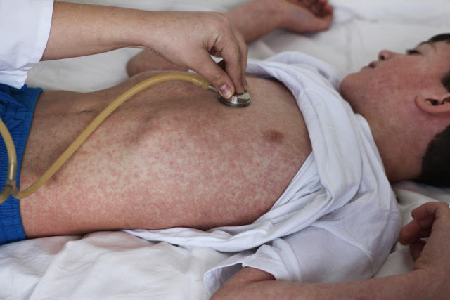
Problem Two
Measles in one of the most infectious diseases known to humans. It is far more infectious than other diseases such as Ebola, SARS or AIDS.
In an unvaccinated population one person with measles can infect 12–18 others.
Measles, and influenza were brought to Aotearoa by European settlers and killed thousands of Maori people in the 1800s.

Slide 4
Imagine one person in New Zealand got measles and the population was not immunised.
With each generation of the disease an infected person infected 15 others before they were no longer infective.
How many generations of the outbreak would be needed to infect the entire population of Aotearoa?

