Slide 1
Question: Which team will win the XXXX Rugby World Cup?
Are the measures well justified?
Method:
What measures did you use?
Measure 1: Number of caps
Measure 2: Top five points scorers
Why did you use those measures?
Usually teams that win have an average of 50 caps. Experience is important in close games.
To win, teams need to score points. Who will do that?

Slide 2
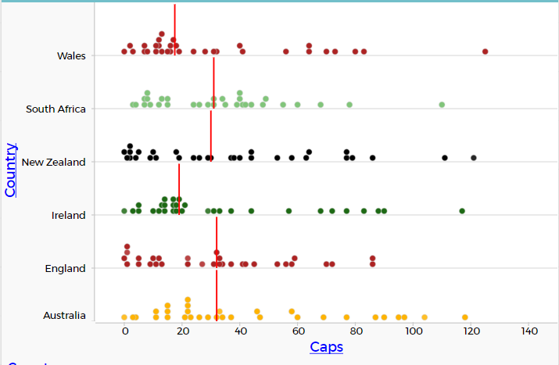
Does the graph match the statement?
Is median the best measure of centre?
South Africa, New Zealand, England and Australia have median numbers of caps closest to 50.

Slide 3
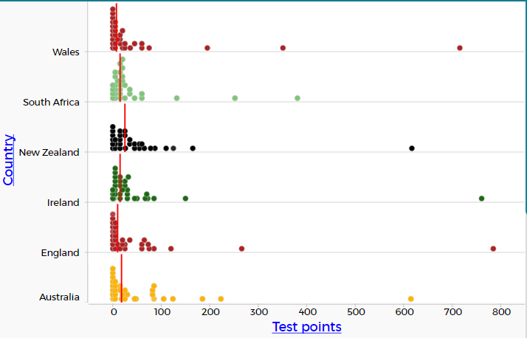
Have the investigators used technology sensibly?
We found the top five point scorers for each country.

Slide 4
Table 1: Top five points scorers in each squad.
Is ‘total points’ the best measure?
Explain.
Wales and England have three very good point scorers and the highest totals. The All Blacks rely too much on one player.

Slide 5
Is the conclusion justified by the data presented?
Do the reasons make sense?
Discussion and conclusion:
Which team has the best chance of winning?
Justify why you think that is true?
England will win the World Cup because they have a good average number of caps and three reliable point scorers.
Give reasons why your predicted team may not win.
Players might get injured or sent off in a crucial game. One team could have a good game against England and knock them out.

