Slide 1
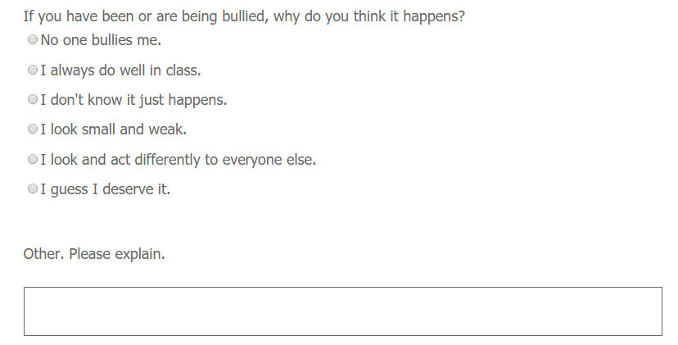

Slide 2
My temper is really bad. Other kids stay away from me.
My temper is really bad. Other kids stay away from me.
I play tricks on other kids a lot. Some of them get angry.
I play tricks on other kids a lot. Some of them get angry.
I am from China and they say I don’t belong here.
I am from China and they say I don’t belong here.
I was born with bad legs so I can’t play sport very good.
I was born with bad legs so I can’t play sport very good.
My Dad is a teacher at their last school. He used to tell them off.
My Dad is a teacher at their last school. He used to tell them off.
They are jealous of me because my family owns a big farm.
They are jealous of me because my family owns a big farm.
It’s because I wear really thick glasses.
It’s because I wear really thick glasses.
I used to have trouble with going to the toilet. Some kids still call me Peewee.
I used to have trouble with going to the toilet. Some kids still call me Peewee.
There are no other Somali kids at my school.
There are no other Somali kids at my school.
Everyone thinks I am dumb ‘cos I can’t read well.
Everyone thinks I am dumb ‘cos I can’t read well.
I’m pretty fat. I guess that’s why nobody wants me on their team.
I’m pretty fat. I guess that’s why nobody wants me on their team.

