Slide 1
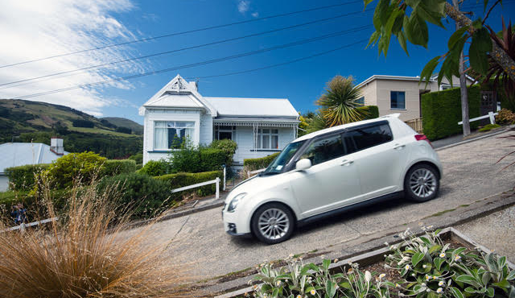
This is Baldwin Street in Dunedin. Why is it famous?

Slide 2
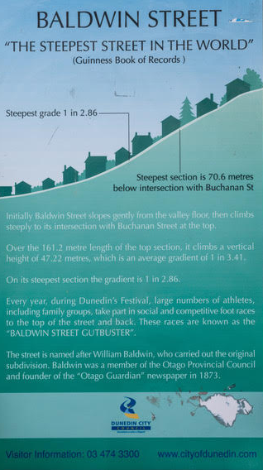
What is meant by a gradient of 1 in 3.41?
1 metre
rise
3.41 metres
run

Slide 3
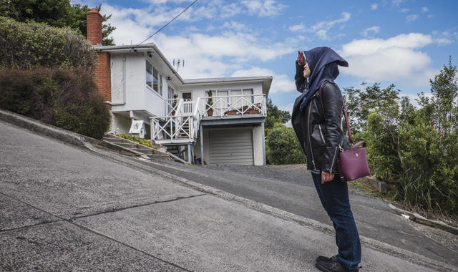
Estimate the angle of inclination

Slide 4
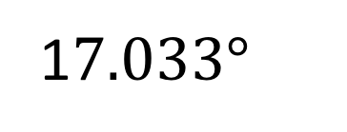
Use trigonometry to find the rise over the upper section of Baldwin Street.
Once that is done, find the run (horizontal distance) of the upper section.
161.2 m
rise
1$7.033°$

Slide 5
$$sin17.033°= \frac{r}{161.2}$$
$$sin17.033°=0.293$$
161.2 $×sin17.033°=r$
161.2 $×0.293=r$
4$7.525m=r$

Slide 6
$${161.2}^{2}={47.525}^{2}+l^{2}$$
$${161.2}^{2}−{47.525}^{2}=l^{2}$$
$$\sqrt{{161.2}^{2}−{47.525}^{2}}=l$$
154.035m$=l$

Slide 7
The very top section of Baldwin Street is even steeper.
What is the angle of ascent for the steepest part?
70 m
23.104m
θ

Slide 8
$$sinθ=\frac{23.104}{70}$$
$$sinθ=0.33$$
$$θ=\sin^{−1}{0.33}$$
θ$=19.27° (2dp)$

