Slide 1
1
0.5
30◦
0.866

Slide 2
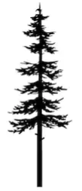
1
0.5
30◦
0.866
?
30◦
20 cubits

Slide 3
What are the two lengths marked x and y?
1 cubit
y
65◦
x

Slide 4
What is the height of the tree?
What is the length of the hypotenuse?
?
?
45◦
18 metres

