Slide 2
Ngā Whāinga mō tēnei Akoranga
Kia mārama ki:

Slide 3
Ngā Whāinga mō tēnei Akoranga
Kia mārama ki:
1. ngā huatau matua e hāngai ana ki te tau ā-ira;

Slide 4
Ngā Whāinga mō tēnei Akoranga
Kia mārama ki:
ngā huatau matua e hāngai ana ki te tau ā-ira;
te hononga o te hautanga ā-ira ki te hautau noa;

Slide 5
Ngā Whāinga mō tēnei Akoranga
Kia mārama ki:
ngā huatau matua e hāngai ana ki te tau ā-ira;
te hononga o te hautanga ā-ira ki te hautau noa;
te hononga o te hautanga ā-ira ki te pūnaha uara tū;

Slide 6
Ngā Whāinga mō tēnei Akoranga
Kia mārama ki:
ngā huatau matua e hāngai ana ki te tau ā-ira;
te hononga o te hautanga ā-ira ki te hautau noa;
te hononga o te hautanga ā-ira ki te pūnaha uara tū;
te whakaatu hautanga ā-ira ki te rauemi;

Slide 7
Ngā Whāinga mō tēnei Akoranga
Kia mārama ki:
ngā huatau matua e hāngai ana ki te tau ā-ira;
te hononga o te hautanga ā-ira ki te hautau noa;
te hononga o te hautanga ā-ira ki te pūnaha uara tū;
te whakaatu hautanga ā-ira ki te rauemi;
te raupapa hautanga ā-ira;

Slide 8
Ngā Whāinga mō tēnei Akoranga
Kia mārama ki:
ngā huatau matua e hāngai ana ki te tau ā-ira;
te hononga o te hautanga ā-ira ki te hautau noa;
te hononga o te hautanga ā-ira ki te pūnaha uara tū;
te whakaatu hautanga ā-ira ki te rauemi;
te raupapa hautanga ā-ira;
te whakaoti paheko (+ - x ÷) e whai wāhi mai ana te hautanga ā-ira;

Slide 9
Ngā Whāinga mō tēnei Akoranga
Kia mārama ki:
ngā huatau matua e hāngai ana ki te tau ā-ira;
te hononga o te hautanga ā-ira ki te hautau noa;
te hononga o te hautanga ā-ira ki te pūnaha uara tū;
te whakaatu hautanga ā-ira ki te rauemi;
te raupapa hautanga ā-ira;
te whakaoti paheko (+ - x ÷) e whai wāhi mai ana te hautanga ā-ira;
te whakaoti rapanga e whai wāhi mai ana te hautanga ā-ira;

Slide 10
Ngā Whāinga mō tēnei Akoranga
Kia mārama ki:
ngā huatau matua e hāngai ana ki te tau ā-ira;
te hononga o te hautanga ā-ira ki te hautau noa;
te hononga o te hautanga ā-ira ki te pūnaha uara tū;
te whakaatu hautanga ā-ira ki te rauemi;
te raupapa hautanga ā-ira;
te whakaoti paheko (+ - x ÷) e whai wāhi mai ana te hautanga ā-ira;
te whakaoti rapanga e whai wāhi mai ana te hautanga ā-ira;
nga hīkoi matua mō te whakaako i te hautanga ā-ira.

Slide 11
Te Tau ā-Ira: Ngā Huatau Matua
E whā ngā huatau matua e hangai ana ki te hautanga ā-ira.

Slide 12
Te Tau ā-Ira: Ngā Huatau Matua
E whā ngā huatau matua e hangai ana ki te hautanga ā-ira.
1. Ko ngā tau ā-ira he pūnaha whakaatu hautanga.

Slide 13
Te Tau ā-Ira: Ngā Huatau Matua
E whā ngā huatau matua e hangai ana ki te hautanga ā-ira.
Ko ngā tau ā-ira he pūnaha whakaatu hautanga.
Haere tonu ai tā tātou pūnaha uara tū ngahuru ki ngā pito e rua. Kāore he mutunga o ngā uara kaitā rawa, o ngā uara mōkitokito hoki.

Slide 14
Te Tau ā-Ira: Ngā Huatau Matua
E whā ngā huatau matua e hangai ana ki te hautanga ā-ira.
Ko ngā tau ā-ira he pūnaha whakaatu hautanga.
Haere tonu ai tā tātou pūnaha uara tū ngahuru ki ngā pito e rua. Kāore he mutunga o ngā uara kaitā rawa, o ngā uara mōkitokito hoki.
Whakanohia ai te ira ki tētahi tau hei wehewehe i ngā tauoti me ngā hautanga. Arā, ko te uara tū o ngā tahi ki te taha mauī o te ira.

Slide 15
Te Tau ā-Ira: Ngā Huatau Matua
E whā ngā huatau matua e hangai ana ki te hautanga ā-ira.
Ko ngā tau ā-ira he pūnaha whakaatu hautanga.
Haere tonu ai tā tātou pūnaha uara tū ngahuru ki ngā pito e rua. Kāore he mutunga o ngā uara kaitā rawa, o ngā uara mōkitokito hoki.
Whakanohia ai te ira ki tētahi tau hei wehewehe i ngā tauoti me ngā hautanga. Arā, ko te uara tū o ngā tahi ki te taha mauī o te ira.
E hāngai tonu ana ngā rautaki paheko tauoti (+ – × ÷) ki ngā rautaki paheko tau ā-ira.

Slide 16
Te Tau ā-Ira: Ngā Huatau Matua
E whā ngā huatau matua e hangai ana ki te hautanga ā-ira.
Ko ngā tau ā-ira he pūnaha whakaatu hautanga.
Haere tonu ai tā tātou pūnaha uara tū ngahuru ki ngā pito e rua. Kāore he mutunga o ngā uara kaitā rawa, o ngā uara mōkitokito hoki.
Whakanohia ai te ira ki tētahi tau hei wehewehe i ngā tauoti me ngā hautanga. Arā, ko te uara tū o ngā tahi ki te taha mauī o te ira.
E hāngai tonu ana ngā rautaki paheko tauoti (+ – × ÷) ki ngā rautaki paheko tau ā-ira.
Hei Mahi:
Āta whakaarohia he tauira hei whakaatu i ia huatau matua.

Slide 17
Te Tau ā-Ira: Ngā Huatau Matua
Hei whakatauira i te huatau matua tuatahi o te hautanga ā-ira:
Ko ngā tau ā-ira he pūnaha whakaatu hautanga.
- Ko te mati ā-ira tuatahi hei whakaatu hautekau. Arā:
0.1 = ¹ , 0.2 = ² , 0.3 =
10 10
3
10
...

Slide 18
Te Tau ā-Ira: Ngā Huatau Matua
Hei whakatauira i te huatau matua tuatahi o te hautanga ā-ira:
Ko ngā tau ā-ira he pūnaha whakaatu hautanga.
- Ko te mati ā-ira tuatahi hei whakaatu hautekau. Arā:
0.1 = ¹ , 0.2 = ² , 0.3 =
10 10
3
10
...
- Ko te mati ā-ira tuarua hei whakaatu haurau. Arā:
0.01 =
1
100
, 0.02 =
2
100
, 0.03 =
3
100
...

Slide 19
Te Tau ā-Ira: Ngā Huatau Matua
Hei whakatauira i te huatau matua tuatahi o te hautanga ā-ira:
Ko ngā tau ā-ira he pūnaha whakaatu hautanga.
- Ko te mati ā-ira tuatahi hei whakaatu hautekau. Arā:
0.1 = ¹ , 0.2 = ² , 0.3 =
10 10
3
10
...
- Ko te mati ā-ira tuarua hei whakaatu haurau. Arā:
0.01 =
1
100
, 0.02 =
2
100
, 0.03 =
3
100
...
- Ko te mati ā-ira tuatoru hei whakaatu haumano. Arā:
0.001 =
1 1000
, 0.002 =
2 1000
, 0.003 =
3 1000
...

Slide 20
Te Tau ā-Ira: Ngā Huatau Matua
Hei whakatauira i te huatau matua tuarua:
Haere tonu ai tā tātou pūnaha uara tū ngahuru ki ngā pito e rua. Kāore he mutunga o ngā uara kaitā rawa,
o ngā uara mōkitokito hoki.

Slide 21
Te Tau ā-Ira: Ngā Huatau Matua
Hei whakatauira i te huatau matua tuarua:
Haere tonu ai tā tātou pūnaha uara tū ngahuru ki ngā pito e rua. Kāore he mutunga o ngā uara kaitā rawa,
o ngā uara mōkitokito hoki.
... | 100,000,000 | 10,000,000 | 1,000,000 | 100,000 | 10,000 | 1,000 | 100 | 10 | 1
... | 10⁸ | 10⁷ | 10⁶ | 10⁵ | 10⁴ | 10³ | 10² | 10¹ | 10⁰
IRA
1 10 | 1 100 | 1 1,000 | 1 10,000 | 1 100,000 | 1 1,000,000 | 1 10,000,000 | 1 100,000,000 | 1 1,000,000,000
₁₀-1 | ₁₀-2 | ₁₀-3 | ₁₀-4 | ₁₀-5 | ₁₀-6 | ₁₀-7 | ₁₀-8 | ₁₀-9 | ...
×10
×10
×10
×10
×10
×10
×10
×10
÷10
÷10
÷10
÷10
÷10
÷10
÷10
÷10
÷10

Slide 22
Te Tau ā-Ira: Ngā Huatau Matua
Hei whakatauira i te huatau matua tuatoru:
Whakanōhia ai te ira ki tētahi tau hei wehewehe i ngā tauoti me ngā hautanga. Arā, ko te uara tū o ngā tahi ki te taha mauī o te ira.

Slide 23
Te Tau ā-Ira: Ngā Huatau Matua
Hei whakatauira i te huatau matua tuatoru:
Whakanohia ai te ira ki tētahi tau hei wehewehe i ngā tauoti me ngā hautanga. Arā, ko te uara tū o ngā tahi ki te taha mauī o te ira.
375.294
he tauoti ki te taha mauī
he hautau
ki te taha matau

Slide 24
Te Tau ā-Ira: Ngā Huatau Matua
Hei whakatauira i te huatau matua tuawhā:
E hāngai tonu ana ngā rautaki paheko tauoti (+ – × ÷) ki ngā rautaki paheko tau ā-ira.

Slide 25
Te Tau ā-Ira: Ngā Huatau Matua
Hei whakatauira i te huatau matua tuawhā:
E hāngai tonu ana ngā rautaki paheko tauoti (+ – × ÷) ki ngā rautaki paheko tau ā-ira.
- 3 × 4 = 12
3 × 0.4 = 1.2 ...
0.3 × 0.4 = 0.12 ...

Slide 26
Te Tau ā-Ira: Ngā Huatau Matua
Hei whakatauira i te huatau matua tuawhā:
E hāngai tonu ana ngā rautaki paheko tauoti (+ – × ÷) ki ngā rautaki paheko tau ā-ira.
- 3 × 4 = 12
3 × 0.4 = 1.2 ...
0.3 × 0.4 = 0.12 ...
- 25 + 27 = 25 + 25 + 2
2.5 + 2.7 = 2.5 + 2.5 + 0.2

Slide 27
Te Tau ā-Ira: Ngā Huatau Matua
Hei whakatauira i te huatau matua tuawhā:
E hāngai tonu ana ngā rautaki paheko tauoti (+ – × ÷) ki ngā rautaki paheko tau ā-ira.
- 3 × 4 = 12
3 × 0.4 = 1.2 ...
0.3 × 0.4 = 0.12 ...
- 25 + 27 = 25 + 25 + 2
2.5 + 2.7 = 2.5 + 2.5 + 0.2
- 64 – 7 = 64 – 4 – 3
6.4 – 0.7 = 6.4 – 0.4 – 0.3

Slide 28
Te whakaako i te tau ā-ira
E rua ngā wāhanga matua o te whakaako i te tau ā-ira:

Slide 29
Te whakaako i te tau ā-ira
E rua ngā wāhanga matua o te whakaako i te tau ā-ira:
Te tūhono i te tau ā-ira ki te hautau

Slide 30
Te whakaako i te tau ā-ira
E rua ngā wāhanga matua o te whakaako i te tau ā-ira:
Te tūhono i te tau ā-ira ki te hautau
Te tūhono i te tau ā-ira ki te pūnaha uara tū

Slide 31
Te whakaako i te tau ā-ira
E rua ngā wāhanga matua o te whakaako i te tau ā-ira:
Te tūhono i te tau ā-ira ki te hautau
Te tūhono i te tau ā-ira ki te pūnaha uara tū
Nō reira, kia mārama te ākonga ki te aha i mua i tana ako i ngā hautanga ā-ira?

Slide 32
Te whakaako i te tau ā-ira
E rua ngā wāhanga matua o te whakaako i te tau ā-ira:
Te tūhono i te tau ā-ira ki te hautau
Te tūhono i te tau ā-ira ki te pūnaha uara tū
Nō reira, kia mārama te ākonga ki te aha i mua i tana ako i ngā hautanga ā-ira?
Kia mārama ki:
te hautau noa, perā i te ¹ , te ³ , te 5 ² , me te
2 4 3
te pūnaha uara tū mō te tauoti
7
100
Whare Mano
... 100,000 10,000 1,000
...
Whare Mātāmua
100 10 1
×10
×10
×10
×10
×10
×10
÷10
÷10
÷10
÷10
÷10
÷10

Slide 33
Te tūhono i te tau ā-ira ki te hautau
E mōhio ke ana te ākonga ki ngā hautau penei i te ¹ , te ¹ , me te
2 10
1
100
. Nō reira ka
tūhonoa ēnei hautau ki ngā hautau ā-ira.

Slide 34
Te tūhono i te tau ā-ira ki te hautau
E mōhio ke ana te ākonga ki ngā hautau penei i te ¹ , te ¹ , me te
2 10
1
100
. Nō reira ka
tuhonoa ēnei hautau ki ngā hautau ā-ira.
Ngā momo whakatauira:
tētahi āhua/rohe
tauoti
100 | 10 | 1
 |  | 0
hautanga
1 10 | 1 100 | 1 1000
5
= = 0.5
1 5
2 10

Slide 35

Te tūhono i te tau ā-ira ki te hautau
E mōhio ke ana te ākonga ki ngā hautau penei i te ¹ , te ¹ , me te
2 10
1
100
. Nō reira ka
tuhonoa ēnei hautau ki ngā hautau ā-ira.
Ngā momo whakatauira:
tētahi āhua/rohe
tētahi roa
tauoti
100 | 10 | 1
 |  | 0
hautanga
1 10 | 1 100 | 1 1000
5
= = 0.5
1 5
2 10
³ = ² = 0.3
10 5

Slide 36
Te tūhono i te tau ā-ira ki te hautau
E mōhio ke ana te ākonga ki ngā hautau penei i te ¹ , te ¹ , me te
2 10
1
100
. Nō reira ka
tuhonoa ēnei hautau ki ngā hautau ā-ira.
Ngā momo whakatauira:
tētahi āhua/rohe
tētahi roa
tētahi huinga
⁷ = 0.7
tauoti
100 | 10 | 1
 |  | 0
hautanga
1 10 | 1 100 | 1 1000
5
10
= = 0.5
Ko te 0.7 te hautanga ā-ira
o ngā porotiti whero.
1 5
2 10
³ = ² = 0.3
10 5

Slide 37
Te tūhono i te tau ā-ira ki te hautau
E mōhio ke ana te ākonga ki ngā hautau penei i te ¹ , te ¹ , me te
2 10
1
100
. Nō reira ka
tuhonoa ēnei hautau ki ngā hautau ā-ira.
Ngā momo whakatauira:
tētahi āhua/rohe
tētahi roa
tētahi huinga
⁷ = 0.7
tauoti
100 | 10 | 1
 |  | 0
hautanga
1 10 | 1 100 | 1 1000
5
10
= = 0.5
Ko te 0.7 te hautanga ā-ira
o ngā porotiti whero.
1 5
2 10
³ = ² = 0.3
10 5
Ko te mea nui kia mārama te ākonga he aha te mea tūtahi. He aha ai?

Slide 38
Te tūhono i te tau ā-ira ki te hautau Ko te mea nui kia mārama te ākonga he aha te mea tūtahi. He aha ai?

Slide 39

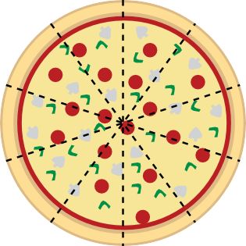
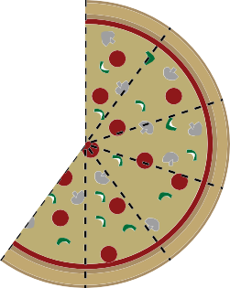
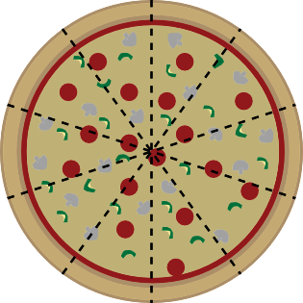
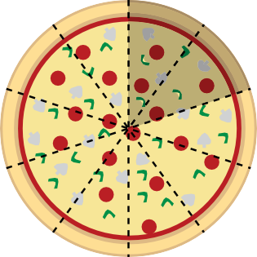
Te tūhono i te tau ā-ira ki te hautau Ko te mea nui kia mārama te ākonga he aha te mea tūtahi. He aha ai?
Mā te mōhio ki te rahi o te mea tūtahi, e whiriwhiria ai te rahi o te hautanga:
Ko te 0.6 o te parehe kotahi
He whero te 0.8 o ngā porotiti katoa.
Ko te 0.5 tēnei o ngā porotiti whero.
Ko te 0.6 o te ētahi parehe e rua

Slide 40
Te whakatauira i te hautau ā-ira
He raupapatanga pātai tēnei he arataki i te ākonga ki te tūhura i te hautanga ā-ira.

Slide 41
Te whakatauira i te hautau ā-ira
He raupapatanga pātai tēnei he arataki i te ākonga ki te tūhura i te hautanga ā-ira.
Tekau ngā wehenga o te poro tiakareti kotahi:

Slide 42
Te whakatauira i te hautau ā-ira
He raupapatanga pātai tēnei he arataki i te ākonga ki te tūhura i te hautanga ā-ira.
Tekau ngā wehenga o te poro tiakareti kotahi:
Whakaaturia te haurua o te poro tiakareti

Slide 43
Te whakatauira i te hautau ā-ira
He raupapatanga pātai tēnei he arataki i te ākonga ki te tūhura i te hautanga ā-ira.
Tekau ngā wehenga o te poro tiakareti kotahi:
Whakaaturia te haurua o te poro tiakareti
He aha te tohu hautau e hāngai ana?

Slide 44
Te whakatauira i te hautau ā-ira
He raupapatanga pātai tēnei he arataki i te ākonga ki te tūhura i te hautanga ā-ira.
Tekau ngā wehenga o te poro tiakareti kotahi:
Whakaaturia te haurua o te poro tiakareti
He aha te tohu hautau e hāngai ana?
Ko te ⁵ tētahi atu tohu hautau e hāngai ana.
10
Whakamāramatia mai.

Slide 45
Te whakatauira i te hautau ā-ira
He raupapatanga pātai tēnei he arataki i te ākonga ki te tūhura i te hautanga ā-ira.
Tekau ngā wehenga o te poro tiakareti kotahi:
Whakaaturia te haurua o te poro tiakareti
He aha te tohu hautau e hāngai ana?
Ko te ⁵ tētahi atu tonu hautau e hāngai ana.
10
Whakamāramatia mai.
Ko te 0.5 tētahi atu momo hautau mō tēnei haurua poro tiakareti. Whakamāramatia mai.

Slide 46
Te whakatauira i te hautau ā-ira
He raupapatanga pātai tēnei he arataki i te ākonga ki te tūhura i te hautanga ā-ira.
Tekau ngā wehenga o te poro tiakareti kotahi:
Whakaaturia te haurua o te poro tiakareti
He aha te tohu hautau e hāngai ana?
Ko te ⁵ tētahi atu tonu hautau e hāngai ana.
10
Whakamāramatia mai.
Ko te 0.5 tētahi atu momo hautau mō tēnei haurua poro tiakareti. Whakamāramatia mai.
Whakaaturia ēnei hautanga poro tiakareti:
3
10
0.7
6
10
02 1.1 2.4

Slide 47
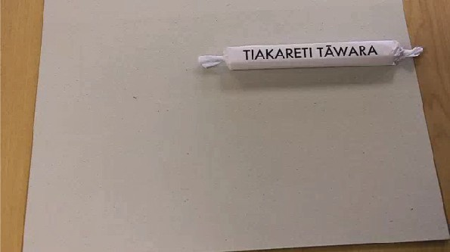

Te whakatauira i te hautau ā-ira
He raupapatanga pātai tēnei he arataki i te ākonga ki te tūhura i te hautanga ā-ira.
Tekau ngā wehenga o te poro tiakareti kotahi:
Whakaaturia te haurua o te poro tiakareti
He aha te tohu hautau e hāngai ana?
Ko te ⁵ tētahi atu tonu hautau e hāngai ana.
10
Whakamāramatia mai.
Ko te 0.5 tētahi atu momo hautau mō tēnei haurua poro tiakareti. Whakamāramatia mai.
Whakaaturia ēnei hautanga poro tiakareti:
3
10
0.7
6
10
02 1.1 2.4
Mātakihia māi tēnei raupapatanga whakamārama mō te hautanga ā-ira.

Slide 48
Te whakatauira i te hautau ā-ira
Hei mahi, hei whakaaroaro, hei wakawhitiwhiti korero:

Slide 49
Te whakatauira i te hautau ā-ira
Hei mahi, hei whakaaroaro, hei wakawhitiwhiti korero:
Tekau ngā wehenga o te poro tiakareti kotahi:

Slide 50
Te whakatauira i te hautau ā-ira
Hei mahi, hei whakaaroaro, hei wakawhitiwhiti korero:
Tekau ngā wehenga o te poro tiakareti kotahi:
He aha ngā hautanga ā-ira kei ia taha o te ¹ o te poro tiakareti?
4
He aha ngā hautanga ā-ira kei ia taha o te ³ o te poro tiakareti?
4

Slide 51
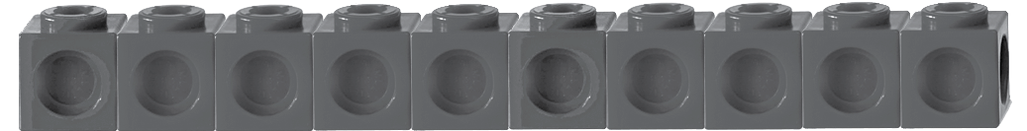
Te whakatauira i te hautau ā-ira
Hei mahi, hei whakaaroaro, hei wakawhitiwhiti korero:
Tekau ngā wehenga o te poro tiakareti kotahi:
He aha ngā hautanga ā-ira kei ia taha o te ¹ o te poro tiakareti?
He aha ngā hautanga ā-ira kei ia taha o te ³ o te poro tiakareti?
Tuhia he pikitia hei whakamārama.
4
4
0.2
0.3
0.7
0.8
0
0.25
0.5
0.75
1.0

Slide 52
Te whakatauira i te hautau ā-ira
Hei mahi, hei whakaaroaro, hei wakawhitiwhiti korero:
Tekau ngā wehenga o te poro tiakareti kotahi:
He aha ngā hautanga ā-ira kei ia taha o te ¹ o te poro tiakareti?
He aha ngā hautanga ā-ira kei ia taha o te ³ o te poro tiakareti?
Tuhia he pikitia hei whakamārama.
4
4
0.2
0.3
0.7
0.8
0 0.25 0.5 0.75 1.0
He aha te hautanga ā-ira e pātata ana ki te kotahi poro tiakareti?

Slide 53
Te whakatauira i te hautau ā-ira
Hei mahi, hei whakaaroaro, hei wakawhitiwhiti korero:
Tekau ngā wehenga o te poro tiakareti kotahi:
He aha ngā hautanga ā-ira kei ia taha o te ¹
He aha ngā hautanga ā-ira kei ia taha o te ³
Tuhia he pikitia hei whakamārama.
o te poro tiakareti?
o te poro tiakareti?
4
4
0.2
0.3
0.7
0.8
0 0.25 0.5 0.75 1.0
He aha te hautanga ā-ira e pātata ana ki te kotahi poro tiakareti?
He aha te hautanga ā-ira e pātata ana ki te kore?

Slide 54
Te whakatau tata i te tau ā-ira
Tuhia he rārangi huapae ki te pepa (kei a koe te whiriwhiri i te roa o te rārangi, engari kaua e inea).
Whakatau tata i te 0.4 o te rārangi mai i tōna pito mauī, ka tuhi ai i tētahi rīpeka whero. Whakamāramatia mai tō whakatau tata i te 0.4.

Slide 55
Te whakatau tata i te tau ā-ira
Tuhia he rārangi huapae ki te pepa (kei a koe te whiriwhiri i te roa o te rārangi, engari kaua e inea).
Whakatau tata i te 0.4 o te rārangi mai i tōna pito mauī, ka tuhi ai i tētahi rīpeka whero. Whakamāramatia mai tō whakatau tata i te 0.4.
He iti ake i te 0.5, engari e pātata ana.
0.5 (¹ )
2
× ×
0.4 (whakatau tata)

Slide 56
Te whakatau tata i te tau ā-ira
Tuhia he rārangi huapae ki te pepa (kei a koe te whiriwhiri i te roa o te rārangi, engari kaua e inea).
Whakatau tata i te 0.4 o te rārangi mai i tōna pito mauī, ka tuhi ai i tētahi rīpeka whero. Whakamāramatia mai tō whakatau tata i te 0.4.
He iti ake i te 0.5, engari e pātata ana.
0.5 (¹ )
2
× ×
0.4 (whakatau tata)
Whakatau tata i te 0.6 o te rārangi mai i tōna pito mauī, ka tuhi ai i tētahi rīpeka kōwhai. Whakamāramatia mai.

Slide 57
Te whakatau tata i te tau ā-ira
Tuhia he rārangi huapae ki te pepa (kei a koe te whiriwhiri i te roa o te rārangi, engari kaua e inea).
Whakatau tata i te 0.4 o te rārangi mai i tōna pito mauī, ka tuhi ai i tētahi rīpeka whero. Whakamāramatia mai tō whakatau tata i te 0.4.
He iti ake i te 0.5, engari e pātata ana.
0.5 (¹ )
2
× ×
0.4 (whakatau tata)
Whakatau tata i te 0.6 o te rārangi mai i tōna pito mauī, ka tuhi ai i tētahi rīpeka kōwhai. Whakamāramatia mai.
He nui ake i te 0.5, engari e pātata ana.
0.5 (¹ )
2
× ×
0.6 (whakatau tata)

Slide 58
Te whakatau tata i te tau ā-ira
Tuhia he rārangi huapae ki te pepa (kei a koe te whiriwhiri i te roa o te rārangi, engari kaua e inea).
Whakatau tata i te 0.8 o te rārangi mai i tōna pito mauī, ka tuhi ai i tētahi rīpeka kahurangi. Whakamāramatia mai.

Slide 59
Te whakatau tata i te tau ā-ira
Tuhia he rārangi huapae ki te pepa (kei a koe te whiriwhiri i te roa o te rārangi, engari kaua e inea).
Whakatau tata i te 0.8 o te rārangi mai i tōna pito mauī, ka tuhi ai i tētahi rīpeka kahurangi. Whakamāramatia mai.
He paku nui ake i te 0.75, arā, te toru hauwhā.
0.5 (¹ ) 0.75 (³ )
2 4
× ×
0.8 (whakatau tata)

Slide 60
Te whakatau tata i te tau ā-ira
Tuhia he rārangi huapae ki te pepa (kei a koe te whiriwhiri i te roa o te rārangi, engari kaua e inea).
Whakatau tata i te 0.8 o te rārangi mai i tōna pito mauī, ka tuhi ai i tētahi rīpeka kahurangi. Whakamāramatia mai.
He paku nui ake i te 0.75, arā, te toru hauwhā.
0.5 (¹ ) 0.75 (³ )
2 4
× ×
0.8 (whakatau tata)
Tuhia he rārangi huapae ki raro iho, kia 1.5 te roa ake i te roa o te rārangi tuatahi. Whakamāramatia mai.

Slide 61
Te whakatau tata i te tau ā-ira
Tuhia he rārangi huapae ki te pepa (kei a koe te whiriwhiri i te roa o te rārangi, engari kaua e inea).
Whakatau tata i te 0.8 o te rārangi mai i tōna pito mauī, ka tuhi ai i tētahi rīpeka kahurangi. Whakamāramatia mai.
He paku nui ake i te 0.75, arā, te toru hauwhā.
0.5 (¹ ) 0.75 (³ )
2 4
× ×
0.8 (whakatau tata)
Tuhia he rārangi huapae ki raro iho, kia 1.5 te roa ake i te roa o te rārangi tuatahi. Whakamāramatia mai.
Tāpiria te haurua o te rārangi ki te katoa rārangi.

Slide 62
Te whakatau tata i te tau ā-ira
Tuhia he rārangi huapae ki te pepa (kei a koe te whiriwhiri i te roa o te rārangi, engari kaua e inea).
Whakatau tata i te 0.8 o te rārangi mai i tōna pito mauī, ka tuhi ai i tētahi rīpeka kahurangi. Whakamāramatia mai.
He paku nui ake i te 0.75, arā, te toru hauwhā.
0.5 (¹ ) 0.75 (³ )
2 4
× ×
0.8 (whakatau tata)
Tuhia he rārangi huapae ki raro iho, kia 1.5 te roa ake i te roa o te rārangi tuatahi. Whakamāramatia mai.
Tāpiria te haurua o te rārangi ki te katoa rārangi.
Hei whakaaroaro:
He aha te hua o tēnei mahi te whakatau tata i te rahi o tētahi hautanga ā-ira?

Slide 63
Te whakatauira i te tau ā-ira
He tauira anō tēnei o tētahi mahi whakatau tata i te hautanga ā-ira o tētahi roa:

Slide 64
Te whakatauira i te tau ā-ira
He tauira anō tēnei o tētahi mahi whakatau tata i te hautanga ā-ira o tētahi roa:
Tirohia te mahere o Te Ika a Māui
He aha tētahi tāone kei te takiwā o te 0.2 o te haerenga mai i Papaioea ki Ahuriri. Whakamāramatia mai.

Slide 65
Te whakatauira i te tau ā-ira
He tauira anō tēnei o tētahi mahi whakatau tata i te hautanga ā-ira o tētahi roa:
A
E
H
I
K
M
N
Ng
O
P
R
Tirohia te mahere o Te Ika a Māui
1
raki
2
He aha tētahi tāone kei te takiwā o te 0.2 o te haerenga mai i Papaioea ki Ahuriri. Whakamāramatia mai.
E taraiwa ana koe mai i Tāmakimakaurau
ki Te Whanganui-a-Tara. Ina tau atu koe ki 10 Kirikiriroa, he aha te hautanga ā-ira o te haerenga kua oti? Whakamāramatia mai.
uru
rāwhiti
3
Ke
rikeri
Kaitāia
Paihia
Wha
āwha
tonga
ta: 1cm
= 100k
m
4
ngārei
5
Darga
ville
6
Tā
makim
akaur
au
P
T
7
aeroa
hames
Taur
anga
Ōto
Kirikirir
rohang
oa a
T
Rot
e Puke
orua
Ōpōtiki
8
9
Ngā
motu
Tokoroa
Tau
pō
Tūr
anganui
-a-Kiwa
Hāwera
T
Wa
ūrangi iouru
Ahuri
ri
11
Wha
nganui
Papai
Parapar
aumu
oea
Woodville
12
Te Oreore
13
T
e Wh
angan
ui-a-T
ara
14

Slide 66
Te whakatauira i te tau ā-ira
Kua oti tētahi raupapatanga whakaako i te hautanga ā-ira o tētahi roa (kia 1 te mati ā-ira).

Slide 67
Te whakatauira i te tau ā-ira
Kua oti tētahi raupapatanga whakaako i te hautanga ā-ira o tētahi roa (kia 1 te mati ā-ira).
Hei whakaaroaro:
He aha ngā hīkoi matua?

Slide 68
He raupapatanga whakaako mō te tau ā-ira
1. Te whakamahi rauemi hei tūhono ki te hautau noa (he mātauranga e
mōhiotia ana – arā te mea tūtahi.
1 5
2 10
= = 0.5). Ko te mea nui kia mārama he aha

Slide 69
He raupapatanga whakaako mō te tau ā-ira
1. Te whakamahi rauemi hei tūhono ki te hautau noa (he mātauranga e
mohiotia ana – arā te mea tūtahi.
1 5
2 10
= = 0.5). Ko te mea nui kia mārama he aha
2. Te whakawhānui, mai i te 0.5 ki ētahi atu hautanga ā-ira (1 te mati-ā-ira), me te waiho mā te ākonga tonu e hanga tōna ake māramatanga.

Slide 70
He raupapatanga whakaako mō te tau ā-ira
1. Te whakamahi rauemi hei tūhono ki te hautau noa (he mātauranga e
mohiotia ana – arā te mea tūtahi.
1 5
2 10
= = 0.5). Ko te mea nui kia mārama he aha
2. Te whakawhānui, mai i te 0.5 ki ētahi atu hautanga ā-ira (1 te mati-ā-ira), me te waiho mā te ākonga tonu e hanga tōna ake māramatanga.
3. Te tūhono i te hautanga ā-ira ki te
1
4
me te
3
4

Slide 71
He raupapatanga whakaako mō te tau ā-ira
1. Te whakamahi rauemi hei tūhono ki te hautau noa (he mātauranga e
mohiotia ana – arā te mea tūtahi.
1 5
2 10
= = 0.5). Ko te mea nui kia mārama he aha
2. Te whakawhānui, mai i te 0.5 ki ētahi atu hautanga ā-ira (1 te mati-ā-ira), me te waiho mā te ākonga tonu e hanga tōna ake māramatanga.
Te tūhono i te hautanga ā-ira ki te
Te whakawhānui ake ki te tau ā-ira he nui ake i te 1.
1
4
me te
3
4

Slide 72
He raupapatanga whakaako mō te tau ā-ira
1. Te whakamahi rauemi hei tūhono ki te hautau noa (he mātauranga e
mohiotia ana – arā te mea tūtahi.
1 5
2 10
= = 0.5). Ko te mea nui kia mārama he aha
2. Te whakawhānui, mai i te 0.5 ki ētahi atu hautanga ā-ira (1 te mati-ā-ira), me te waiho mā te ākonga tonu e hanga tōna ake māramatanga.
Te tūhono i te hautanga ā-ira ki te
Te whakawhānui ake ki te tau ā-ira he nui ake i te 1.
Te whakawhānui ake ki ētahi atu whakaahuahanga (he rārangi, he tawhiti i te mahere)
1
4
me te
3
4

Slide 73
He raupapatanga whakaako mō te tau ā-ira
1. Te whakamahi rauemi hei tūhono ki te hautau noa (he mātauranga e
mohiotia ana – arā te mea tūtahi.
1 5
2 10
= = 0.5). Ko te mea nui kia mārama he aha
2. Te whakawhānui, mai i te 0.5 ki ētahi atu hautanga ā-ira (1 te mati-ā-ira), me te waiho mā te ākonga tonu e hanga tōna ake māramatanga.
Te tūhono i te hautanga ā-ira ki te
Te whakawhānui ake ki te tau ā-ira he nui ake i te 1.
Te whakawhānui ake ki ētahi atu whakaahuahanga (he rārangi, he tawhiti i te mahere)
Te whakatau tata i te hautanga ā-ira.
1
4
me te
3
4

Slide 74
Te whakaako i te hautau ā-ira
Hei mahi:
Me mahi tahi kōrua ko tētahi hoa:

Slide 75
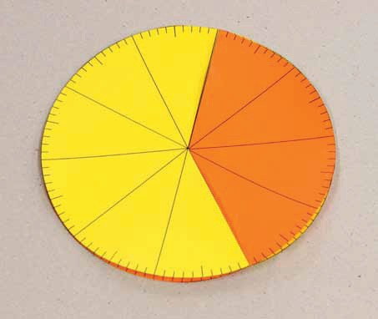
Te whakaako i te hautau ā-ira
Hei mahi:
Me mahi tahi kōrua ko tētahi hoa:
Tūhurangia ētahi rauemi hei whakaako i ngā hautanga ā-ira e whai wāhi mai ana te haurau (kia 2 ngā mati-ā-ira).
Hei tauira:
1. Te porowhita whakaatu haurau
Te rauemi tārua 7-6 o Te Poutama Tau (http://www.nzmaths.co.nz)

Slide 76
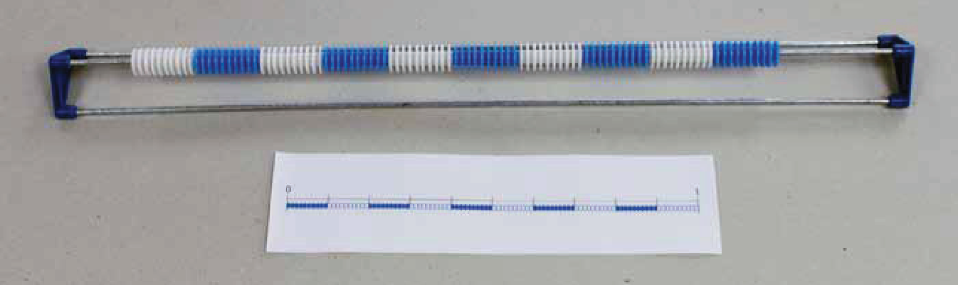
Te whakaako i te hautau ā-ira
Hei mahi:
Me mahi tahi kōrua ko tētahi hoa:
Tūhurangia ētahi rauemi hei whakaako i ngā hautanga ā-ira e whai wāhi mai ana te haurau (kia 2 ngā mati-ā-ira). Hei tauira:
2. Te rārangi haurau
Te rauemi tārua 7-4 o Te Poutama Tau (http://www.nzmaths.co.nz)

Slide 77
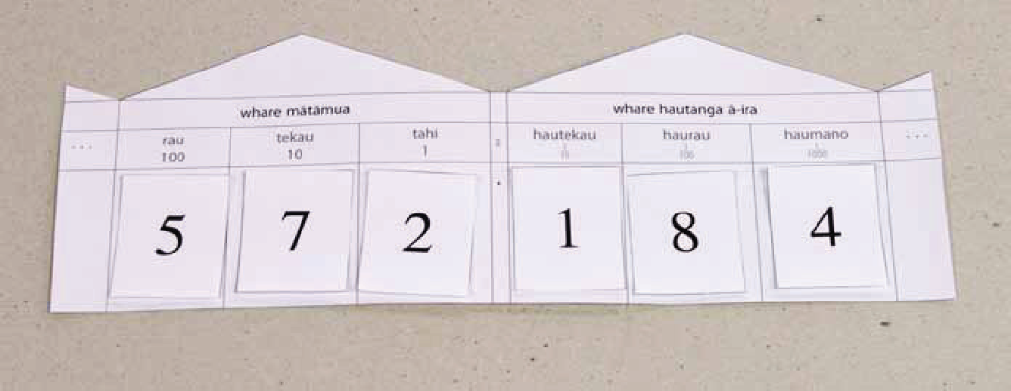
Te whakaako i te hautau ā-ira
Hei mahi:
Me mahi tahi kōrua ko tētahi hoa:
Tūhurangia ētahi rauemi hei whakaako i ngā hautanga ā-ira e whai wāhi mai ana te haurau (kia 2 ngā mati-ā-ira). Hei tauira:
3. Te whare uara tū

Slide 78
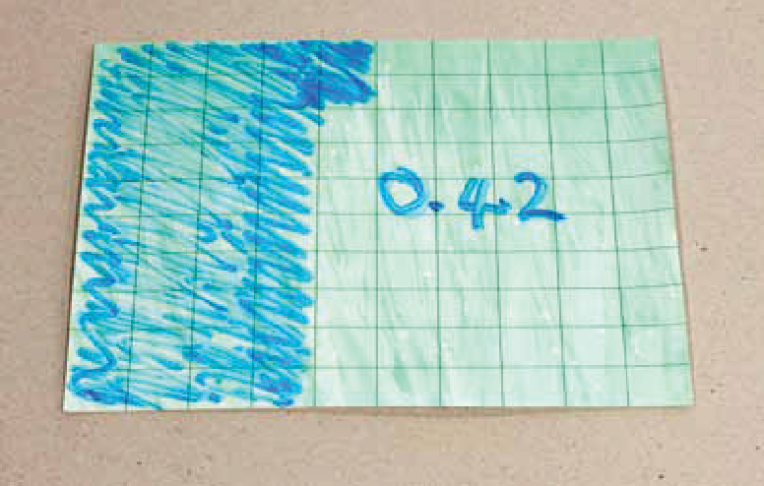
Te whakaako i te hautau ā-ira
Hei mahi:
Me mahi tahi kōrua ko tētahi hoa:
Tūhurangia ētahi rauemi hei whakaako i ngā hautanga ā-ira e whai wāhi mai ana te haurau (kia 2 ngā mati-ā-ira). Hei tauira:
4. Te papa hautanga ā-ira
Te rauemi tārua 7-3 o Te Poutama Tau (http://www.nzmaths.co.nz)

Slide 79
Te tāpiri me te tango hautau ā-ira
E hāngai tonu ana ngā rautaki mō te tāpiri me te tango tauoti ki te tāpiri me te tango hautanga ā-ira.

Slide 80
Te tāpiri me te tango hautau ā-ira
E hāngai tonu ana ngā rautaki mō te tāpiri me te tango tauoti ki te tāpiri me te tango hautanga ā-ira.
Te tatau ake i te tau nui. Hei tauira: 0.4 + 0.7
0
.1
.2
.3
.4
.5
.6
.7
.8
.9
1.0
1.1
1.2
1.3
1.4
1.5

Slide 81
Te tāpiri me te tango hautau ā-ira
E hāngai tonu ana ngā rautaki mō te tāpiri me te tango tauoti ki te tāpiri me te tango hautanga ā-ira.

Slide 82



Te tāpiri me te tango hautau ā-ira
E hāngai tonu ana ngā rautaki mō te tāpiri me te tango tauoti ki te tāpiri me te tango hautanga ā-ira.
Te meka mōhio me te tikanga paremata, Hei tauira: 2.6 + 2.7 = 2.5 + 2.5 + 0.1 + 0.2
= 5.0 + 0.3
= 5.3
+2.5 +2.5
+.1 +.2
0
2.5
5.0 5.3
5.1

Slide 83
Te tāpiri me te tango hautau ā-ira
E hāngai tonu ana ngā rautaki mō te tāpiri me te tango tauoti ki te tāpiri me te tango hautanga ā-ira.

Slide 84
Te tāpiri me te tango hautau ā-ira
E hāngai tonu ana ngā rautaki mō te tāpiri me te tango tauoti ki te tāpiri me te tango hautanga ā-ira.
Te tau māmā me te tikanga paremata, Hei tauira: 0.54 – 0.27 = 0.54 – 0.3 + 0.03
= 0.24 + 0.03
= 0.27
–0.3
+0.03
0.24 0.27
5.0

Slide 85
Te tāpiri me te tango hautau ā-ira
Whakaarohia tētahi tauira o te rautaki ‘wāwāhi uara tū’ hei tāpiri i ētahi tau ā-ira.

Slide 86




Te tāpiri me te tango hautau ā-ira
Whakaarohia tētahi tauira o te rautaki ‘wāwāhi uara tū’ hei tāpiri i ētahi tau ā-ira.
Hei tauira:
0.54 + 0.27 = 0.5 + 0.2 + 0.04 + 0.07
= 0.7 + 0.1
= 0.81
+0.5
+0.2
+0.04+0.07
0
0.5
0.7 0.74 0.81

Slide 87
Te tāpiri me te tango hautau ā-ira
Hei mahi:
Whakaarohia tētahi tauira o te rautaki ‘tapiritanga ōrite’ hei tango i ētahi tau ā-ira.

Slide 88


Te tāpiri me te tango hautau ā-ira
Hei mahi:
Whakaarohia tētahi tauira o te rautaki ‘tapiritanga ōrite’ hei tango i ētahi tau ā-ira.
Hei tauira:
6.3 – 3.8 = 6.5 – 4.0
= 2.5
+0.2
–4.0
–3.8
6.3 6.5
+0.2

Slide 89
Te tāpiri me te tango hautau ā-ira
Hei mahi:
Whakaarohia tētahi tauira o te rautaki ‘paheko kōaro’ hei tango i ētahi tau ā-ira.

Slide 90


Te tāpiri me te tango hautau ā-ira
Hei mahi:
Whakaarohia tētahi tauira o te rautaki ‘paheko kōaro’ hei tango i ētahi tau ā-ira.
Hei tauira:
6.3 – 3.8 ‹ 3.8 + ܅ = 6.3
3.8 + 0.2 + 2.3 = 6.3
3.8 + 2.5 = 6.3
Nō reira 6.3 – 3.8 = 2.5
+2.3
+0.2
3.8
4.0
6.3

Slide 91
Te tāpiri me te tango hautau ā-ira
Whakaaturia ngā whakareatanga nei ki tētahi rauemi uara tū ā-ira:
0.4 × 3 0.6 × 4 0.3 × 7 0.5 × 1.2

Slide 92
Te tāpiri me te tango hautau ā-ira
Whakaaturia ngā whakareatanga nei ki tētahi rauemi uara tū ā-ira:
0.4 × 3 0.6 × 4 0.3 × 7 0.5 × 1.2
Hei whakaaroaro:
Me pēhea te tūhono i ngā whakareatanga ki ngā meka matua?

Slide 93
Te tāpiri me te tango hautau ā-ira
Whakaaturia ngā whakareatanga nei ki tētahi rauemi uara tū ā-ira:
0.4 × 3 0.6 × 4 0.3 × 7 0.5 × 1.2
Hei whakaaroaro:
Me pēhea te tūhono i ngā whakareatanga ki ngā meka matua?
Ko te mahi matua, ko te whakamahi i te aroā hautanga ā-ira hei whakatau tata. Hei tauira:
0.4 × 3 (e pātata ana ki te 0.5 × 3, engari he paku iti ake)

Slide 94
Hei whakamutunga:
He ngohe kotuitui e whai wāhi mai ana te hautau ā-ira

Slide 95
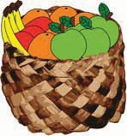
Hei whakamutunga:
He ngohe kotuitui e whai wāhi mai ana te hautau ā-ira
He panana, he ārani, he netarini, he āporo kei roto i te rourou.
0.25 o ngā huarākau he panana.
0.15 he ārani
0.2 he netarini.
E 8 ngā āporo.

Slide 96
Hei whakamutunga:
He ngohe kotuitui e whai wāhi mai ana te hautau ā-ira
He panana, he ārani, he netarini, he āporo kei roto i te rourou.
0.25 o ngā huarākau he panana.
0.15 he ārani
0.2 he netarini.
E 8 ngā āporo.
He aha te hautanga ā-ira o ngā āporo?
E hia ngā panana?
E hia ngā ārani?
E hia ngā netarini?
E 4 ngā panana, kotahi te netarini, e 5 ngā āporo ka kainga e ngā tamariki. He aha te hautanga ā-ira o ngā āporo o roto i ngā huarākau e toe mai ana?

Slide 97
Hei whakamutunga:
He ngohe kotuitui e whai wāhi mai ana te hautau ā-ira
He panana, he ārani, he netarini, he āporo kei roto i te rourou.
0.25 o ngā huarākau he panana.
0.15 he ārani
0.2 he netarini.
E 8 ngā āporo.
1. He aha te hautanga ā-ira o ngā āporo?
Tauira whakautu:

Slide 98
Hei whakamutunga:
He ngohe kotuitui e whai wāhi mai ana te hautau ā-ira
He panana, he ārani, he netarini, he āporo kei roto i te rourou.
0.25 o ngā huarākau he panana.
0.15 he ārani
0.2 he netarini.
E 8 ngā āporo.
1. He aha te hautanga ā-ira o ngā āporo?
Tauira whakautu:
Hui katoa ngā panana, ngā netarini me ngā āporo:
0.25 + 0.15 + 0.2 = 0.6 o ngā huarākau. Nō reira ko te 0.4 te hautanga o ngā āporo.

Slide 99
Hei whakamutunga:
He ngohe kotuitui e whai wāhi mai ana te hautau ā-ira
He panana, he ārani, he netarini, he āporo kei roto i te rourou.
0.25 o ngā huarākau he panana.
0.15 he ārani
0.2 he netarini.
E 8 ngā āporo.
2. E hia ngā panana?
Tauira whakautu:

Slide 100
Hei whakamutunga:
He ngohe kotuitui e whai wāhi mai ana te hautau ā-ira
He panana, he ārani, he netarini, he āporo kei roto i te rourou.
0.25 o ngā huarākau he panana.
0.15 he ārani
0.2 he netarini.
E 8 ngā āporo.
2. E hia ngā panana?
Tauira whakautu:
E 8 ngā āporo, he rite terā ki te 0.4. Ko te 0.25 o te 20 = 5 (ngā panana)
hautanga | huarākau
0.4 | 8
0.1 | 2
1.0 | 20

Slide 101
Hei whakamutunga:
He ngohe kotuitui e whai wāhi mai ana te hautau ā-ira
He panana, he ārani, he netarini, he āporo kei roto i te rourou.
0.25 o ngā huarākau he panana.
0.15 he ārani
0.2 he netarini.
E 8 ngā āporo.
3. E hia ngā ārani?
Tauira whakautu:

Slide 102
Hei whakamutunga:
He ngohe kotuitui e whai wāhi mai ana te hautau ā-ira
He panana, he ārani, he netarini, he āporo kei roto i te rourou.
0.25 o ngā huarākau he panana.
0.15 he ārani
0.2 he netarini.
E 8 ngā āporo.
3. E hia ngā ārani?
Tauira whakautu:
He ārani te 0.15 o ngā huarākau katoa:
0.1 o te 20 = 2
Nō reira 0.05 o te 20 = 1
Hui katoa, 0.15 o te 20 = 3 Nō reira e 3 ngā ārani.

Slide 103
Hei whakamutunga:
He ngohe kotuitui e whai wāhi mai ana te hautau ā-ira
He panana, he ārani, he netarini, he āporo kei roto i te rourou.
0.25 o ngā huarākau he panana.
0.15 he ārani
0.2 he netarini.
E 8 ngā āporo.
4. E hia ngā netarini?
Tauira whakautu:

Slide 104
Hei whakamutunga:
He ngohe kotuitui e whai wāhi mai ana te hautau ā-ira
He panana, he ārani, he netarini, he āporo kei roto i te rourou.
0.25 o ngā huarākau he panana.
0.15 he ārani
0.2 he netarini.
E 8 ngā āporo.
4. E hia ngā netarini?
Tauira whakautu:
He netarini te 0.2 o ngā huarākau katoa:
0.1 o te 20 = 2
Nō reira 0.2 o te 20 = 4 Nō reira e 4 ngā ārani.

Slide 105
Hei whakamutunga:
He ngohe kotuitui e whai wāhi mai ana te hautau ā-ira
5. E 4 ngā panana, kotahi te netarini, e 5 ngā āporo ka kainga e ngā tamariki. He aha te hautanga ā-ira o ngā āporo o roto i ngā huarākau e toe mai ana?
Tauira whakautu:

Slide 106
Hei whakamutunga:
He ngohe kotuitui e whai wāhi mai ana te hautau ā-ira
5. E 4 ngā panana, kotahi te netarini, e 5 ngā āporo ka kainga e ngā tamariki. He aha te hautanga ā-ira o ngā āporo o roto i ngā huarākau e toe mai ana?
Tauira whakautu:
 | panana | ārani | netarini | āporo
timatanga | 5 | 3 | 4 | 8
i muri | 1 | 3 | 3 | 3
Nō reira 10 katoa ngā huarākau e toe ana. E 3 o ēnei he āporo.
He ōrite te 3 o roto i te 10 ki te 0.3. He āporo te 0.3 o ngā huarākau e toe ana.

