Slide 1
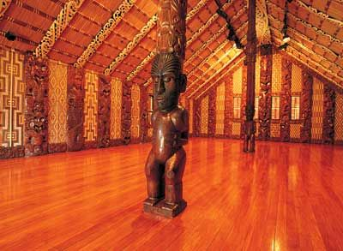
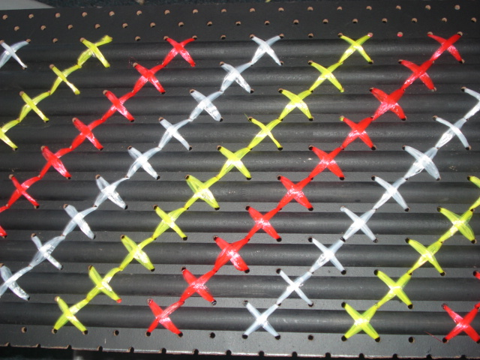
Tukutuku patterns
Tukutuku patterns decorate the inside of wharenui.
How do you think the patterns are made?

Slide 2
Watch how the crosses of the tapatoru pattern are built up layer by layer.
What do you notice?

Slide 3
How many crosses are in all of this tapatoru layer?
How did you count the crosses?

Slide 4
This tapatoru layer has nine across the base? How many crosses are in the whole layer?
Did the counting method you used for the smaller tapatoru layer also work on this one?

Slide 5
Click to see how Kiri counts the crosses on the six across tapatoru layer. What equation would Kiri write down to find the total?
How would she work out the number of crosses for the nine across tapatoru layer?

Slide 6
Click to see how Sione counts the crosses.
What equation would Sione write down to find the total number of crosses?
How would he work out the number of crosses for the nine across tapatoru layer?

Slide 7
Click to see how Taylor count the number of crosses.
What equation would Taylor write down to find the total?
How would she work out the number of crosses for the nine across tapatoru layer?

Slide 8
Imagine the tapatoru pattern kept growing for a while?
How many crosses might be along the base?
How many crosses would there be in total?
Imagine the tapatoru pattern keeps growing for a while.
A new large layer of crosses is added.
How many crosses are in that layer?

Slide 9
Watch how the pātiki (flounder) pattern is built up.
What do you notice about the layers of crosses?

Slide 10
What is a quick way to count the number of crosses on this layer?
How many crosses will make up the next layer?

Slide 11
Imagine the pātiki pattern keeps growing for a while. A square layer of red crosses is added. How many crosses are in the layer?

Slide 12
Find an efficient way to count all the crosses in the tapatoru and in the pātiki pattern.

