Slide 1
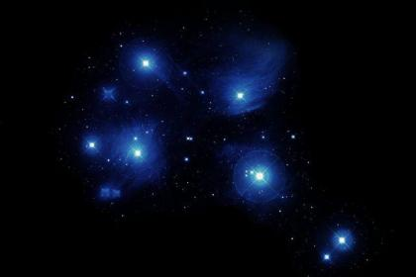
Waipuna-ā-rangi
Uru-ā-rangi
Hiwaiterangi
Waitā
Waitī
Matariki
Pohutukawa
Tupu-ā-rangi
Tupu-ā-nuku

Slide 2
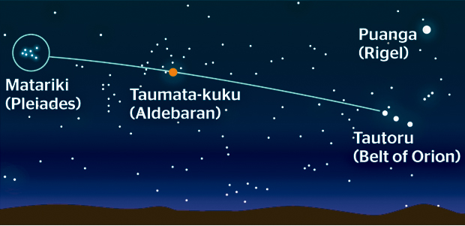
North-East
East
Matariki rises just before dawn . You can find the star cluster in this way.
Look for Puanga (Rigel) or Tautora (Orion’s belt) in the Eastern sky. Look to the left (heading North-East) to find a bright orange star called Taumata-kuku (Aldebaran) and continue left to find Matariki. In the first half of June you might see Mercury looking like a star in this area of the sky as well.

Slide 3
Long ago the night sky was as black as coal. It was so dark that people could not move around. Only taniwha could see in the dark and feasted on any creature they found. In the daytime the taniwha returned to the bottom of lakes and rivers to rest.

Slide 4
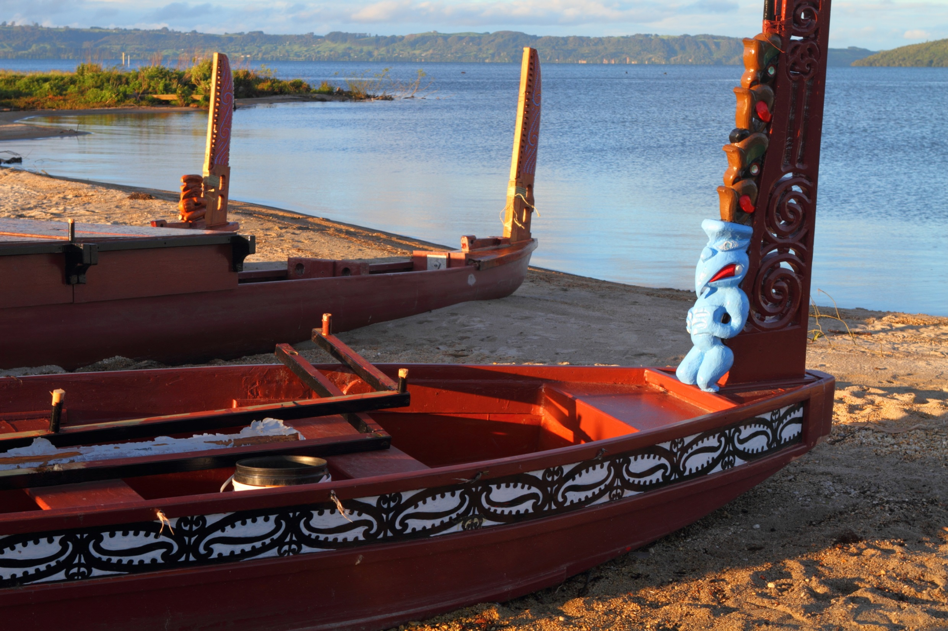
A great warrior named Tamarereti lived on the Southern shores of Lake Taupo. One day he set off in his waka to fish. The day was beautiful and Tamarereti caught three sizeable ika. Feeling a bit sleepy he lay down for a nap. When he awoke he realised that the wind had blown him to the Northern shore of the lake. It was getting dark and Tamarereti wanted to return home to his family. However he knew that the taniwha would eat him if he tried to cross Lake Taupo in the dark.

Slide 5
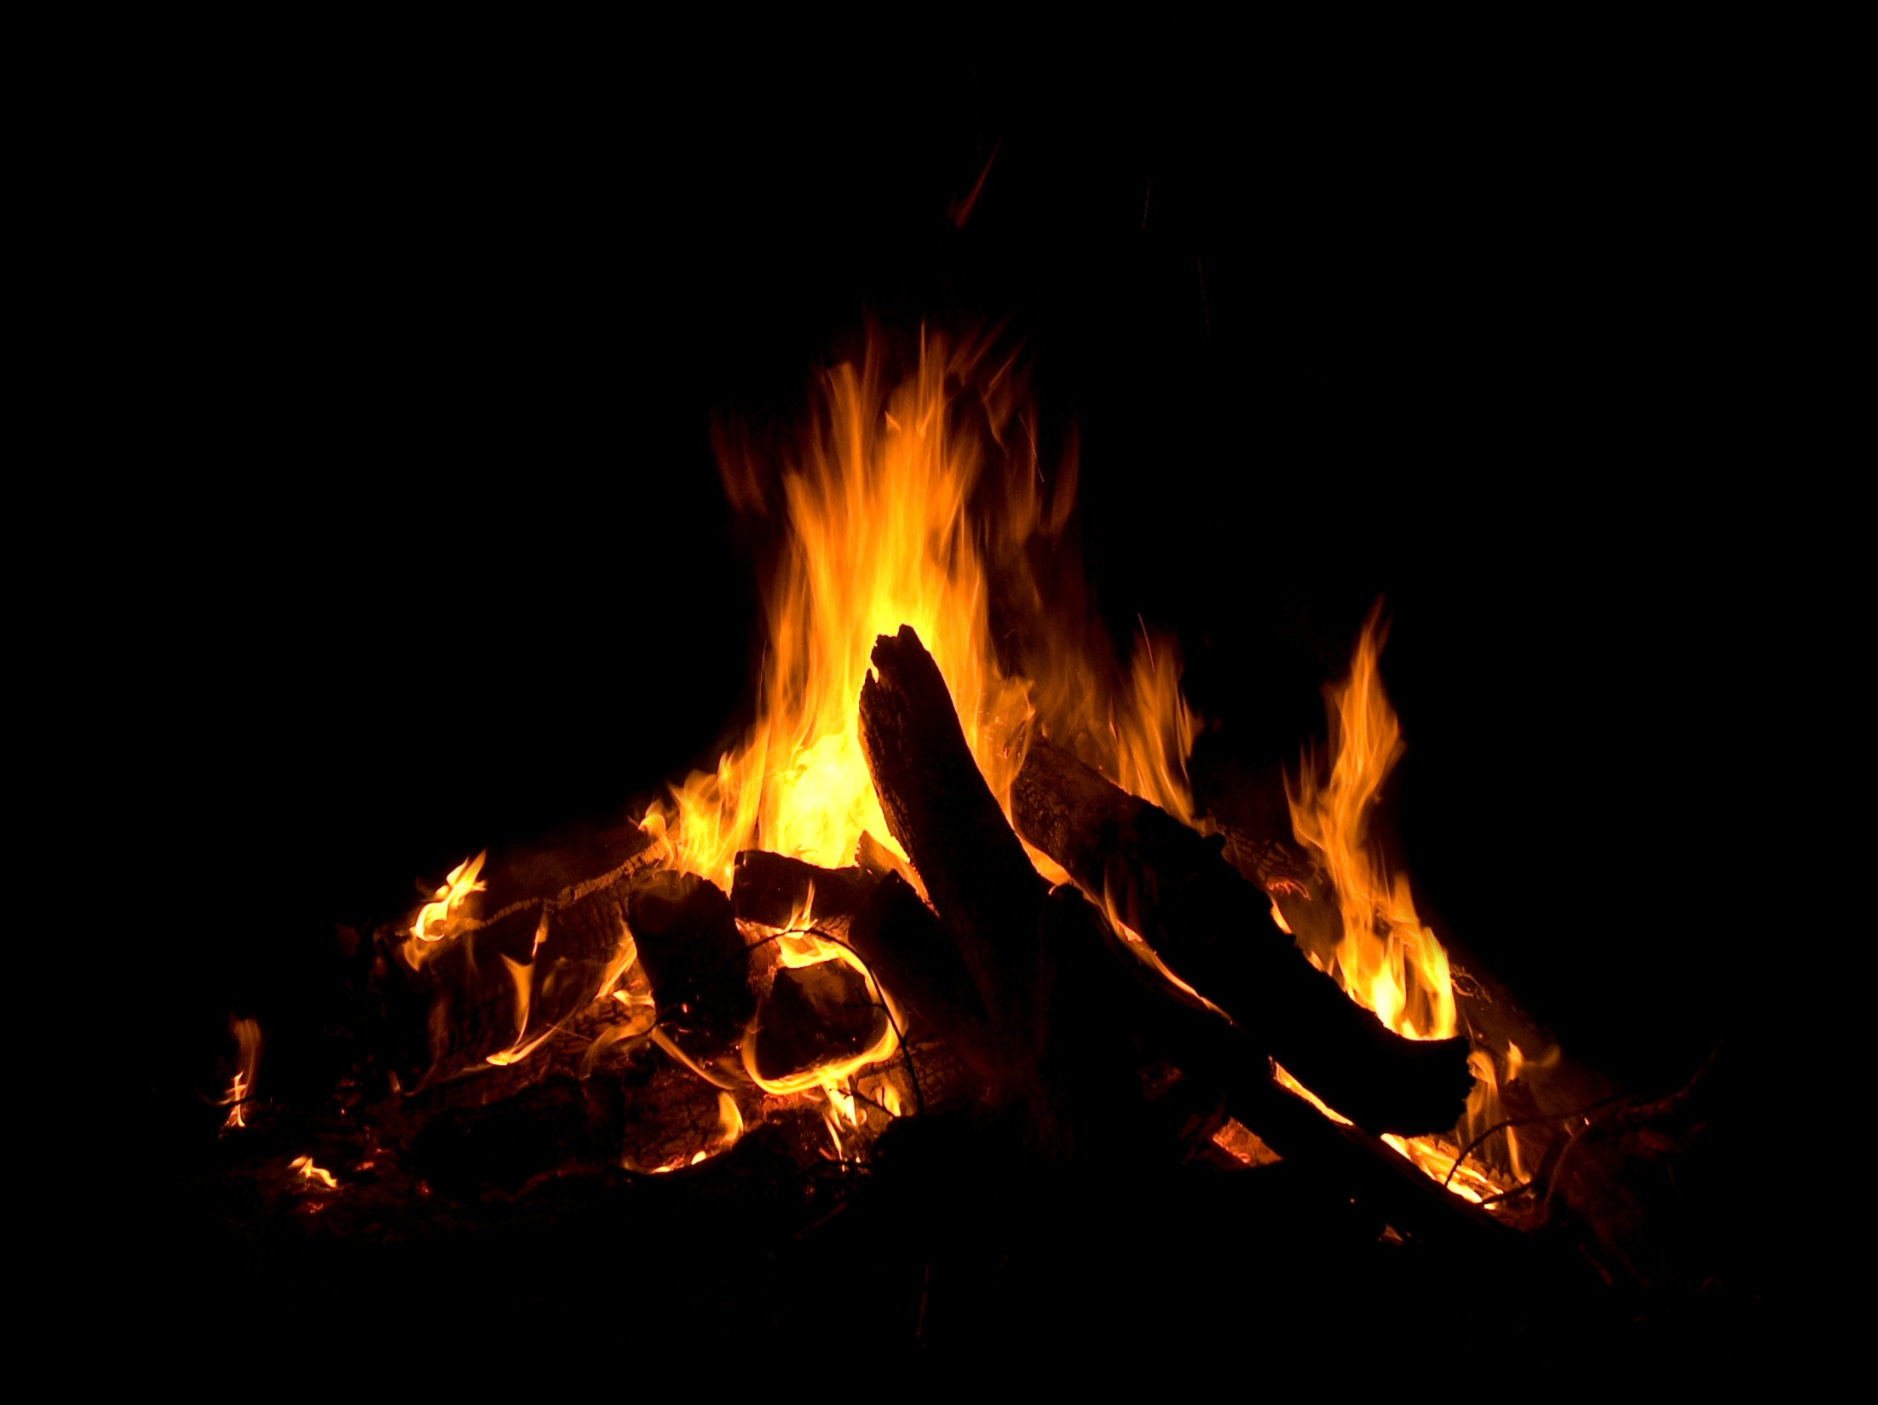
Tamarereti was hungry so he cooked his ika on an open fire while he thought about how he could get back home alive. As he ate the fish Tamrereti noticed that the stones from his fire were glowing brightly. So he gathered as many stones as he could and put them at the bottom of his waka. He set off on the arduous journey back to his village on the far side of the lake.

Slide 6
To light his way ,and to keep the Taniwha away, he threw handfuls of shining stones into the sky where they stuck as beautiful stars. Tamarereti was very careful to make his stones last. At dawn he finally reached his village. He was so exhausted he slept for a full day.

Slide 7
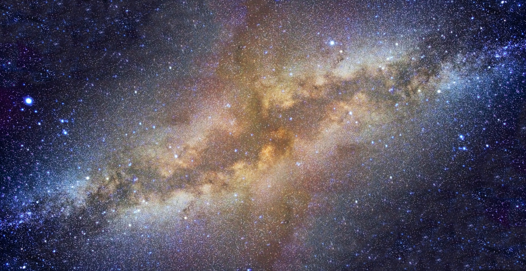
When he awoke Tamarereti found that Ranginui, the sky father, was waiting for him. Tamarereti was worried that Ranganui was hōhā at him for breaking the black sky. Instead the sky father was very pleased that people could now have stars to see by at night. He took Tamarereti’s waka and put it into the night sky so everyone would remember the brave story. You can see the waka now as The Milky Way.

Slide 8
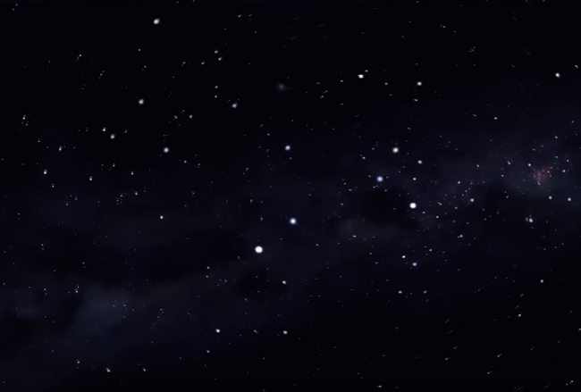
Te waka o Tamarereti
Southern Cross
Pointers
The Southern Cross appears on the New Zealand flag. It was used with the pointers to locate the position of South in the night sky.

Slide 9
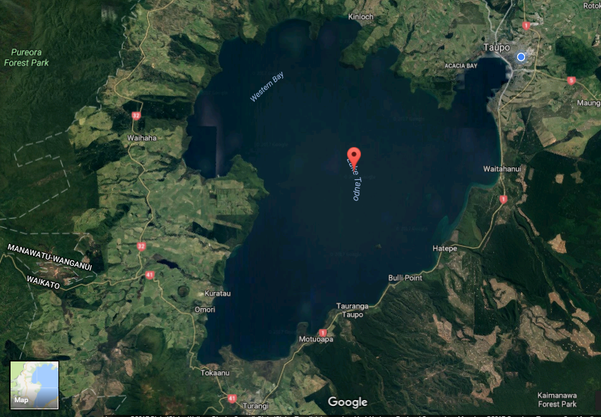
While he was asleep Tamarereti’s canoe drifts ashore. This is where he cooks and eats his fish.
This is where Tamarereti’s village is. No wonder he is exhausted when he gets home. That’s a journey of about 40 kilometres.
Where was Tamarereti’s village? Where did he cook his three fish?

Slide 10
200 – 19 = 181 stones left
181 – 15 = 166 stones left
Help Tamarereti keep track of how many stones he has left. Try not to use them up too fast.

Slide 11
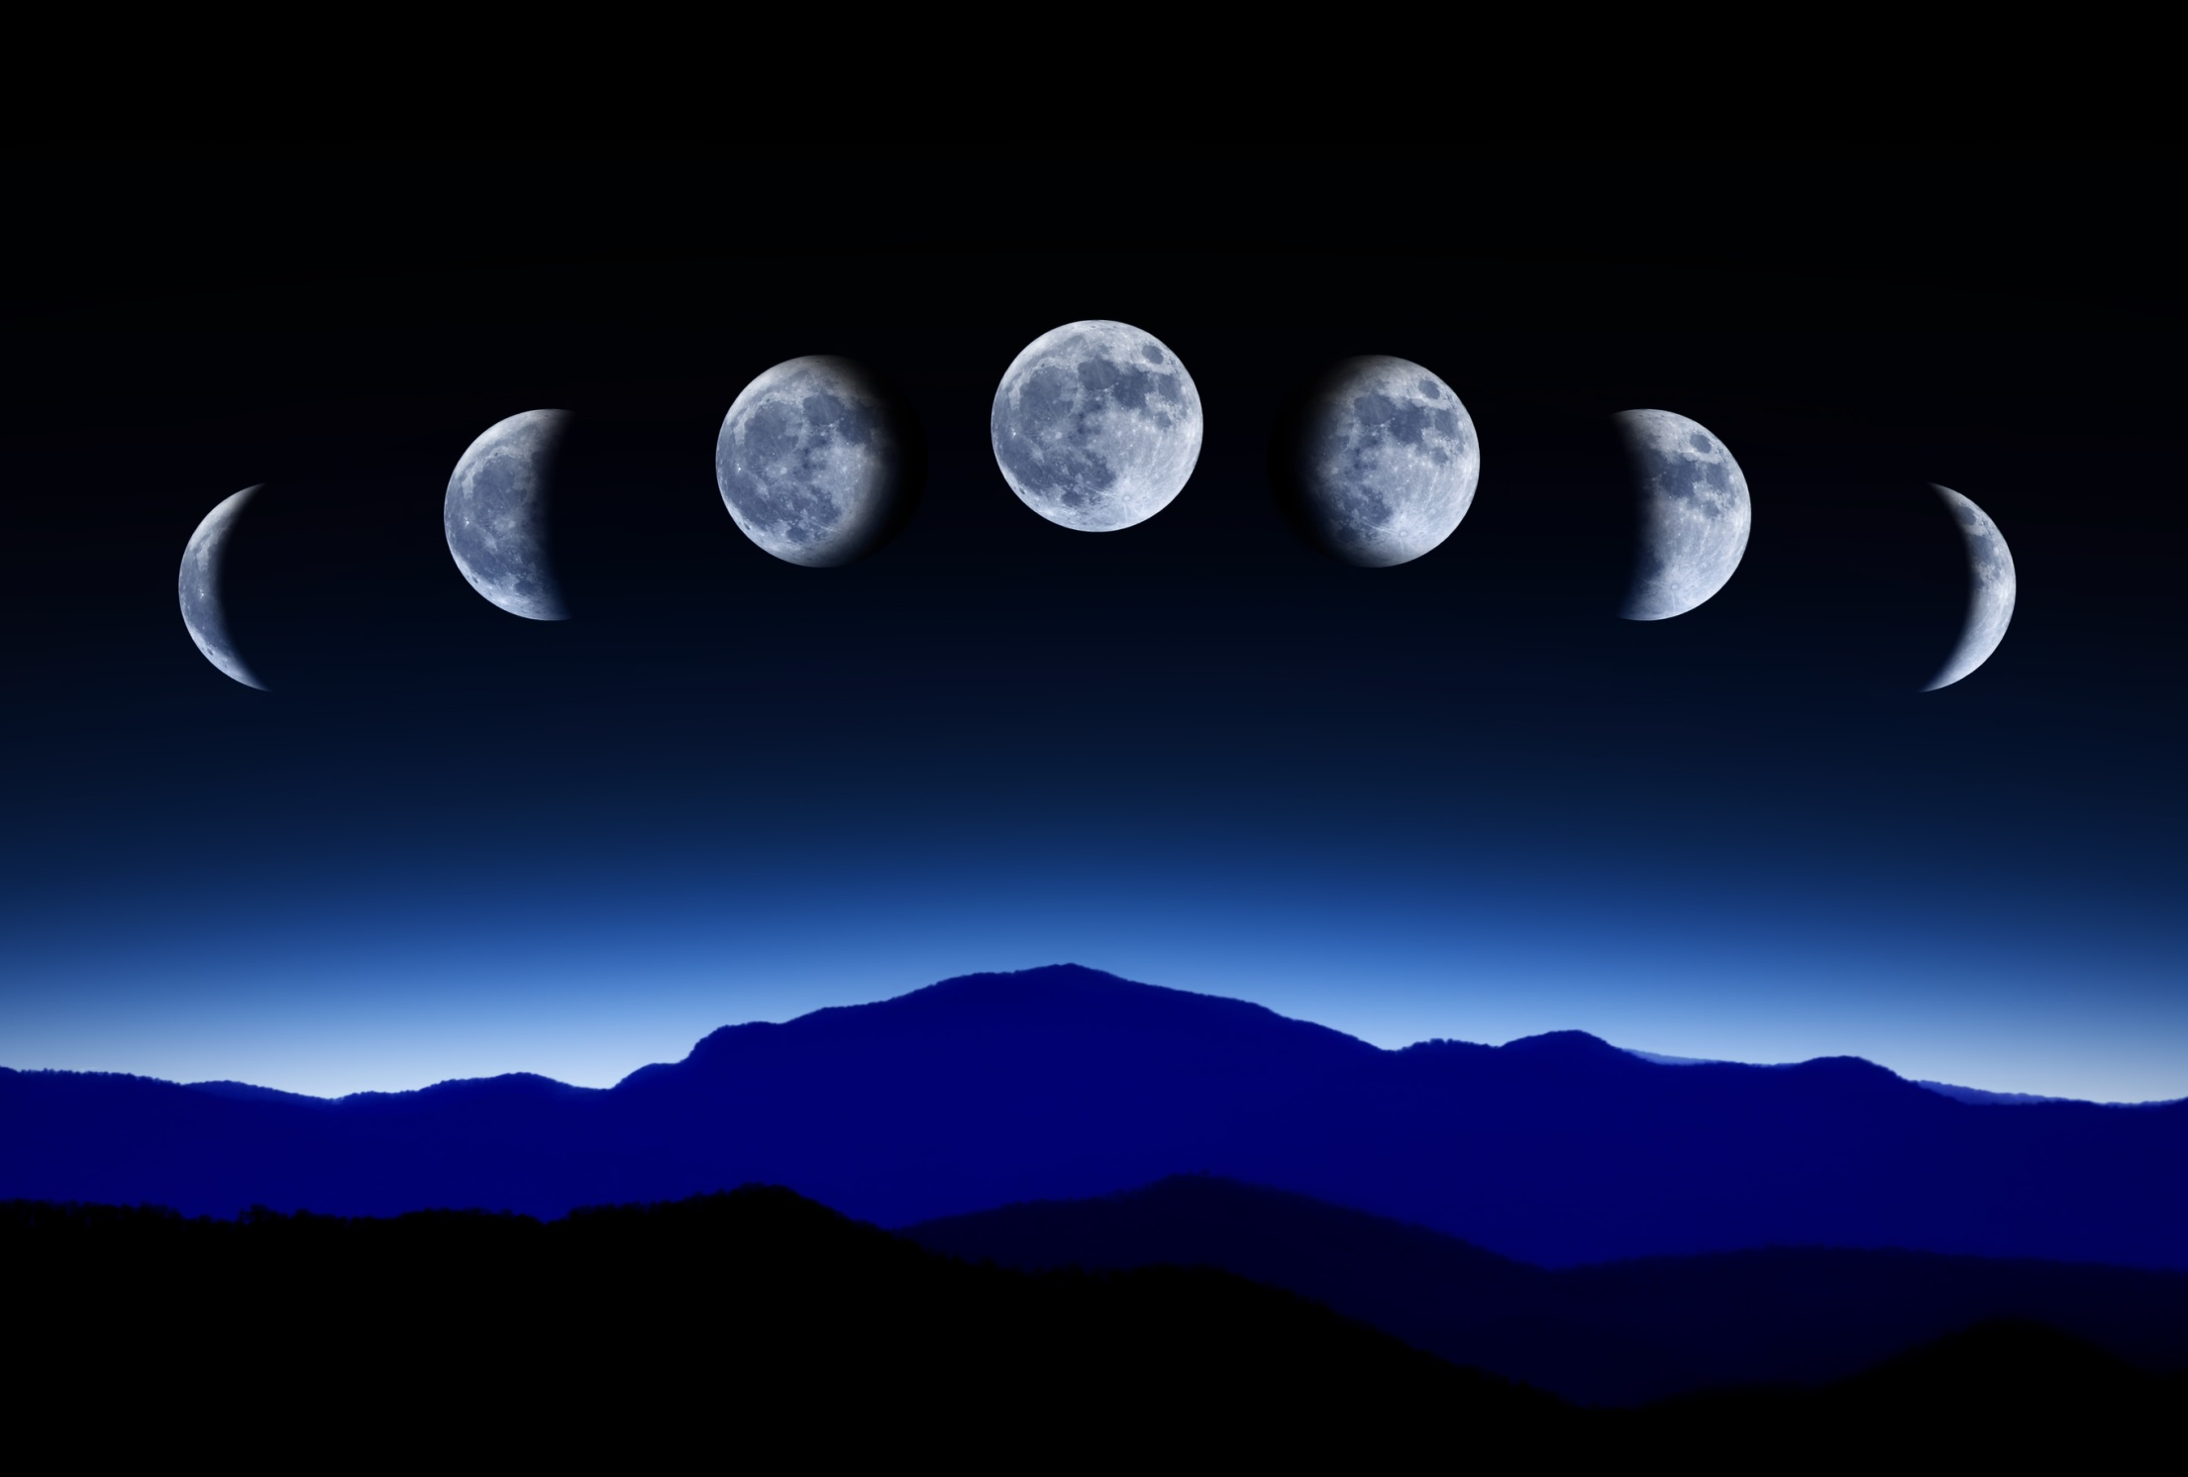
Why does the appearance of the moon change during the month?

Slide 12
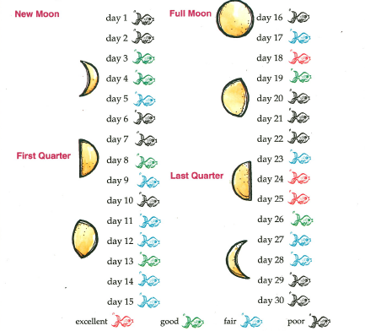
Fishing by the moon
This is a Māori fishing calendar.
It uses the phases of the moon to work out the best days for fishing.

Slide 13
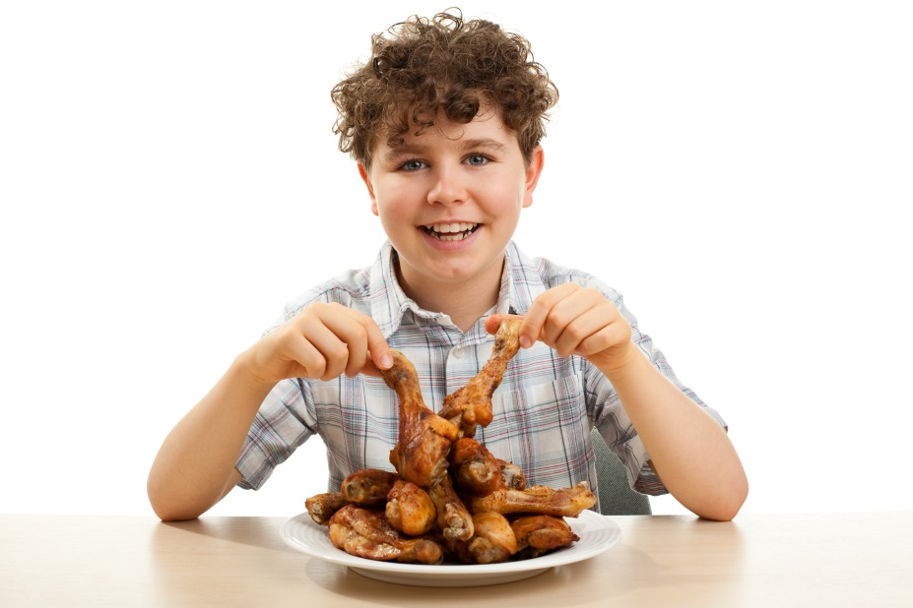
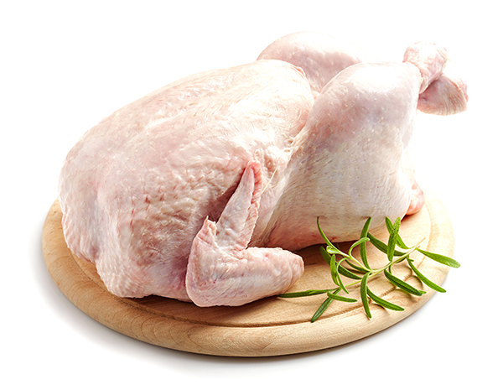
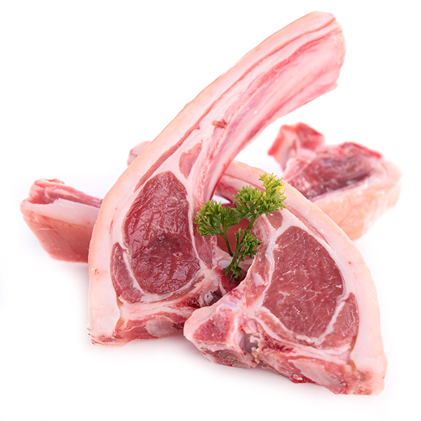
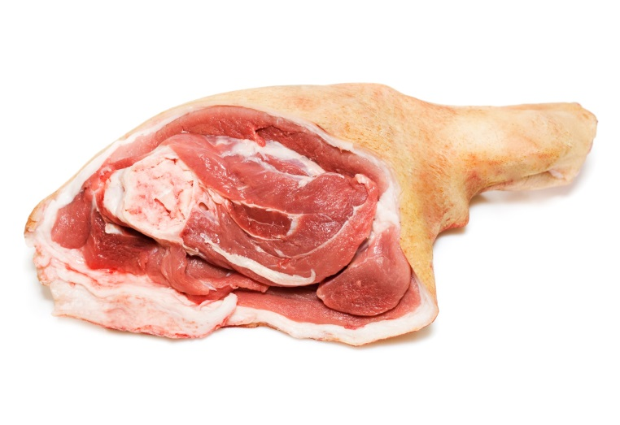
How much meat should you eat?
This boy may look happy but did you know that eating too much meat is not good for you?
Children of your age should eat about 100 grams of meat in a main meal. Of course some people don’t eat meat at all!
A size 14 chicken has about 850 grams of meat.
What is the rest of the chicken made up of?
A lean lamb chop weighs about 120 grams but that includes the bone.
How much of the chop is meat?
A leg of pork weighs about four kilograms.
How many grams is that?
Allow 150 grams per person because of the bone.

