Slide 1
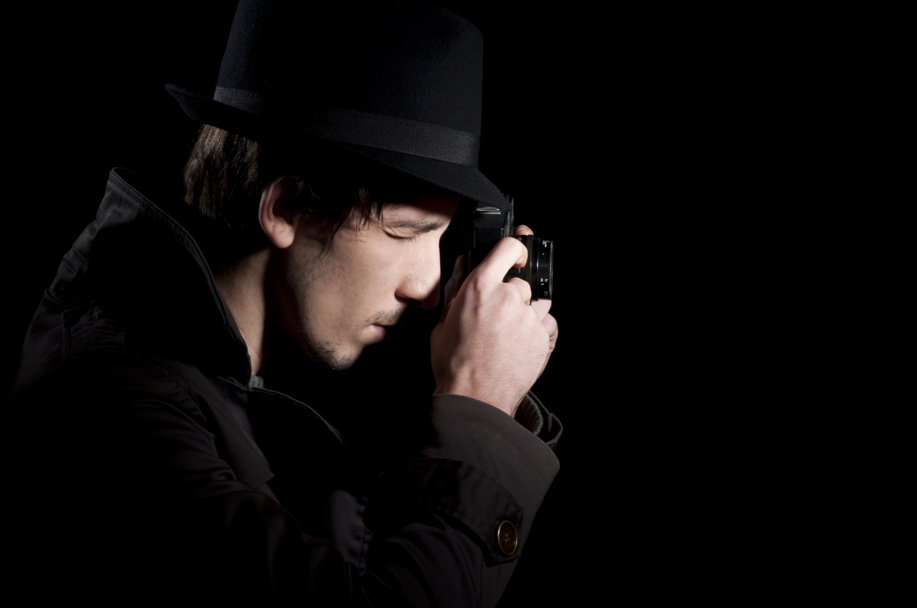
Simon is a spy on a dangerous mission. He takes photographs of an ammunition plant from two positions, the front and left side, before he is spotted. The views match his satellite image of the factory. Luckily Simon escapes and returns to base.

Slide 2
The photographs look clear but Simon knows that Operations Branch will need to model of the factory to plan their attack.
So Simon tries to put the information together.

Slide 3
Here are the satellite image and Simon’s photographs of the building.
Use these pictures to construct the ammunition factory using cubes.
Satellite View
Left View
Front View

