Slide 1
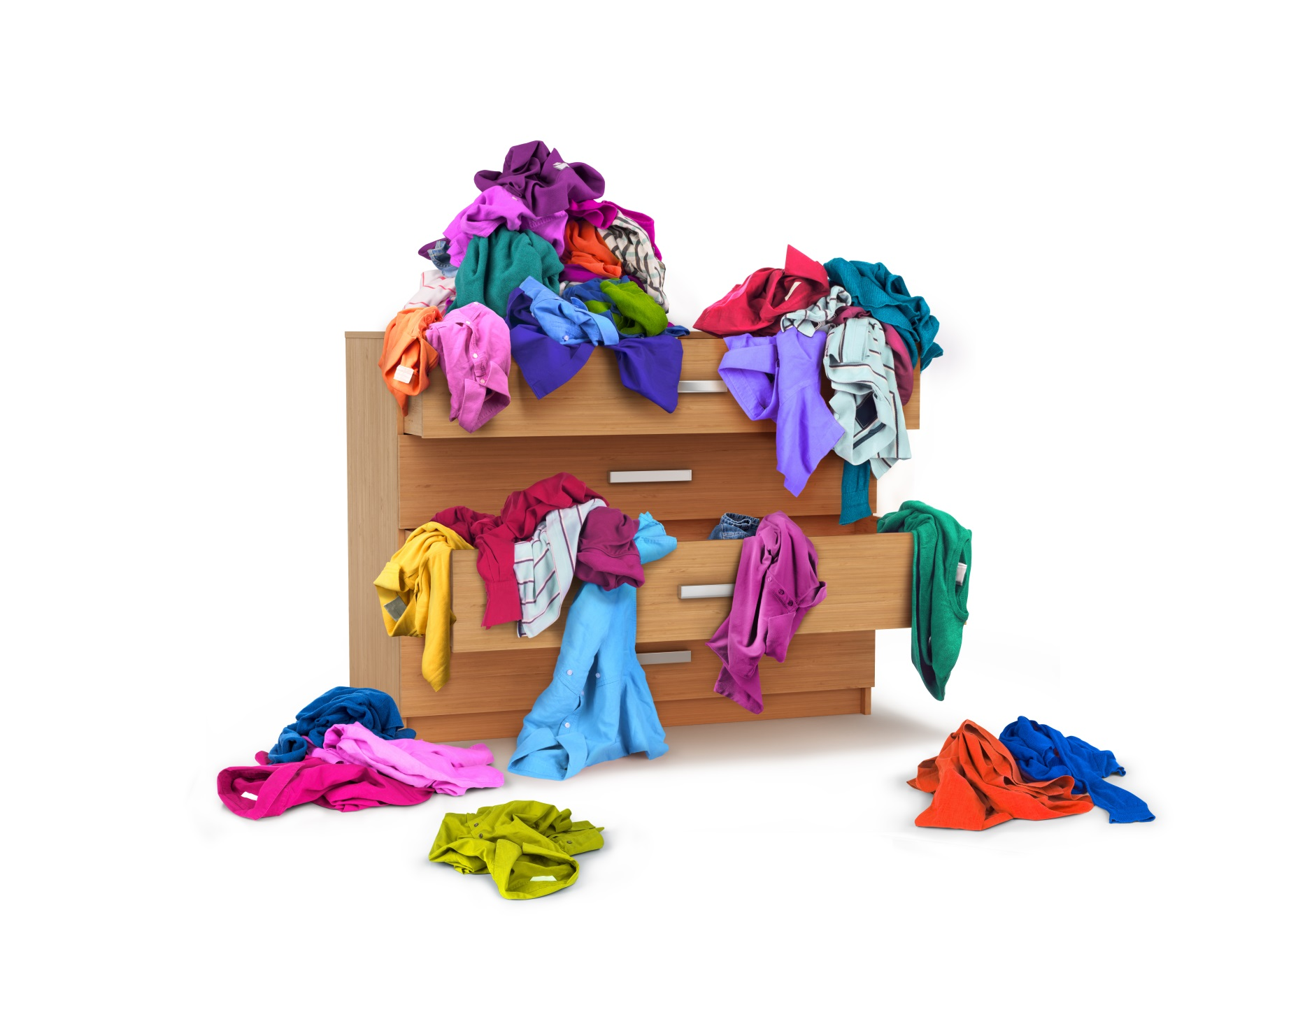
However hard she tries Lucy’s chest of drawers is always a mess.
That is especially true when she has exciting things to do outside in the sunshine.

Slide 2
Please put your clothes away Lucy.
It doesn’t matter how tidy they are inside the drawers as long as I can’t see them.

Slide 3
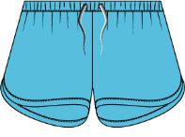
T-shirts
Shorts
So Lucy puts two clean pairs of shorts and two clean t-shirts in different draws.

