Slide 1
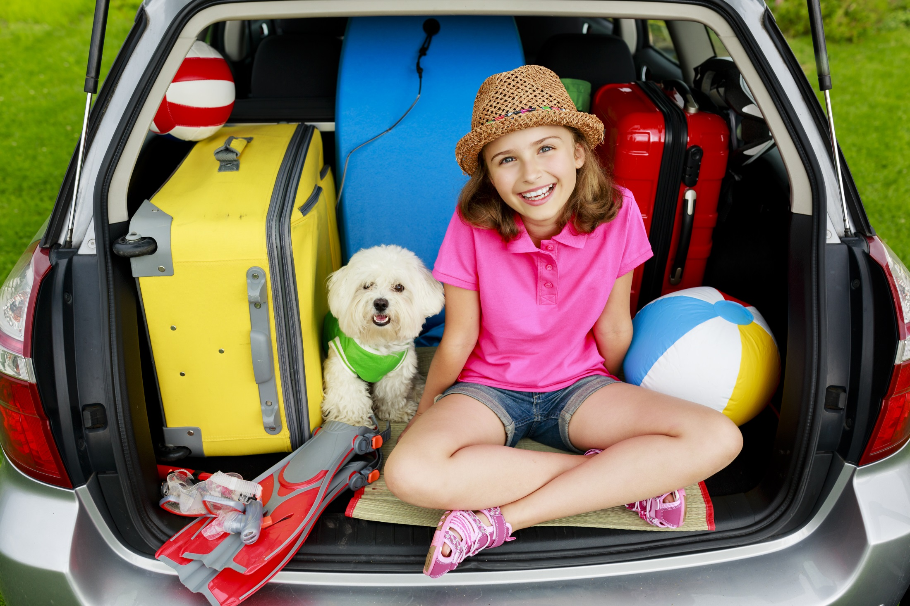
Lucy is going on a 24 day summer holiday. She has packed five pairs of shorts and five t-shirts in her case. She thinks that should be enough.

Slide 2
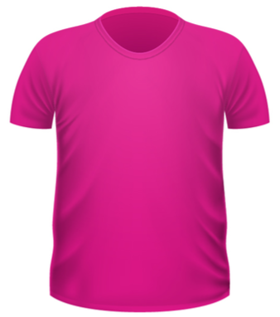
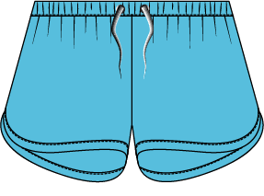
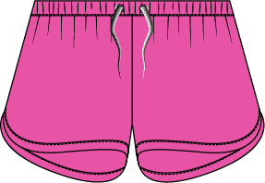
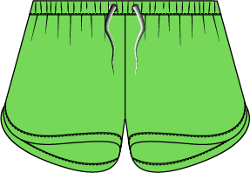
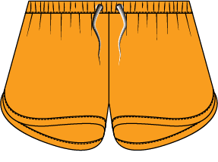
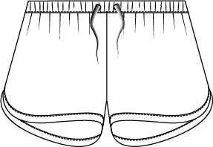
Here are the shorts and t-shirts that Lucy packed.
What do you notice about the colours of the items?

Slide 3
Lucy is hopeful that she can wear a different shorts and t-shirt combination for every day of her holiday.
For example she could have:
White shorts with a blue t-shirt
All pink
Green shorts with an orange t-shirt
Is she correct or did she not pack enough clothes?

Slide 4
You could build a tree diagram like this:
What happens after that?

Slide 5
You could build a two-way table, like this:
T-shirts
Shorts

