Slide 1
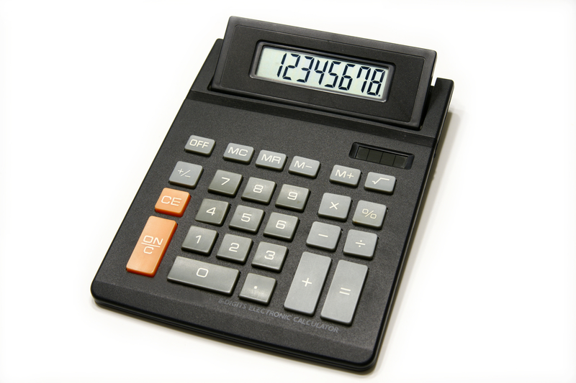
What would tell you that the Odds and Even game is fair?
What would tell you if it was unfair?

Slide 2
Here a two-way table of all the possible outcomes.
What sum goes in this cell?
Why?
Even Winner
2
3
4
5
6
9
+
1
7
8
1
2
3
Odd
Winner
4
What sum goes in this cell?
Why?
5
6
7
8
9

Slide 3
Here is the two-way table of all the possible outcomes.
Even Winner
2
3
4
5
6
9
+
 | 2 | 3 | 4 | 5 | 6 | 7 | 8 | 9 | 10
 | 3 | 4 | 5 | 6 | 7 | 8 | 9 | 10 | 11
 | 4 | 5 | 6 | 7 | 8 | 9 | 10 | 11 | 12
 | 5 | 6 | 7 | 8 | 9 | 10 | 12 | 12 | 13
 | 6 | 7 | 8 | 9 | 10 | 11 | 13 | 13 | 14
 | 7 | 8 | 9 | 10 | 11 | 12 | 14 | 14 | 15
 | 8 | 9 | 10 | 11 | 12 | 13 | 15 | 15 | 16
 | 9 | 10 | 11 | 12 | 13 | 14 | 16 | 16 | 17
 | 10 | 11 | 12 | 13 | 14 | 15 | 17 | 17 | 18
1
7
8
1
2
3
Odd
Winner
4
5
6
What sums are being shaded?
What totals are left blank?
What patterns can you see?
7
8
9

Slide 4
Here is the filled in two-way table of all the possible outcomes.
Is there an easy way to count the number of shaded cells?
If you know the number of shaded cells how can you work out the number of blank cells?
Even Winner
2
3
4
5
6
9
+
 | 2 | 3 | 4 | 5 | 6 | 7 | 8 | 9 | 10
 | 3 | 4 | 5 | 6 | 7 | 8 | 9 | 10 | 11
 | 4 | 5 | 6 | 7 | 8 | 9 | 10 | 11 | 12
 | 5 | 6 | 7 | 8 | 9 | 10 | 12 | 12 | 13
 | 6 | 7 | 8 | 9 | 10 | 11 | 13 | 13 | 14
 | 7 | 8 | 9 | 10 | 11 | 12 | 14 | 14 | 15
 | 8 | 9 | 10 | 11 | 12 | 13 | 15 | 15 | 16
 | 9 | 10 | 11 | 12 | 13 | 14 | 16 | 16 | 17
 | 10 | 11 | 12 | 13 | 14 | 15 | 17 | 17 | 18
1
7
8
1
2
3
Odd
Winner
4
5
6
7
8
9

Slide 5
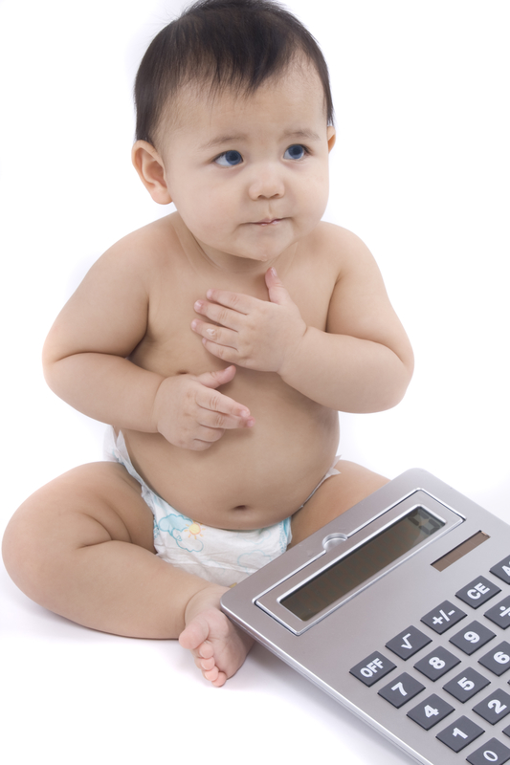
So 41 out of 81 possible outcomes are even and 40 out of 81 possible outcomes are odd.
Is the game fair or unfair?

