Slide 1
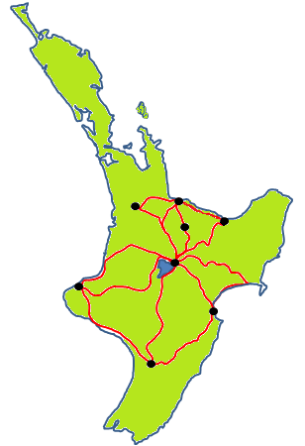
Lucy’s family live in Palmerston North and holiday at Tauranga.
Do you know where those two cities are on the map?

Slide 2
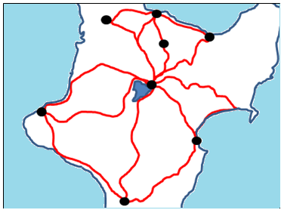
Hamilton
Tauranga
Whakatane
Rotorua
Taupo
New Plymouth
Napier
Palmerston North

Slide 3
Hamilton
Tauranga
29
28
2
33
Whakatane
Rotorua
30
Taupo
38
New Plymouth
43
5
1
Napier
Palmerston North

Slide 4
Unfortunately Lucy’s summer holiday is over and her family need to return home to Palmerston North.

Slide 5
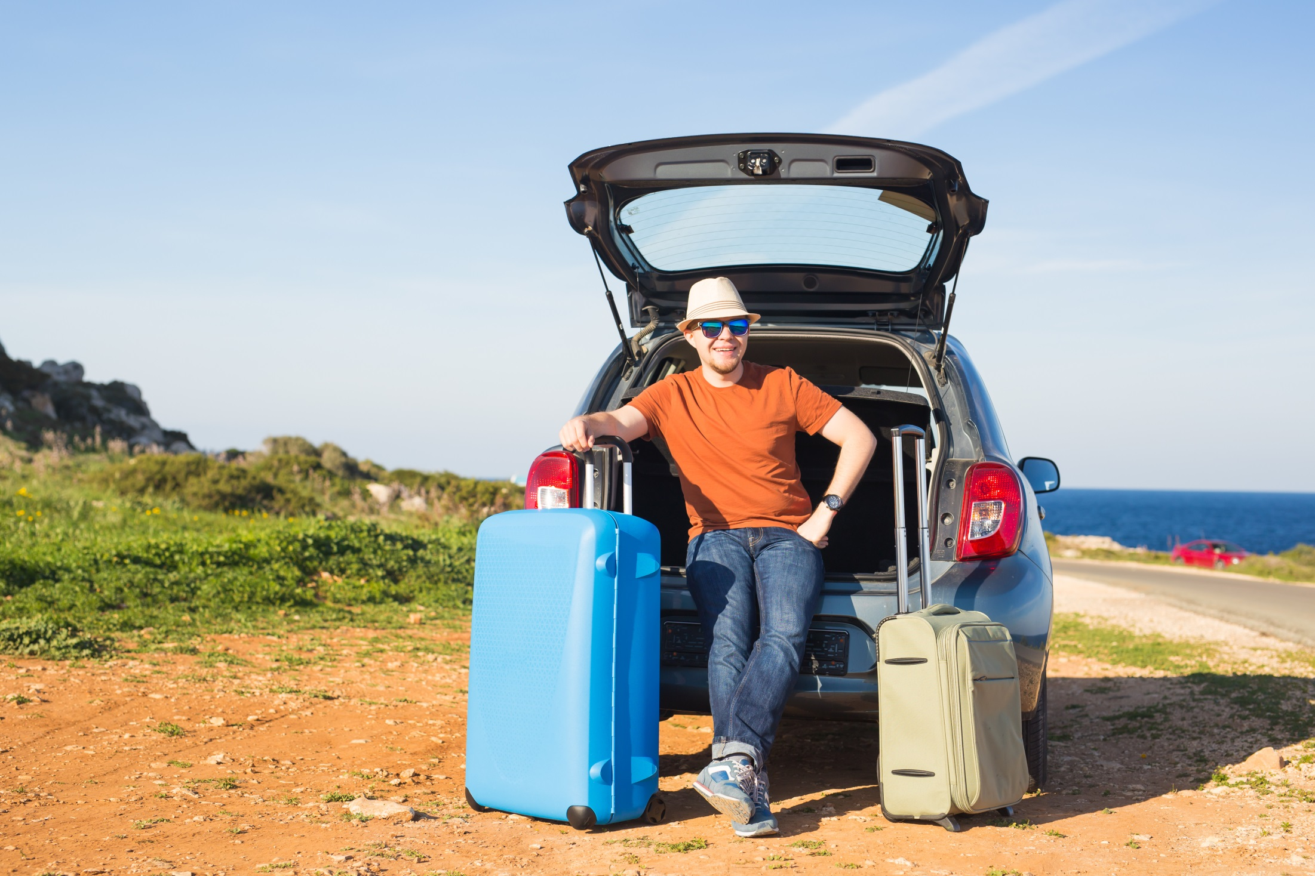
Luckily the adventure is not quite over. Lucy’s Dad loves to drive home from Tauranga to Palmerton North in different ways. He always goes through Taupo to have lunch with Grandma and Grandad.
Staying with the highways marked on the map, how many different routes might the family take?

Slide 6
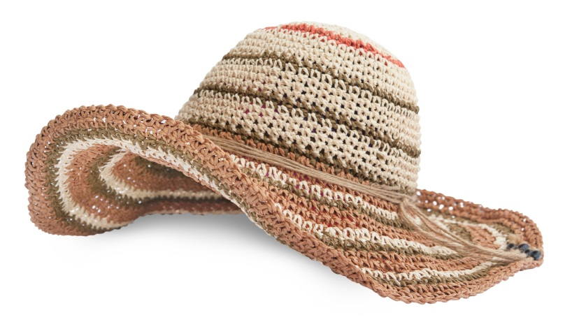
So Lucy uses her sunhat with the Highway numbers in it to select which route to take. She does that for both legs of the journey.
2
28
29
33
1
5
30
38
43
Tauranga – Taupo
Taupo – Palmerston North

Slide 7
1. What are the chances that the route home will take the family through Taupo?
2. What are the chances that the family will travel through Napier?
3. What are the chances that the trip from Taupo to Palmerston North will take them by the sea?

