Slide 2
9 Players

Slide 3
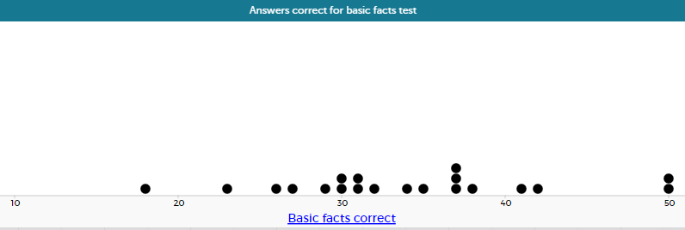
20 Students

Slide 4
