Slide 1
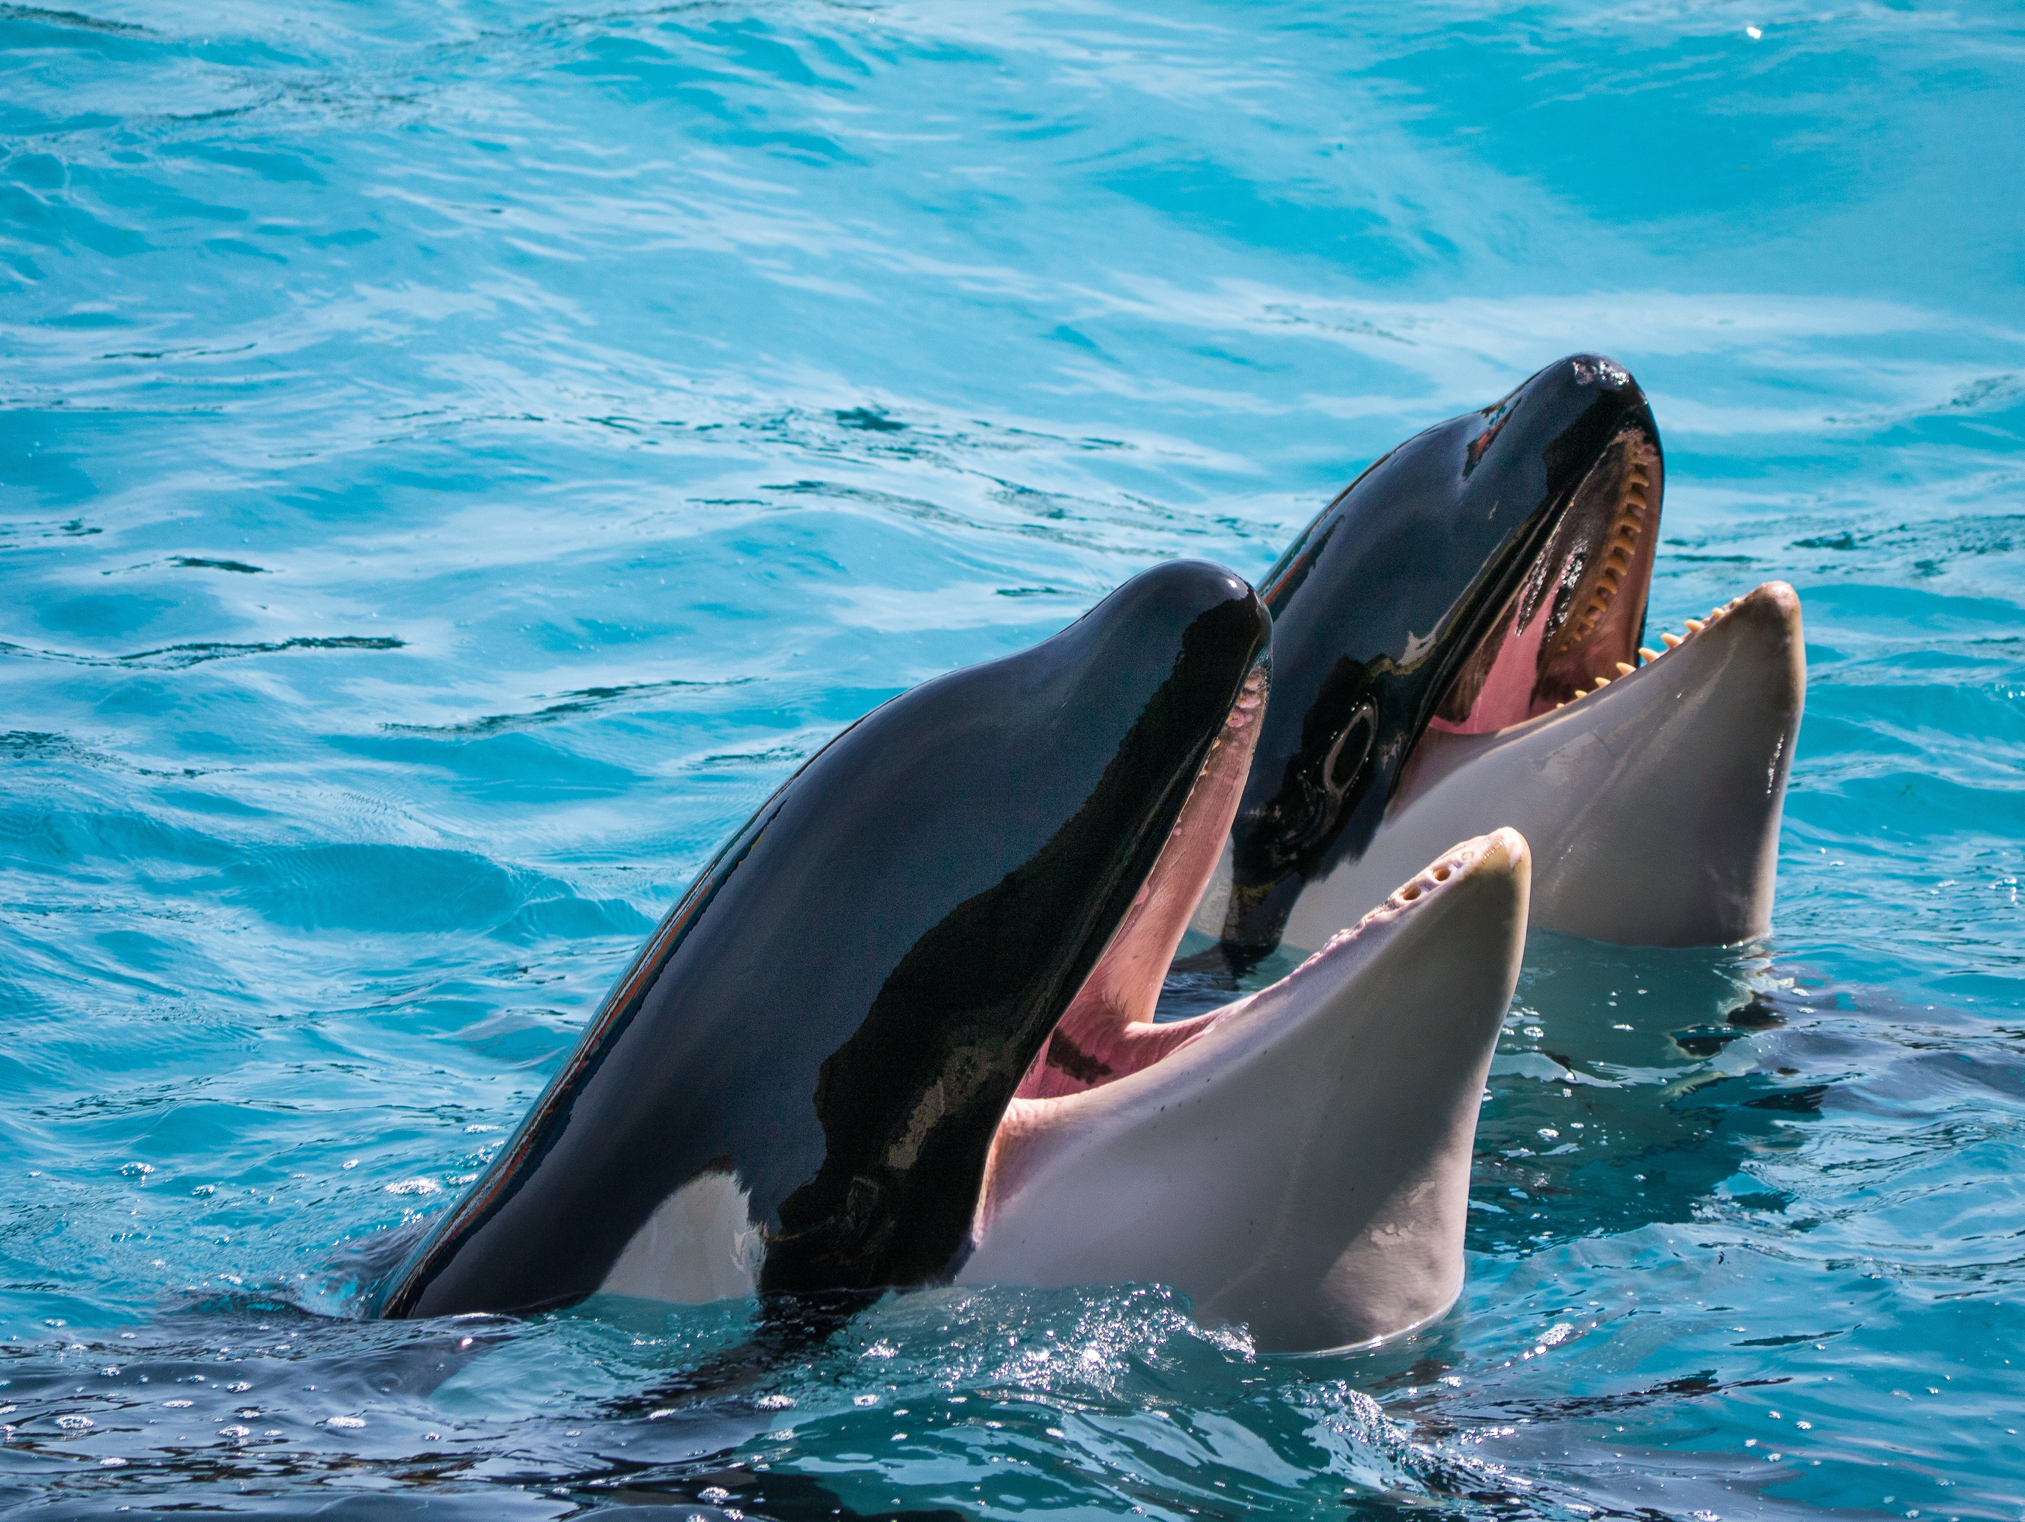
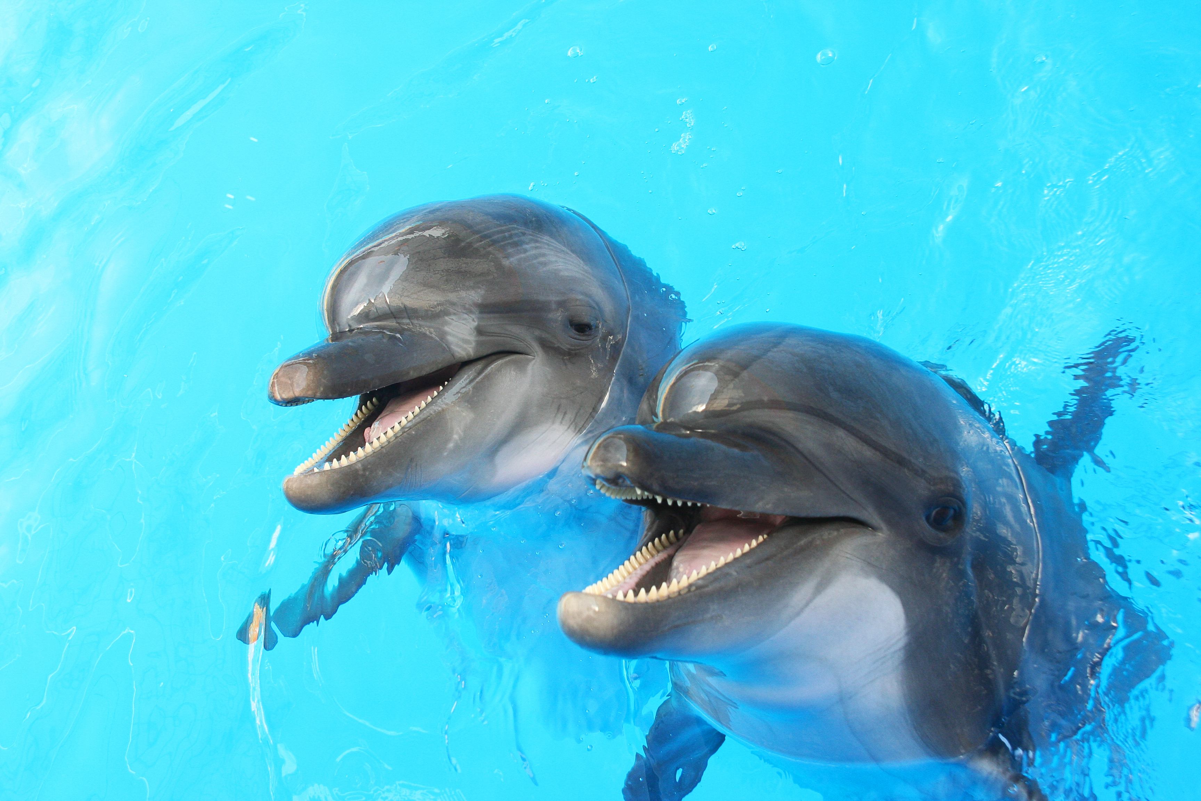
Dolphins and the orcas compete for the same food though they rarely fight.
Marines scientists sometimes monitor the populations in areas where the species may be under threat.

Slide 2
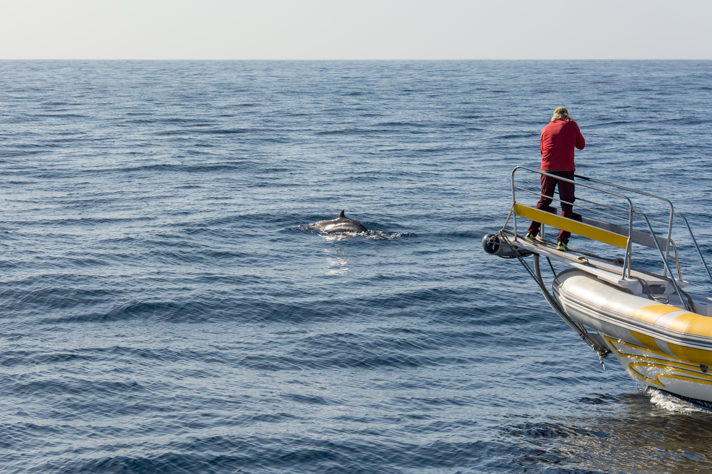
The dolphins and orcas are sometimes tagged, and photographed, so their movements can be tracked.

Slide 3
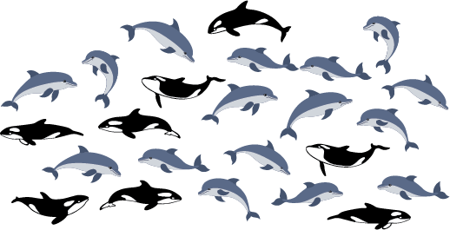
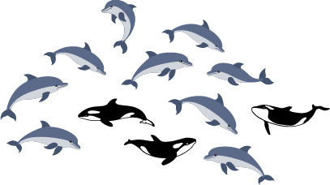
January
July
Two surveys off the coast of Kaikoura, in different months, showed these data.
What fraction of the animals located were orcas? What fraction were dolphins?

Slide 4
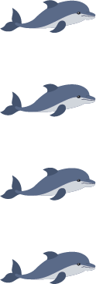

Slide 5
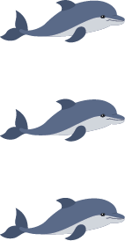

Slide 6
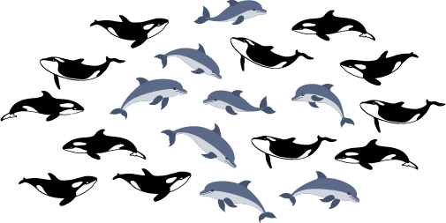
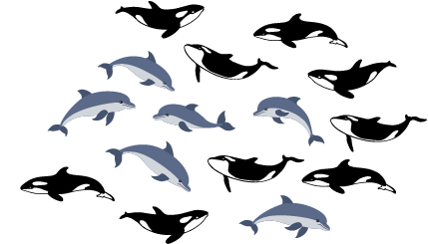
January
July
These data are from two surveys in Otago Harbour, in different months
What fractions can you find in the data?

Slide 7
Otago Harbour in January

Slide 8
Otago Harbour in July

