Slide 1
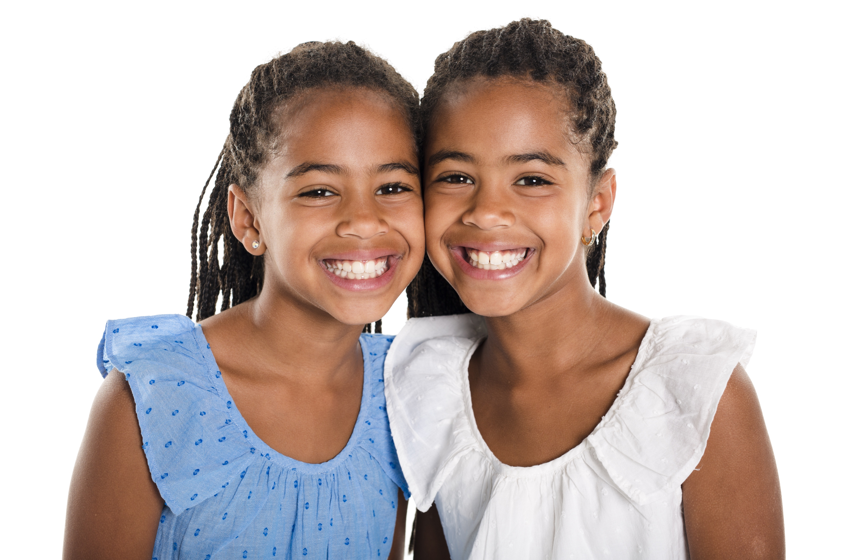
Nia and Ashanti are identical twins.
Each birthday they each get identical birthday cakes.
Nia eats two thirds of her cake and Ashanti eats three quarters of her cake.
Who eats the most?
How much more cake does she eat than her sister?

Slide 2
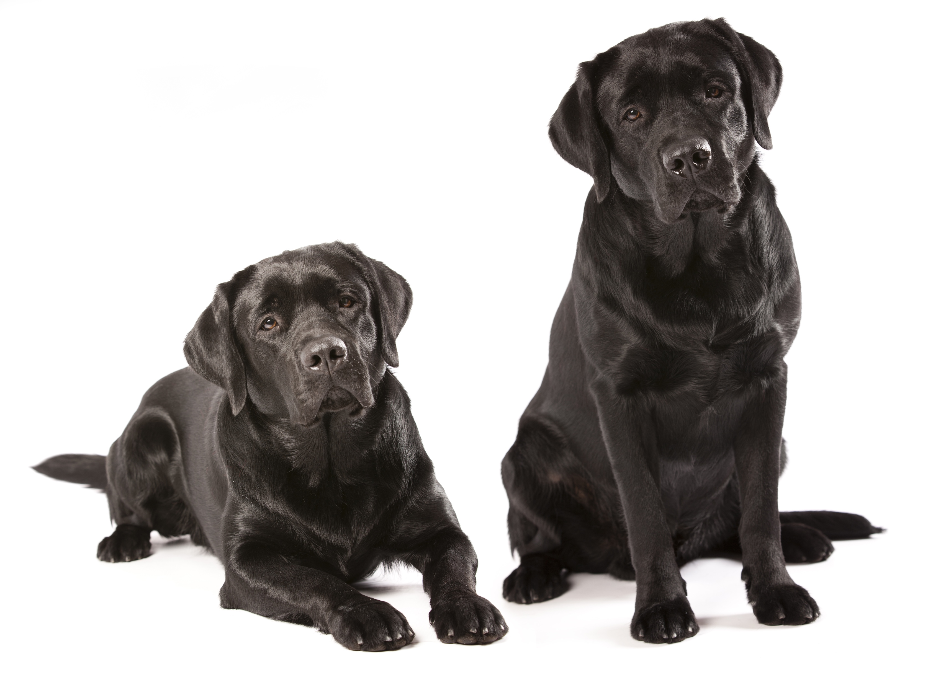
Po and Mangu are identical twin labradors.
Each day they get identical dog biscuits.
Po eats three fifths of his biscuit for breakfast and Mangu eats five eighths of his biscuit.
Who eats the most?
How much more cake does he eat than his brother?

Slide 3
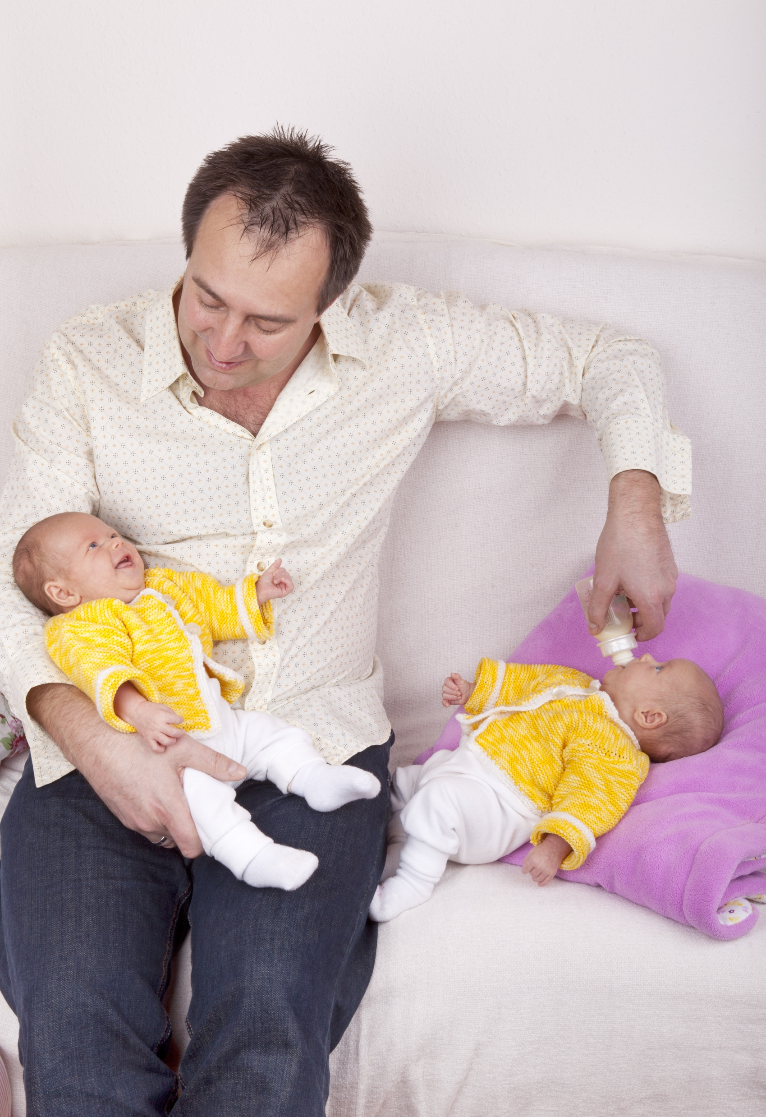
Thalia and Andreas are identical twin babies.
Before going to bed they get identical bottles of formula.
Thalia drinks two thirds of her milk and Andreas drinks seven tenths of his milk.
Who drinks the most?
How much more milk does that baby drink than their sibling?

