Slide 1
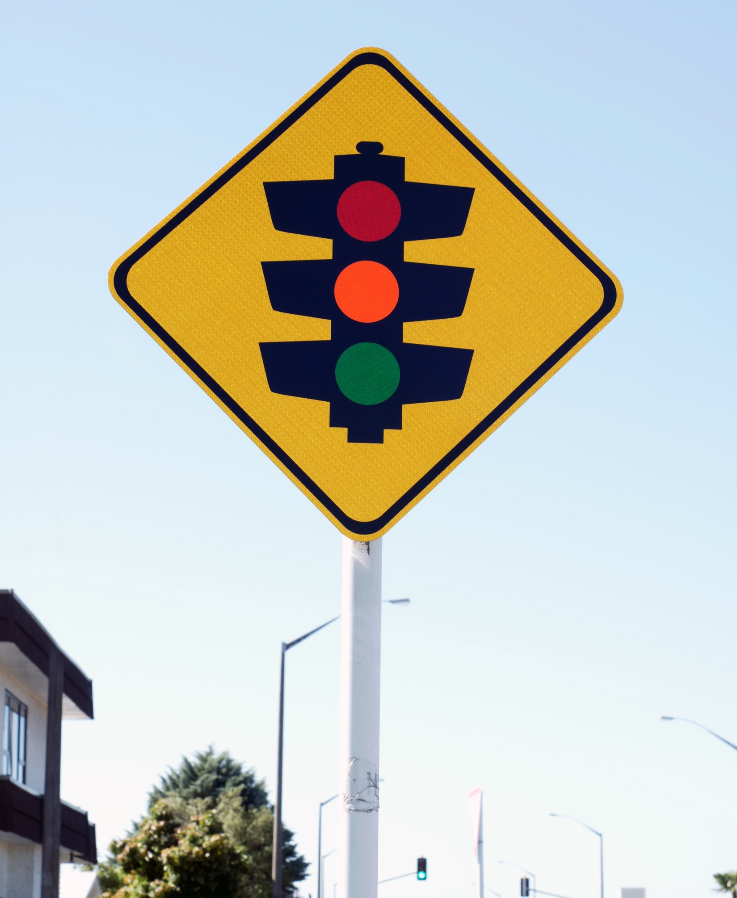
What colours can a traffic light appear as you approach it?
What does each colour mean for the driver?

Slide 2
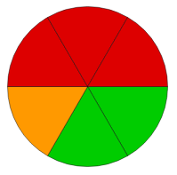
Stop
Stop
Stop
Light changing
Go
Go
Luciana passes through two sets of traffic lights on her way to work.
This spinner shows the fraction of time the lights show each colour.

Slide 3
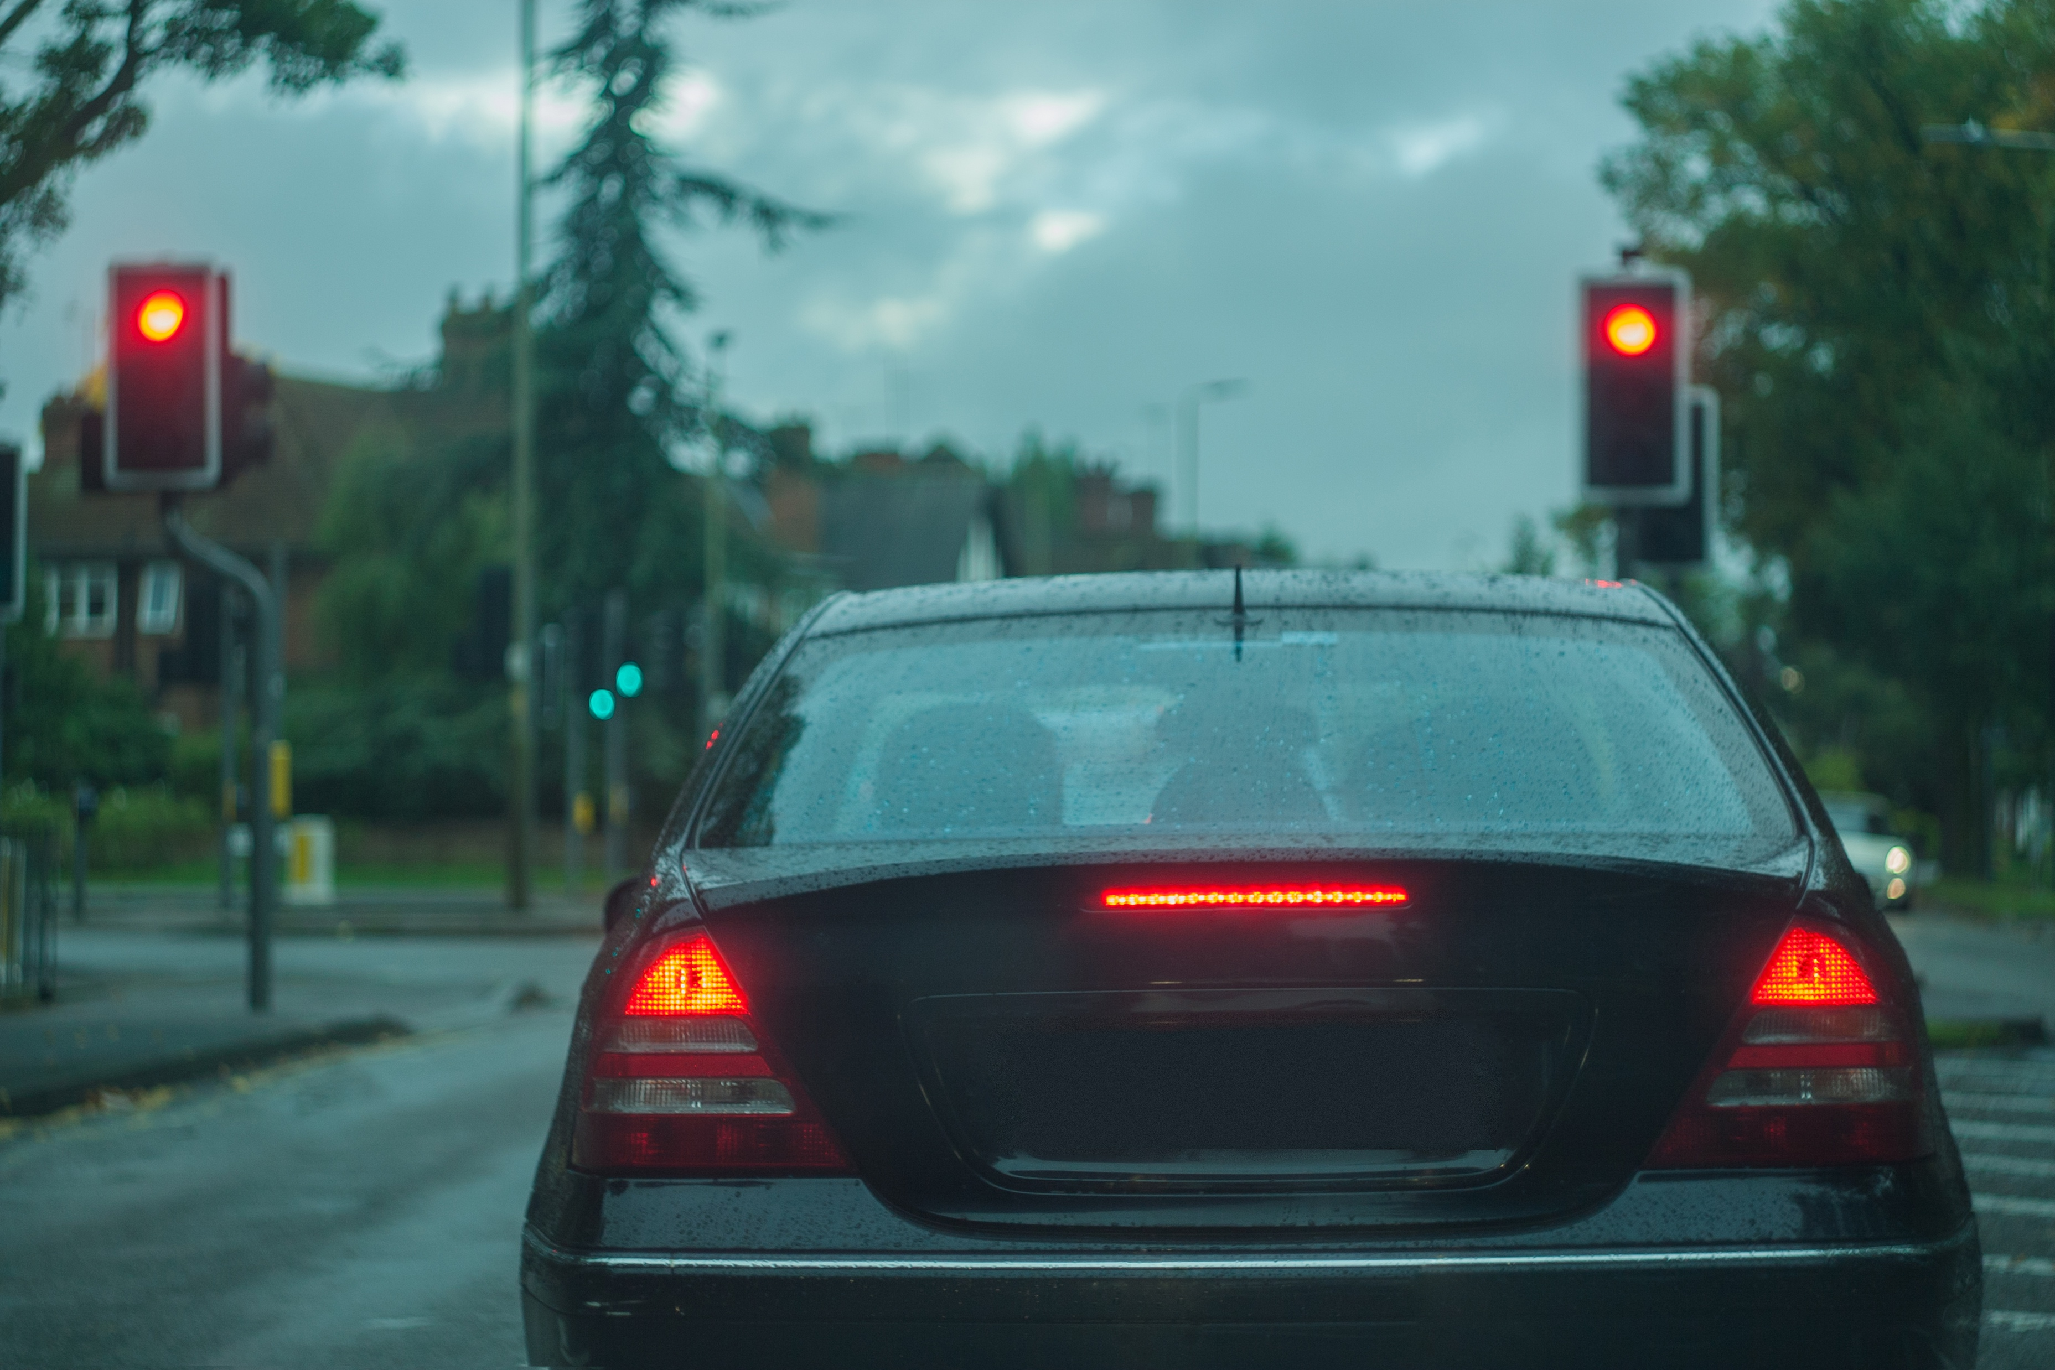
What is the probability that:
Luciana gets through both sets of lights without stopping (both green)?
Luciana stops at both lights (when the lights are red)?
Luciana only stops at one set of lights.

Slide 4
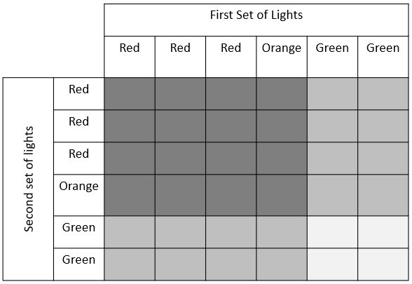

Slide 5
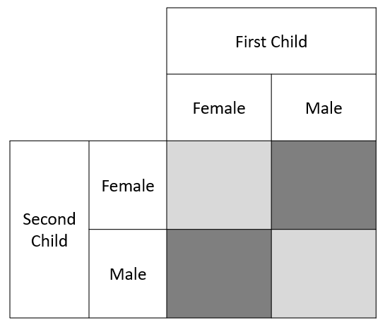

Slide 6
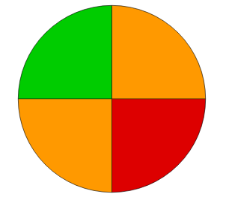
Light changing
Go
Light changing
Stop
Luciana changes her driving route.
The new route is the same distance but has two sets of lights phased like this.
Is Luciana better off than before or should she go back to the previous route?

Slide 7
