Slide 1
First Child
Second Child
F
F
M
F
M
M

Slide 2
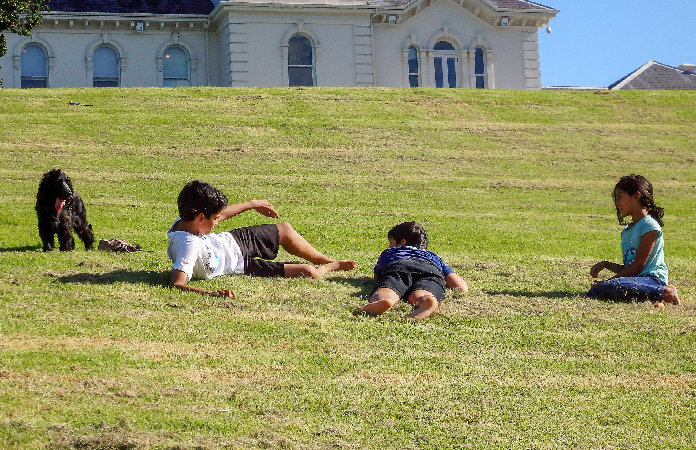
What mixes of female and male children are possible in a three-child family?
Use the spinner to simulate having three-child families, at least 24 times.
Record your results.
Which events happen most frequently?
Which events happen least frequently?
Create a tree diagram to explain your results.

Slide 3
First Child
Second Child
Third Child
F
F
M
F
F
M
M
F
F
M
M
F
M
M

Slide 4
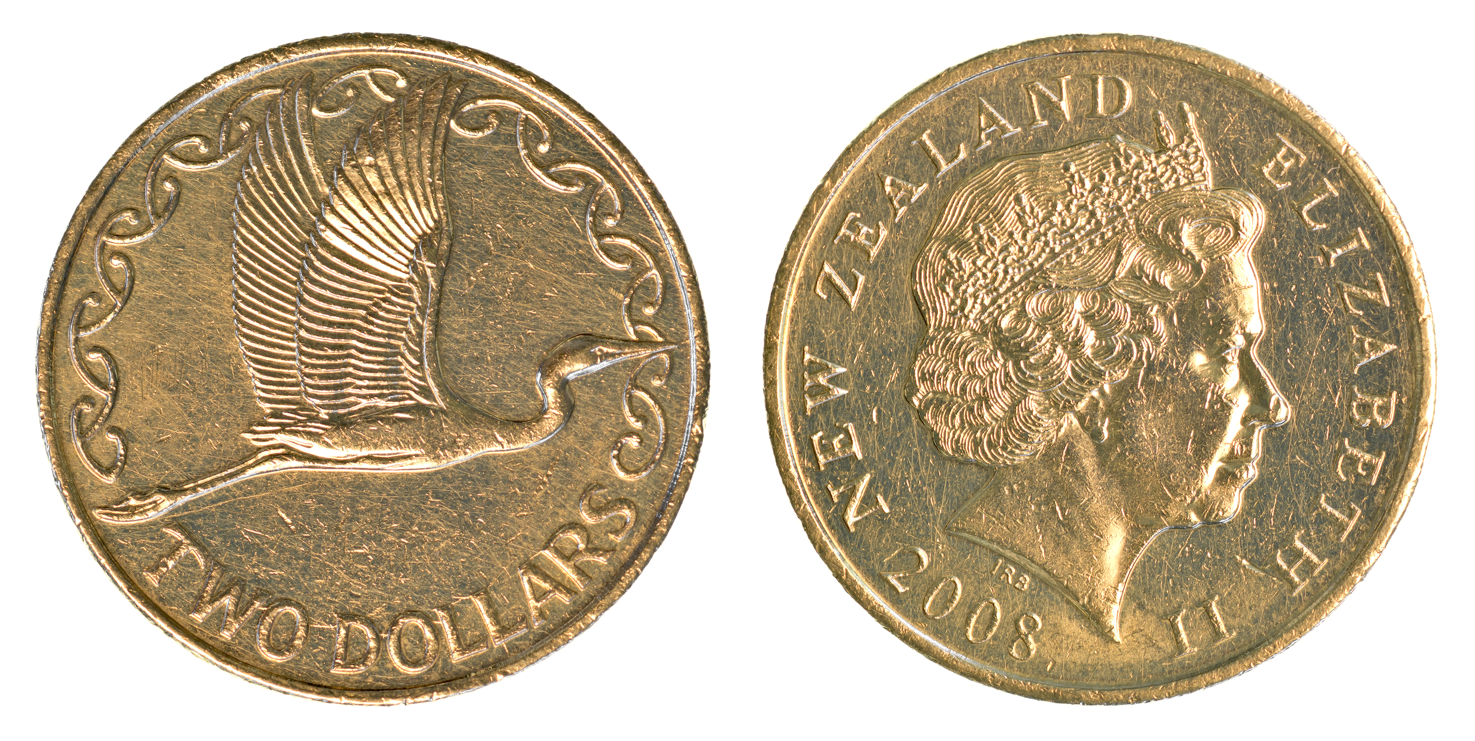
Jacob tosses two coins. Each coin has a ‘heads’ side, and a ‘tales’ side.
“There are three possible outcomes, two heads, two tails, and a heads and tails mix,” he says.
What does Jacob think is the probability of getting two heads?
Is he correct? Explain.

