Slide 1
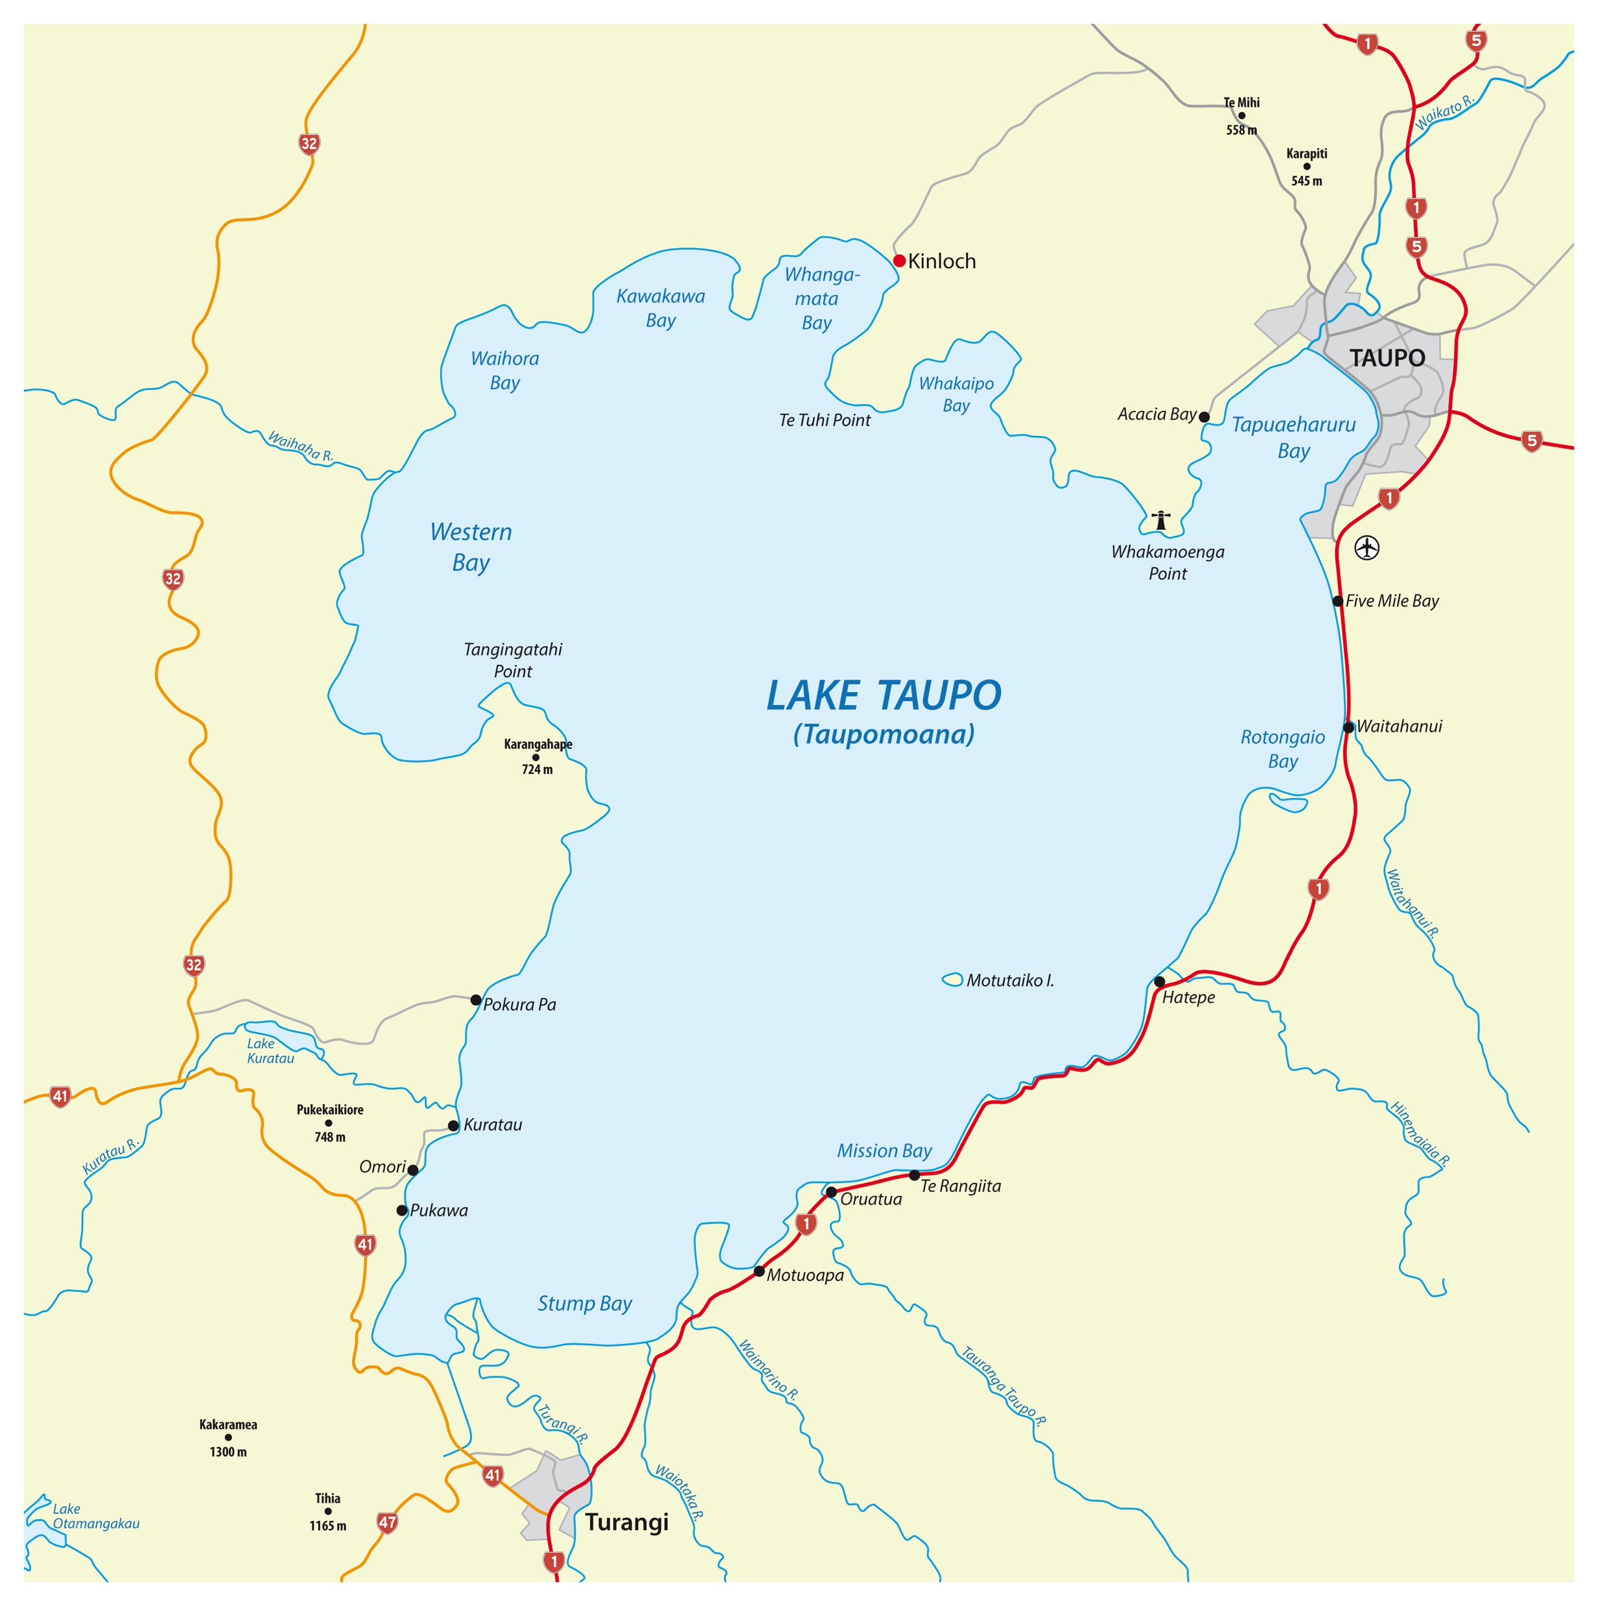
42 km
30 km

Slide 2
26 km
25 km

Slide 3
Painters and plasterers are very interested in surface area.
What does surface area mean?
Why are painters and plasterers so interested?

Slide 4
6cm
4cm
10cm

