Slide 1
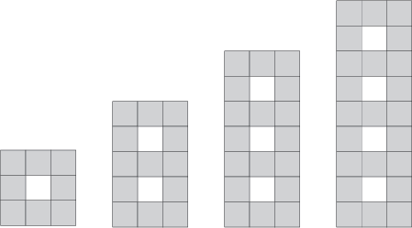
Term 1
Term 2
Term 3
Term 4

Slide 3
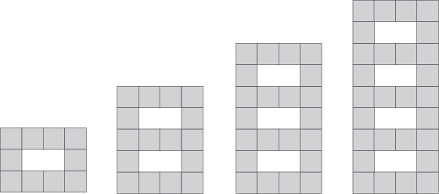
Term 1
Term 2
Term 3
Term 4

Slide 4
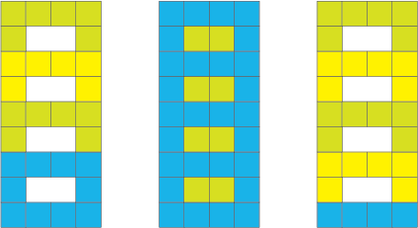
Teina
3 x 6 +10
Philip
9 x 4 - 8
Cameron
4 x 6 + 4

