Slide 1
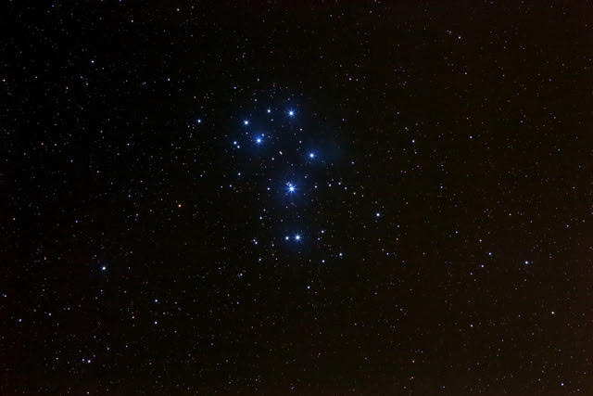
The ancient Greek name for the Matariki cluster is Pleiades.

Slide 2
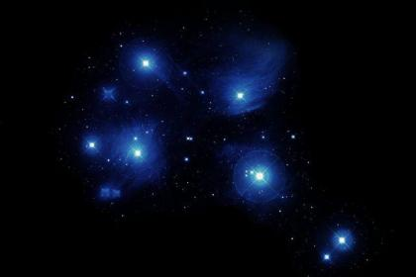
Waipuna-ā-rangi
Uru-ā-rangi
Hiwa-i-te-rangi
Waitā
Waitī
Matariki
Pohutukawa
Tupu-ā-rangi
Tupu-ā-nuku

Slide 3
Use a matrix, or table, to organise the information.
 | Hiwa | Matariki | Pōhutukawa | Tupu-ā-rangi | Tupu-ā-nuku | Waipunarangi | Waitā | Waitī | Ururangi
Health and well-being
Crops in the Earth
Food from the forest
Fresh water fish
Seafood (Kaimoana)
Rainfall
Wind
Good fortune
Care for the departed
Waipunarangi
Ururangi
Hiwa-i-te-rangi
Matariki

Waitā
Waitī
Tupu-ā-nuku
Tupu-ā-rangi
Pōhutakawa


Slide 4
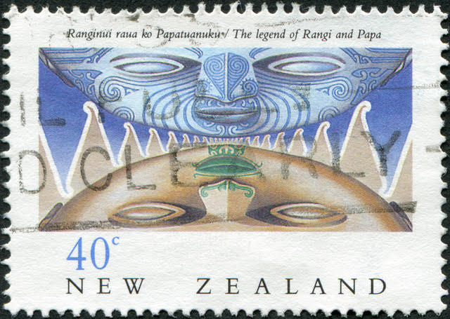
Clue Tahi
Tupu means “growing.” One of these twins overlooks crops.
The other twin overlooks food sources from above the ground, Tane’s domain.

Slide 5
Use a matrix, or table, to organise the information.
 | Hiwa | Matariki | Pōhutukawa | Tupu-ā-rangi | Tupu-ā-nuku | Waipunarangi | Waitā | Waitī | Ururangi
Health and well-being
Crops in the Earth
Food from the forest
Fresh water fish
Seafood (Kaimoana)
Rainfall
Wind
Good fortune
Care for the departed
Waipunarangi
Ururangi











Hiwa-i-te-rangi
Matariki









Waitā




Waitī
Tupu-ā-nuku


Tupu-ā-rangi
Pōhutakawa







Slide 6
Clue Rua
The two stars responsible for the sky are above the rest when Matariki rises.
Waipuna means “spring of water.”

Slide 7
Use a matrix, or table, to organise the information.
 | Hiwa | Matariki | Pōhutukawa | Tupu-ā-rangi | Tupu-ā-nuku | Waipunarangi | Waitā | Waitī | Ururangi
Health and well-being
Crops in the Earth
Food from the forest
Fresh water fish
Seafood (Kaimoana)
Rainfall
Wind
Good fortune
Care for the departed
Waipunarangi
Ururangi













Hiwa-i-te-rangi
Matariki









Waitā








Waitī
Tupu-ā-nuku









Tupu-ā-rangi
Pōhutakawa


















Slide 8
Clue Toru
The other twin stars oversee the fresh waters (streams, rivers, lakes) and the salt water (sea).
Fresh water flows down to the sea.

Slide 9
Use a matrix, or table, to organise the information.
 | Hiwa | Matariki | Pōhutukawa | Tupu-ā-rangi | Tupu-ā-nuku | Waipunarangi | Waitā | Waitī | Ururangi
Health and well-being
Crops in the Earth
Food from the forest
Fresh water fish
Seafood (Kaimoana)
Rainfall
Wind
Good fortune
Care for the departed
Waipunarangi
Ururangi















Hiwa-i-te-rangi
Matariki









Waitā


















Waitī
Tupu-ā-nuku









Tupu-ā-rangi
Pōhutakawa






















Slide 10
Clue Wha
There is an ancient tree at the Northern tip of aotearoa.
According to Māori beliefs, spirits of the deceased travel along the roots into the underworld.

Slide 11
Use a matrix, or table, to organise the information.
 | Hiwa | Matariki | Pōhutukawa | Tupu-ā-rangi | Tupu-ā-nuku | Waipunarangi | Waitā | Waitī | Ururangi
Health and well-being
Crops in the Earth
Food from the forest
Fresh water fish
Seafood (Kaimoana)
Rainfall
Wind
Good fortune
Care for the departed
Waipunarangi
Ururangi
















Hiwa-i-te-rangi
Matariki









Waitā


















Waitī
Tupu-ā-nuku









Tupu-ā-rangi
Pōhutakawa


























Slide 12
Clue Rima
Hiwa means “vigorous of growth.”
Her connection was with people’s aspirations for the future.

Slide 13
Use a matrix, or table, to organise the information.
 | Hiwa | Matariki | Pōhutukawa | Tupu-ā-rangi | Tupu-ā-nuku | Waipunarangi | Waitā | Waitī | Ururangi
Health and well-being
Crops in the Earth
Food from the forest
Fresh water fish
Seafood (Kaimoana)
Rainfall
Wind
Good fortune
Care for the departed
Waipunarangi
Ururangi


















Hiwa-i-te-rangi
Matariki









Waitā


















Waitī
Tupu-ā-nuku









Tupu-ā-rangi
Pōhutakawa




























Slide 14
Waipuna-ā-rangi (rain)
Hiwaiterangi (wishes)
Uru-ā-rangi (wind)
Waitā (sea)
Waitī (freshwater)
Matariki (leadership)
Pohutukawa
(The departed)
Tupu-ā-rangi (forests)
Tupu-ā-nuku (crops)

