Slide 1
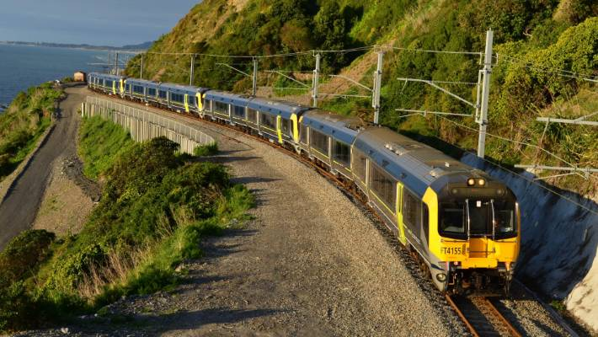
Met-link operates train and bus services throughout Wellington.
Here is the type of train that is used on the Waikanae to City route.

Slide 2
Henare and Leisha commute from Waikanae to Wellington City each day for work.
They both have office jobs less than a five minute walk to the Central Station.

Slide 3
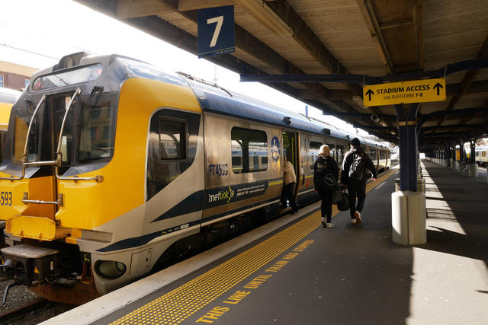
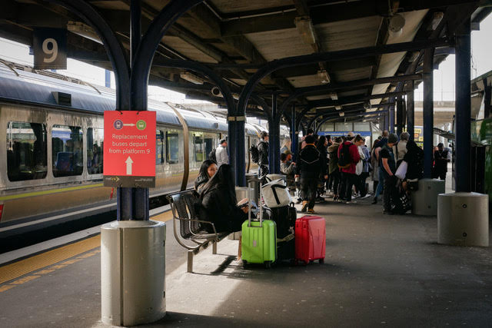
Their jobs allow for working ‘glide time’ which means they can alter their start and finish times to suit.
In total their contract requires 9 hours work per day. They take 1 hour for lunch.
However, they also use up to 1.5 hours of ‘down time’ on the train to answer emails and do work on their computers. That time counts towards the 9 hours.

Slide 4
Kapiti Line
Waikanae to City
 | Monday to Friday
Waikanae Station | 05.00 | 06.00 | 06.28 | 06.58 | 07.18 | 07.38 | 08.25 | 09.05
Paraparaumu | 05.06 | 06.06 | 06.34 | 07.04 | 07.24 | 07.44 | 08.31 | 09. 11
Paekakariki | 05.14 | 06.14 | 06.42 | 07.12 | 07.32 | 07.52 | 08.39 | 09.19
Pukerua Bay | 05:24 | 06.24 | 06.52 | 07.22 | 07.42 | 08.02 | 08:49 | 09:29
Plimmerton | 05.31 | 06.31 | 06.59 | 07.29 | 07.49 | 08.09 | 08.56 | 09.36
Mana | 05:33 | 06.33 | 07.01 | 07.31 | 07.51 | 08.11 | 08:58 | 09:38
Paremata | 05:35 | 06.35 | 07.03 | 07.33 | 07.53 | 08.13 | 09:00 | 09:40
Porirua | 05:39 | 06.39 | 07.07 | 07.37 | 07.57 | 08.17 | 09:04 | 09:44
Kenepuru | 05:41 | - | - | - | - | - | 09:06 | 09:46
Linden | 05:43 | - | - | - | - | - | 09:08 | 09:48
Tawa | 05:45 | - | - | - | - | - | 09:10 | 09:50
Redwood | 05:46 | - | - | - | - | - | 09:11 | 09:51
Takapu | 05:48 | - | - | - | - | - | 09:13 | 09:53
WELLINGTON CITY STATION | 06.00 | 06.57 | 07.25 | 07.55 | 08.15 | 08.35 | 09.25 | 10.05

Slide 5
Kapiti Line
City to Waikanae
 | Monday to Friday
WELLINGTON CITY STATION | 16.01 | 16.41 | 17.01 | 17.21 | 17.35 | 18.01 | 18.21 | 18.45
Takapu | 16.13 | 16.53 | - | - | - | - | 18.33 | 18.57
Redwood | 16.15 | 16.55 | - | - | - | - | 18.35 | 18.59
Tawa | 16.17 | 16.57 | - | - | - | - | 18.37 | 19.01
Linden | 16.19 | 16.59 | - | - | - | - | 18.39 | 19.03
Kenepuru | 16.21 | 17.01 | - | - | - | - | 18.41 | 19.05
Porirua | 16.23 | 17.03 | 17.18 | 17.38 | 17.52 | 18.18 | 18.43 | 19.07
Paremata | 16.27 | 17.07 | 17.22 | 17.42 | 17.56 | 18.22 | 18.47 | 19.11
Mana | 16.29 | 17.09 | 17.24 | 17.44 | 17.58 | 18.24 | 18.49 | 19.13
Plimmerton | 16.31 | 17.11 | 17.26 | 17.46 | 18.00 | 18.26 | 18.51 | 19.15
Pukerua Bay | 16.38 | 17.18 | 17.33 | 17.53 | 18.07 | 18.33 | 18.58 | 19.22
Paekakariki | 16.48 | 17.28 | 17.43 | 18.03 | 18.13 | 18.43 | 19.08 | 19.32
Paraparaumu | 16.55 | 17.35 | 17.50 | 18.10 | 18.20 | 18.50 | 19.15 | 19.39
Waikanae Station | 17.01 | 17.41 | 17.56 | 18.16 | 18.26 | 18.56 | 19.21 | 19.45

