Slide 1
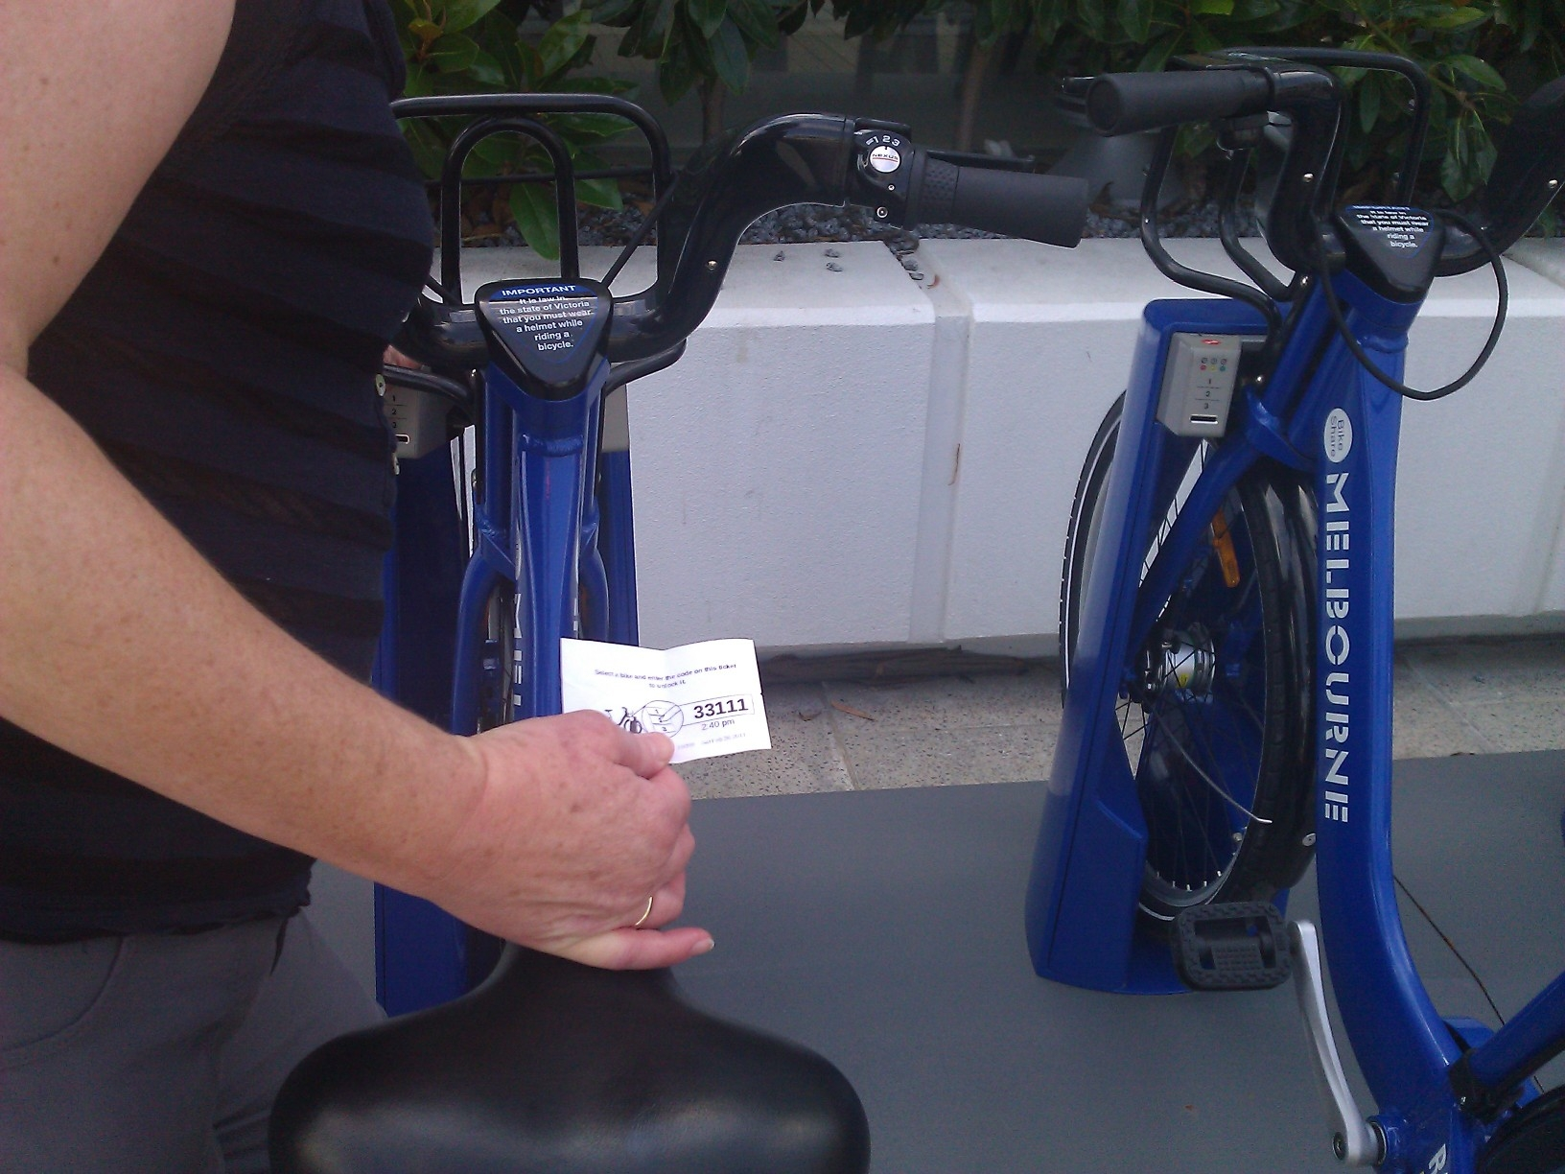
In Melbourne you can hire a commuter bicycle using your EFTPOS card.
A machine gives you a five-place code to unlock the bicycle.
The code only uses the digits 1, 2, and 3.

Slide 2
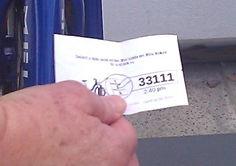
Why did the system designer opt for 5-place numbers using the digits 1, 2, and 3?

Slide 3
What happens next?
1
1
2
3
1
2
2
3
1
3
2
3
One place
Two places

Slide 4
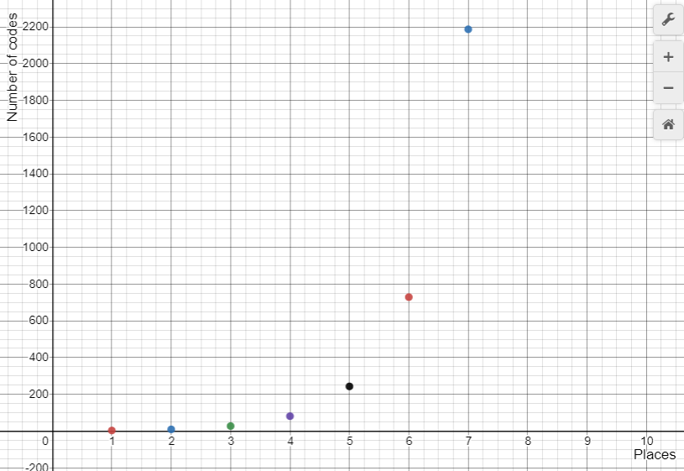

Slide 5
1
What happens next?
1
2
3
4
1
2
2
3
4
1
3
2
3
4
1
4
2
3
4
One place
Two places

Slide 6
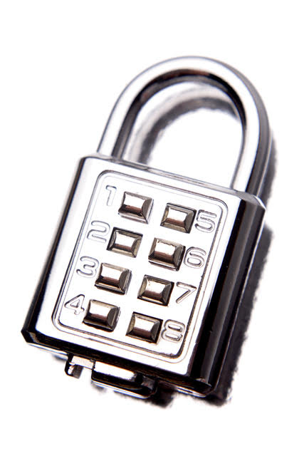
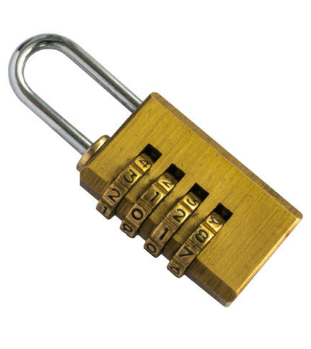
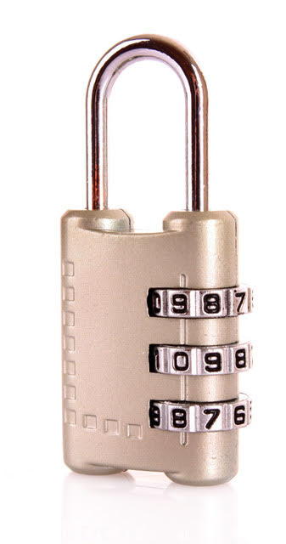
Here are three different security locks. The wheels on the combination locks have the digits 0, 1, 2, 3, 4, 5, 6, 7, 8, 9. The key pad allows you to enter a four digit code.
Put the locks in order by the number of different numbers it is possible to select.

Slide 7
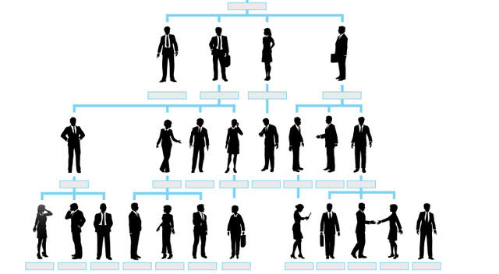
Successful businesses have good management structures.
In big businesses there are many layers of people reporting to their managers.

Slide 8
Balancing the number of employees per manager is very important. Management positions are often well paid so an inefficient structure costs the business a lot of money.

Slide 9
The number of employees per manager is a ratio. For example, if there are three employees reporting to every manager, the ratio is 1:3. Watch the animation to see how the number of people in a business grows as more layers of management are added.

Slide 10
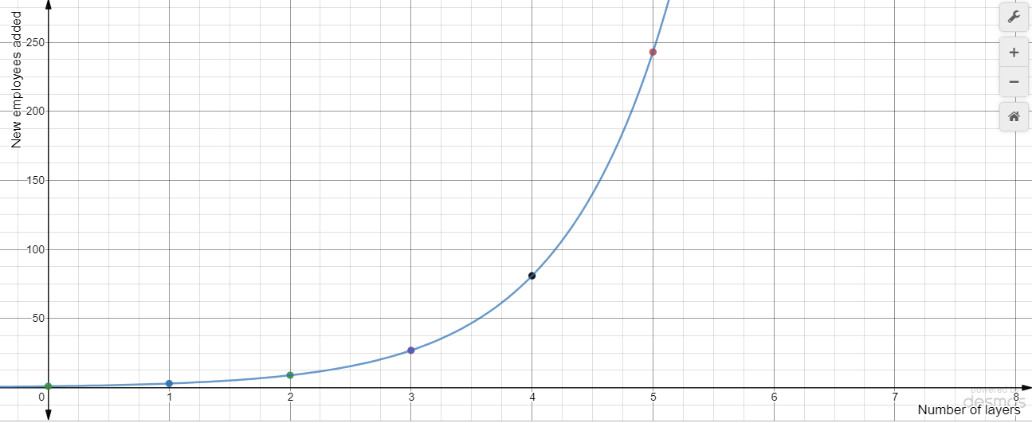

Slide 11
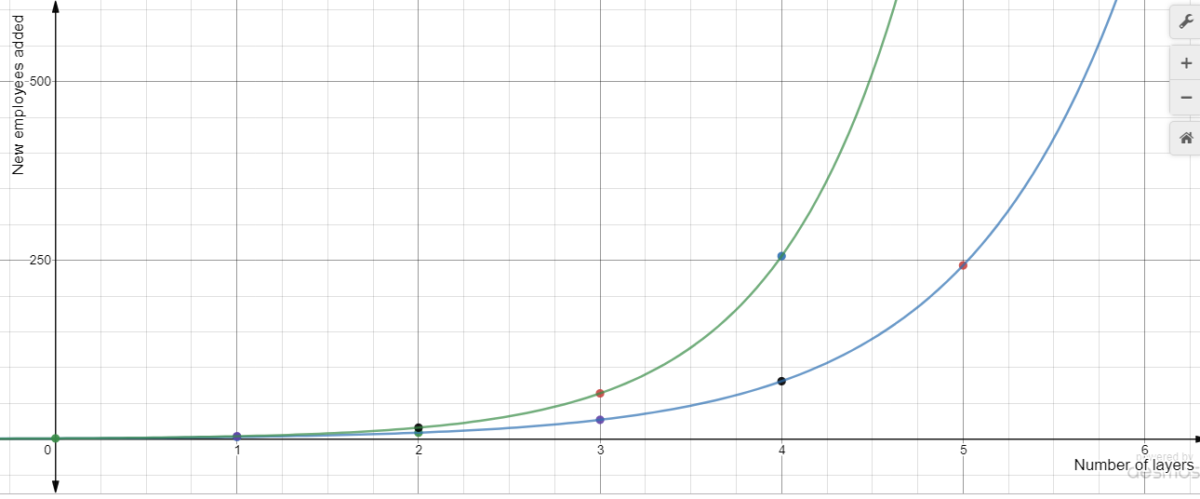

Slide 12
In this diagram there are four managers and nine employees.
Where are they located?

Slide 13
How many managers and employees are in this diagram?

Slide 14
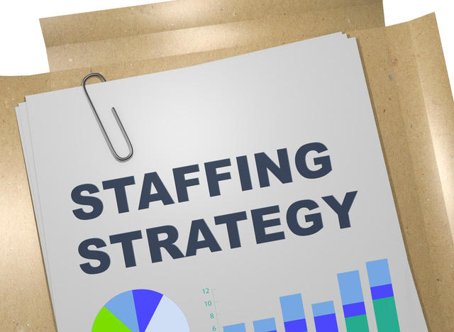
A big business employs 10 000 employees who make, sell and distribute the product. All of the employees are indispensable. You need to come up with a management plan for the business.
If you have a ratio of one manager to two employees (1:2), how many managers do you need?
What happens to the number of managers needed as you vary the ratio? e.g. 1:3, 1:4, 1:5, etc.
Come up with recommendations
for the best ratio.

