Slide 1
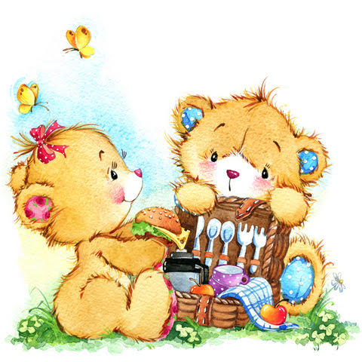
Teddy and Tina Bear go on a picnic.
Papa Bear makes a scrumptious lunch for them.
But, oh dear! He forgets to cut up the food.

Slide 2
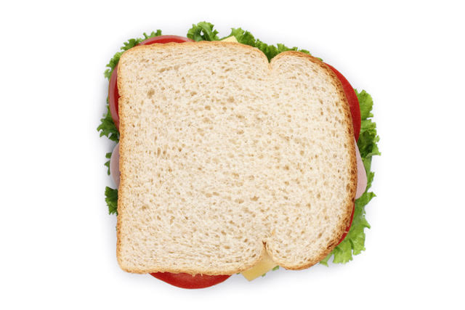
How will they cut up this sandwich?
How will they check if the pieces are equal in size?

Slide 5
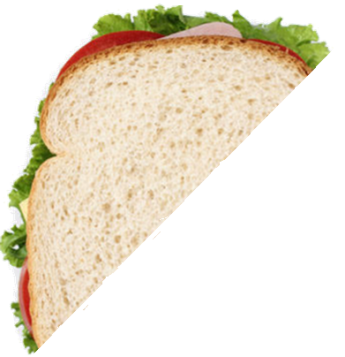
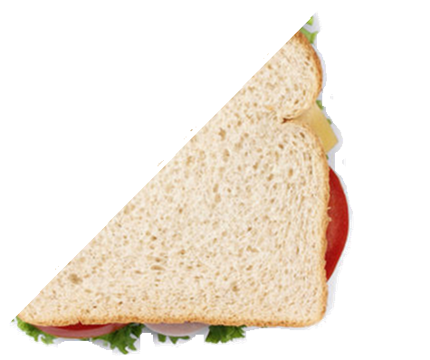
Are these sandwiches cut in half?

Slide 6
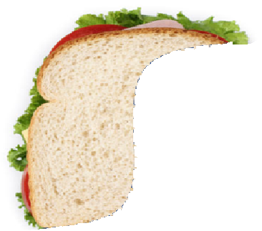
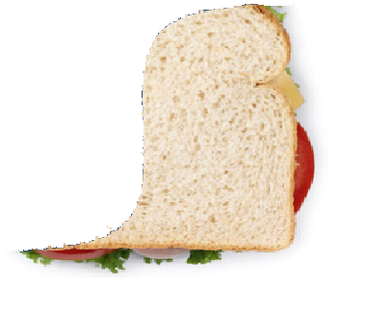
Are these sandwiches cut in half?

Slide 8
