Slide 1
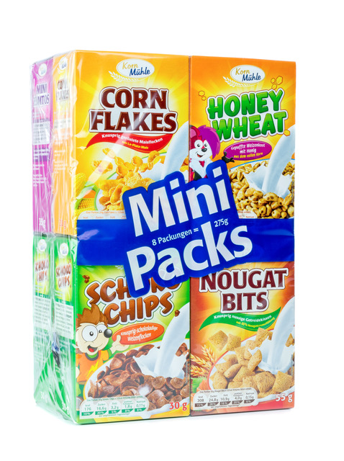
Small boxes of cereal are very popular.
Single serves are used in places like restaurants and motels as there is minimal waste.

Slide 2
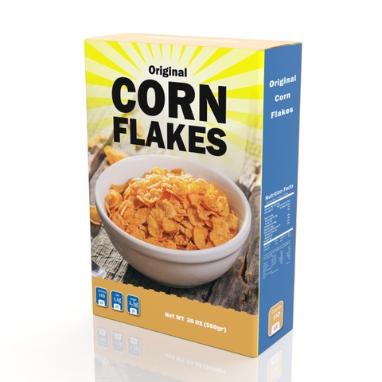
Healthy Brand Cereals want you to create a cuboid shaped box for their new product.
You will need to make your prototype designs from A4 sized sheets of paper, to see that they work.
You will beat all other designers if you create a box with the greatest possible volume.

Slide 3
Your template (net) must be continuous. It cannot be made up of several pieces.
This template is continuous.
This template is not continuous.

