Slide 1
21
13
8
5
3
2
1
1

Slide 2
+
+
Grand-dadee
bee.
Grand-mumee
bee.
+
This is she,
my mother bee.
+
This is me,
a male bee.

Slide 4
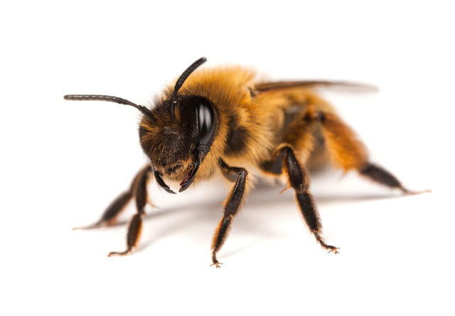
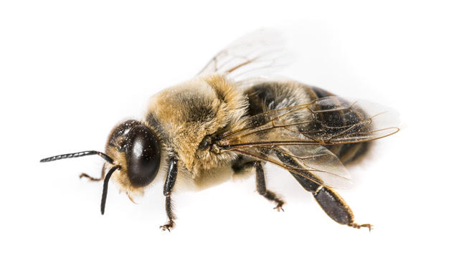
No wonder that only 5% of the bees in a hive are males!
That is true but female worker bees make the honey!
Bee-lieve it or not!

Slide 5
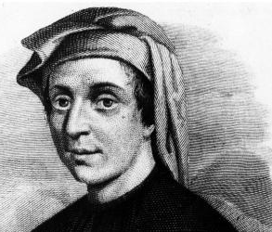
The sequence of 1, 1, 2, 3, 5, 8, 13, …, is known as the Fibonacci Sequence.
Fibonacci was an Italian mathematician who lived from 1170 to 1240. He is famous for promoting the Hindu-Arabic number system in Europe, his work on algebra, and this famous sequence.
Fibonacci’s real name was Leonardo of Pisa. As a young boy he would have seen the leaning tower being built.

Slide 6
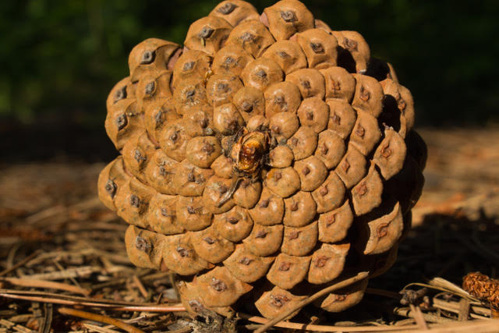

Slide 8
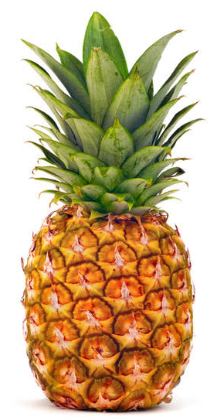

Slide 10
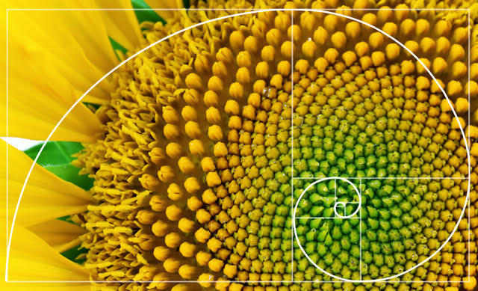
Sunflower

Slide 11
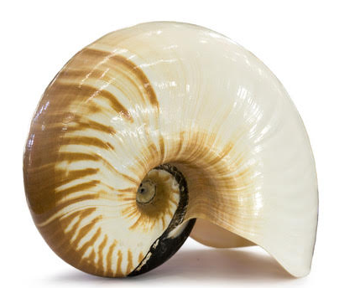
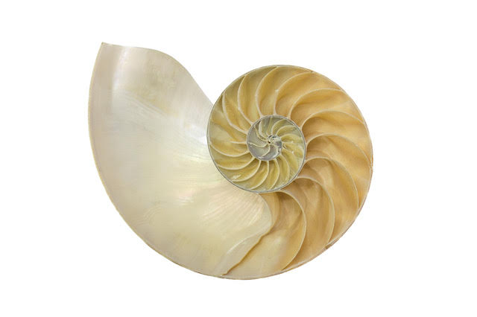
Nautilus Shell

Slide 12
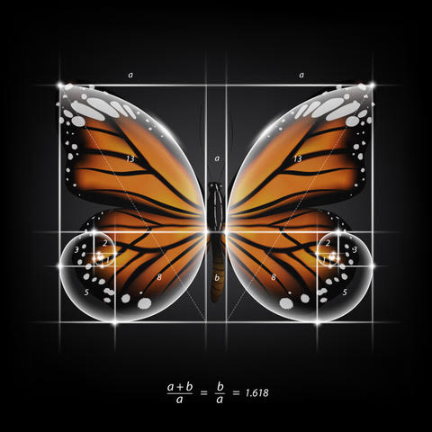

Slide 13
4
1
1
25
9

Slide 14
5
For a square of side length, five, the area is 5 x 5 = 25 square units.
This result can also be written as 5² = 25, which is read as “Five squared equals twenty-five.”
5

Slide 15
8
For a square of side length, eight, the area is 8 x 8 = 64 square units.
This result can also be written as 8² = 64, which is read as “Eight squared equals sixty-four.”
8

Slide 16
Here are the first few Fibonacci numbers:
There are two Fibonacci numbers that are equal to the square of their place (n).
What numbers are those?
n | 1 | 2 | 3 | 4 | 5 | 6 | …
Fibonacci Number | 1 | 1 | 2 | 3 | 5 | 8 | …

