Slide 1
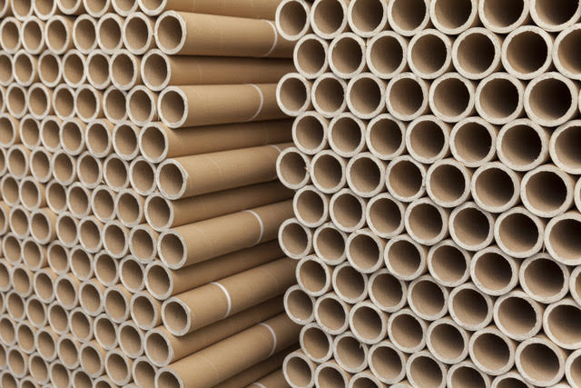
We stack objects to save space, keep track of them, and to make patterns.
What do you notice about the way the tubes are stacked?

Slide 2
One way to stack objects is in a triangular pattern.
Which stack has the most cubes?
How did you count the number of cubes?

Slide 7
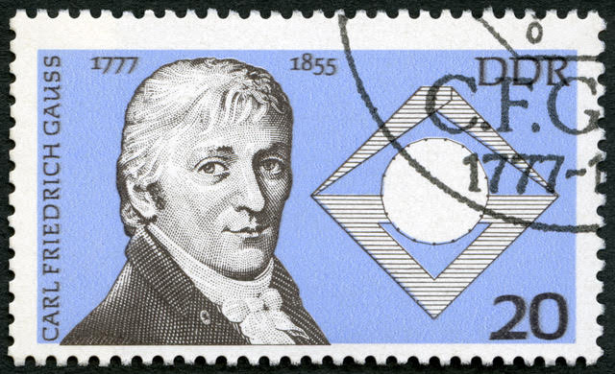
When Carl Frederick Gauss was only ten years old his teacher set his class a challenge.
Add all the counting numbers from one to 100, that it, 1 + 2 + 3 + … + 98 + 99 + 100.
Carl took only 30 seconds to write the answer on his slate and hand it to his teacher.
Can you?

Slide 8
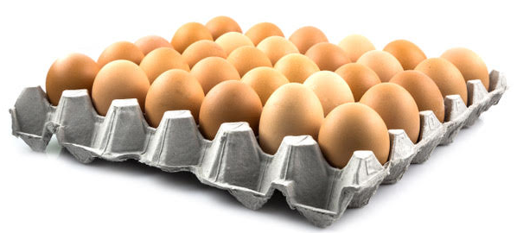
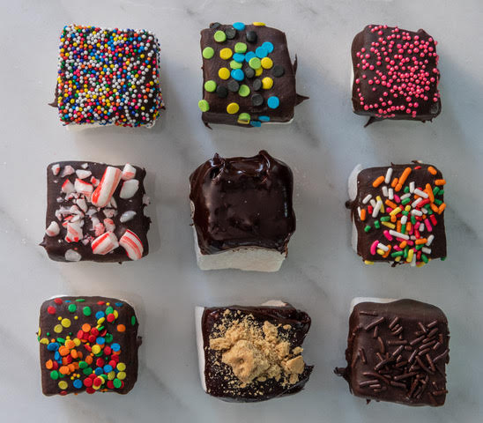
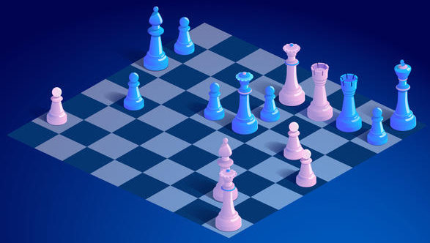
In all three pictures, what shape have the objects been arranged in?
How many objects are in each pattern?

Slide 9
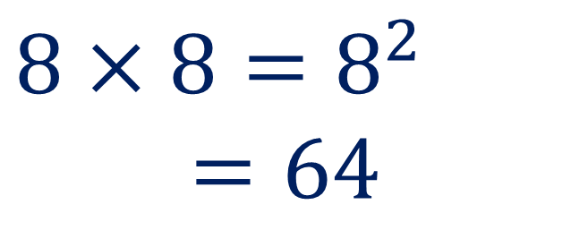
$$8×8=8^{2} =64$$
8
8

Slide 10
1
4
9
16
25
3
5
7
9

Slide 11
1
4
9
16
25
3
5
7
9

Slide 12
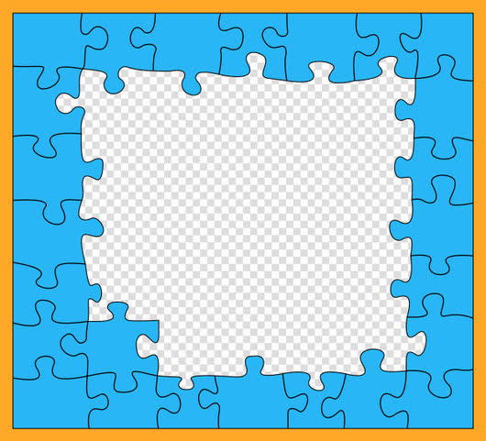
How many pieces are in the complete jigsaw?

